Slide 1
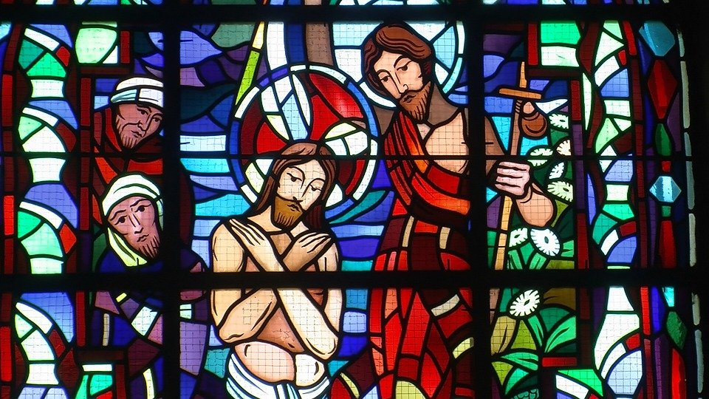

Baptism of Jesus

Slide 2
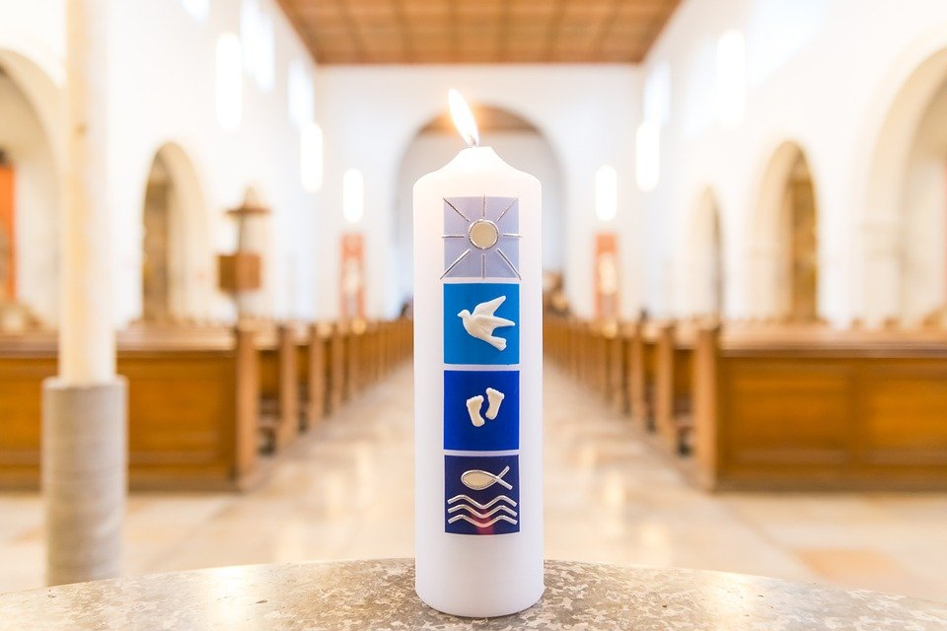
What do you remember about Baptism? Use this image to help you.
Before we begin…

Slide 3
[John the Baptist] announced to the people, “The man who will come after me is much greater than I am. I am not good enough even to bend down and untie his sandals. I baptize you with water, but he will baptize you with the Holy Spirit.”
Not long afterward Jesus came from Nazareth in the province of Galilee, and was baptised by John in the Jordan. As soon as Jesus came up out of the water, he saw heaven opening and the Spirit coming down on him like a dove. And a voice came from heaven, “You are my own dear Son. I am pleased with you.”
Listen (Mark 1:7-11)

Slide 4
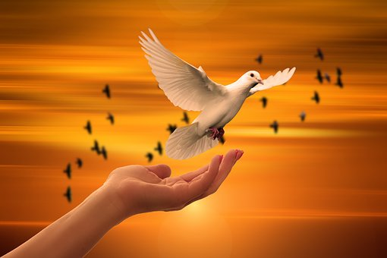
Here at Jesus’ Baptism at the Jordan river, we see the Trinity all together. God the Father speaks from heaven, God the Son stands in the river and God the Holy Spirit comes down from heaven in the form of a dove.
Reflect

Slide 5
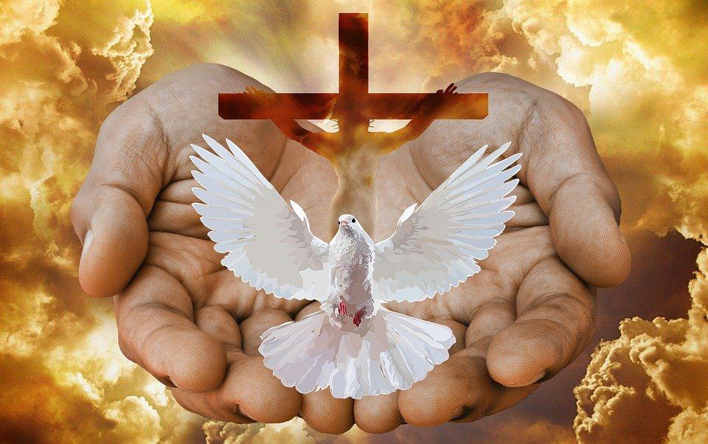
This shows us that God isn’t someone who sits in heaven and watches ‘stuff’ happen on earth. He became fully human so that we can know him more fully. And even though we’re only human he wraps us in the love of the Trinity in God’s love forever.
Do you feel the love of God and others?
When? How?
How can you show God’s love to others?
Reflect

Slide 6
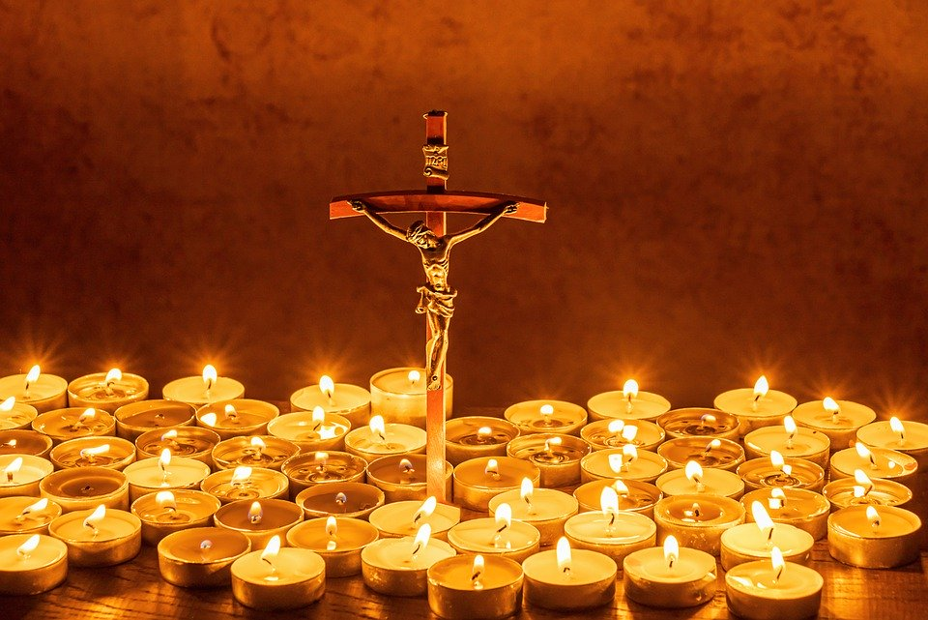
Let us pray

Slide 7
Loving God, you call us by our name and we are your children. Help us to share your message of love and hope with others, and to make the world a fairer place for all to live. Amen.
(CAFOD’s Children’s Liturgy prayers for the Baptism of the Lord Year B)
Let us pray

Slide 8
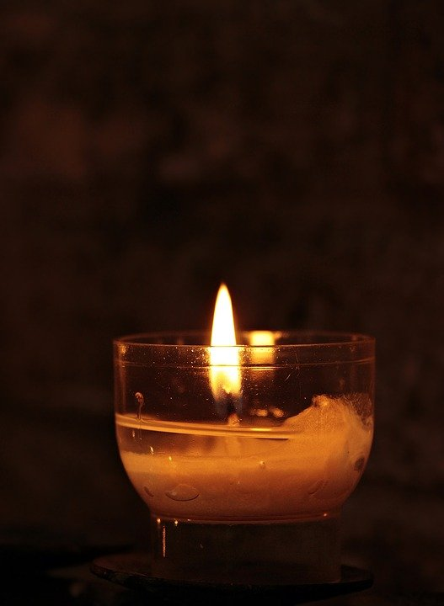
Pray for those who need hope and a light in the darkness at this time.
Do some kind actions and say kind words to bring light into your home.
Mission

Slide 9
Create a piece of artwork to celebrate the Baptism of Jesus. You can use the template provided or you can create your own piece of artwork.

