Slide 1
The Gloria
Glory to God in the highest

Slide 2
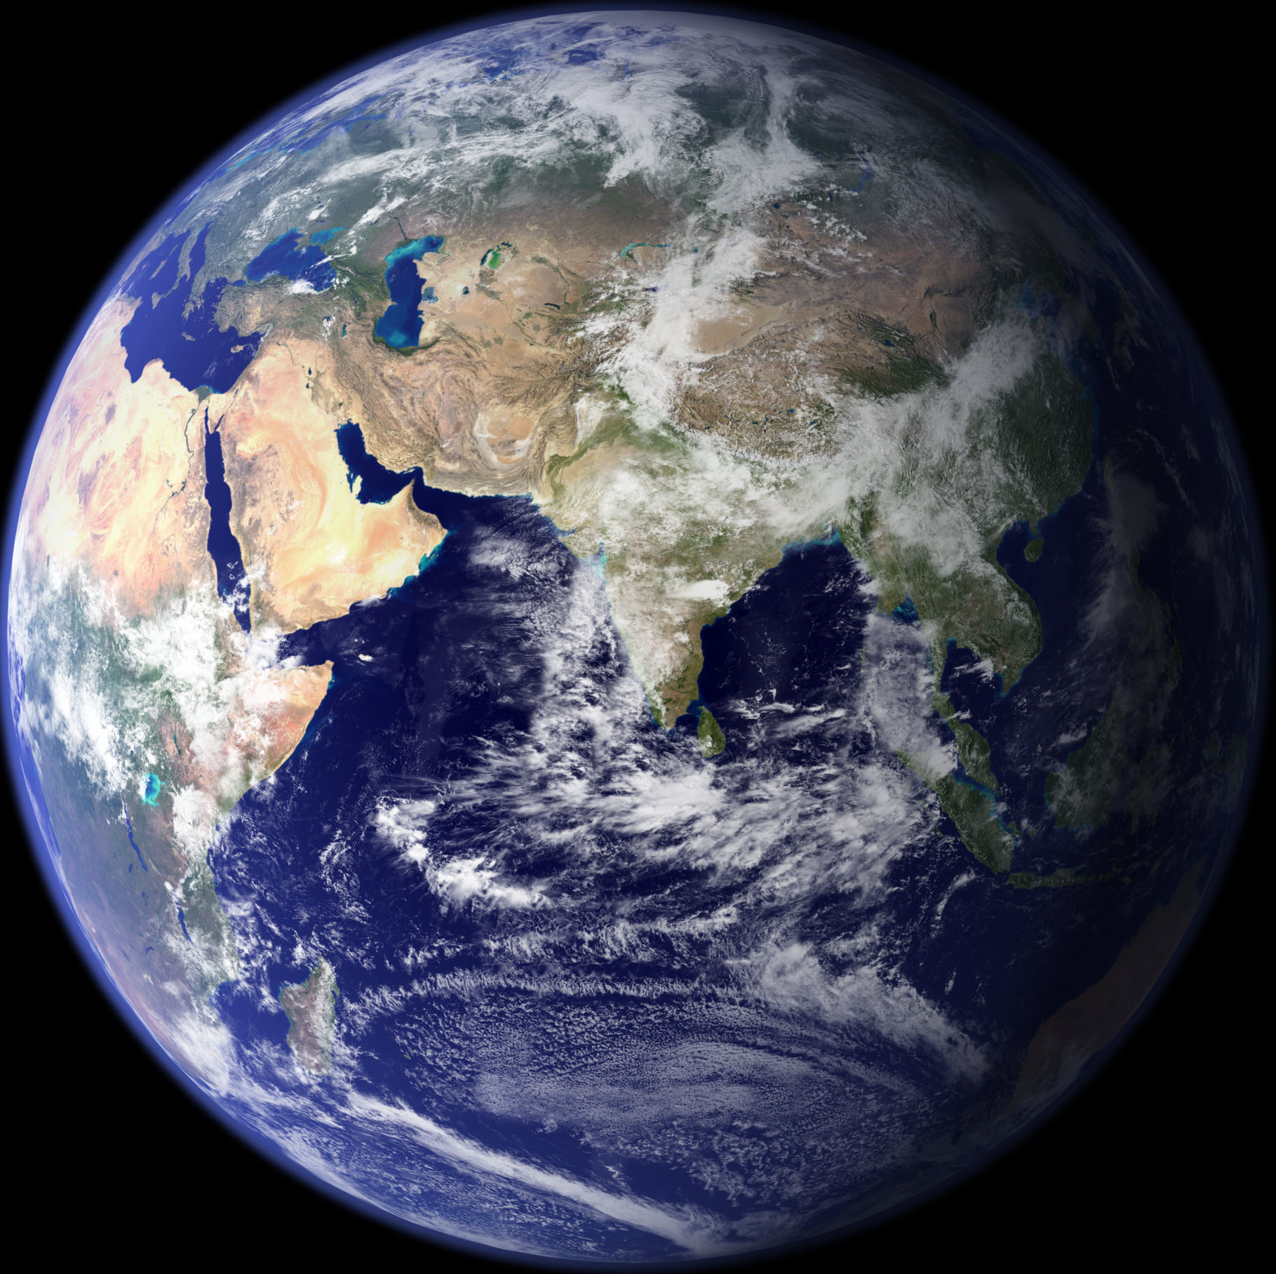
Glory to God in the highest,
And on earth peace to people of good will.

Slide 3
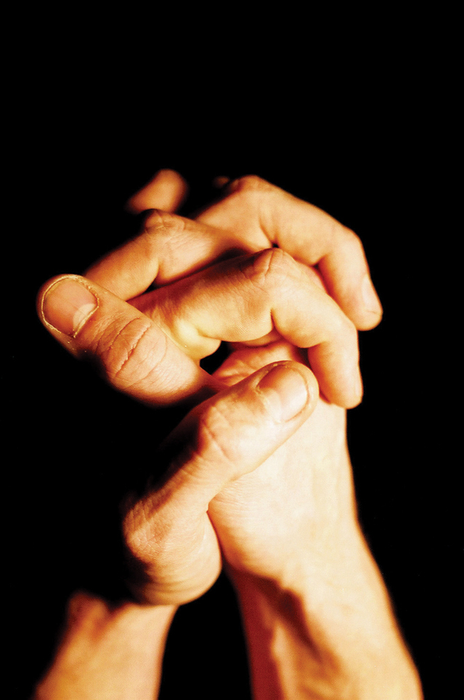
We praise you,
We bless you,
We adore you,
We glorify you,
We give thanks for your great glory,
Lord God, heavenly King,
God, almighty Father.

Slide 4
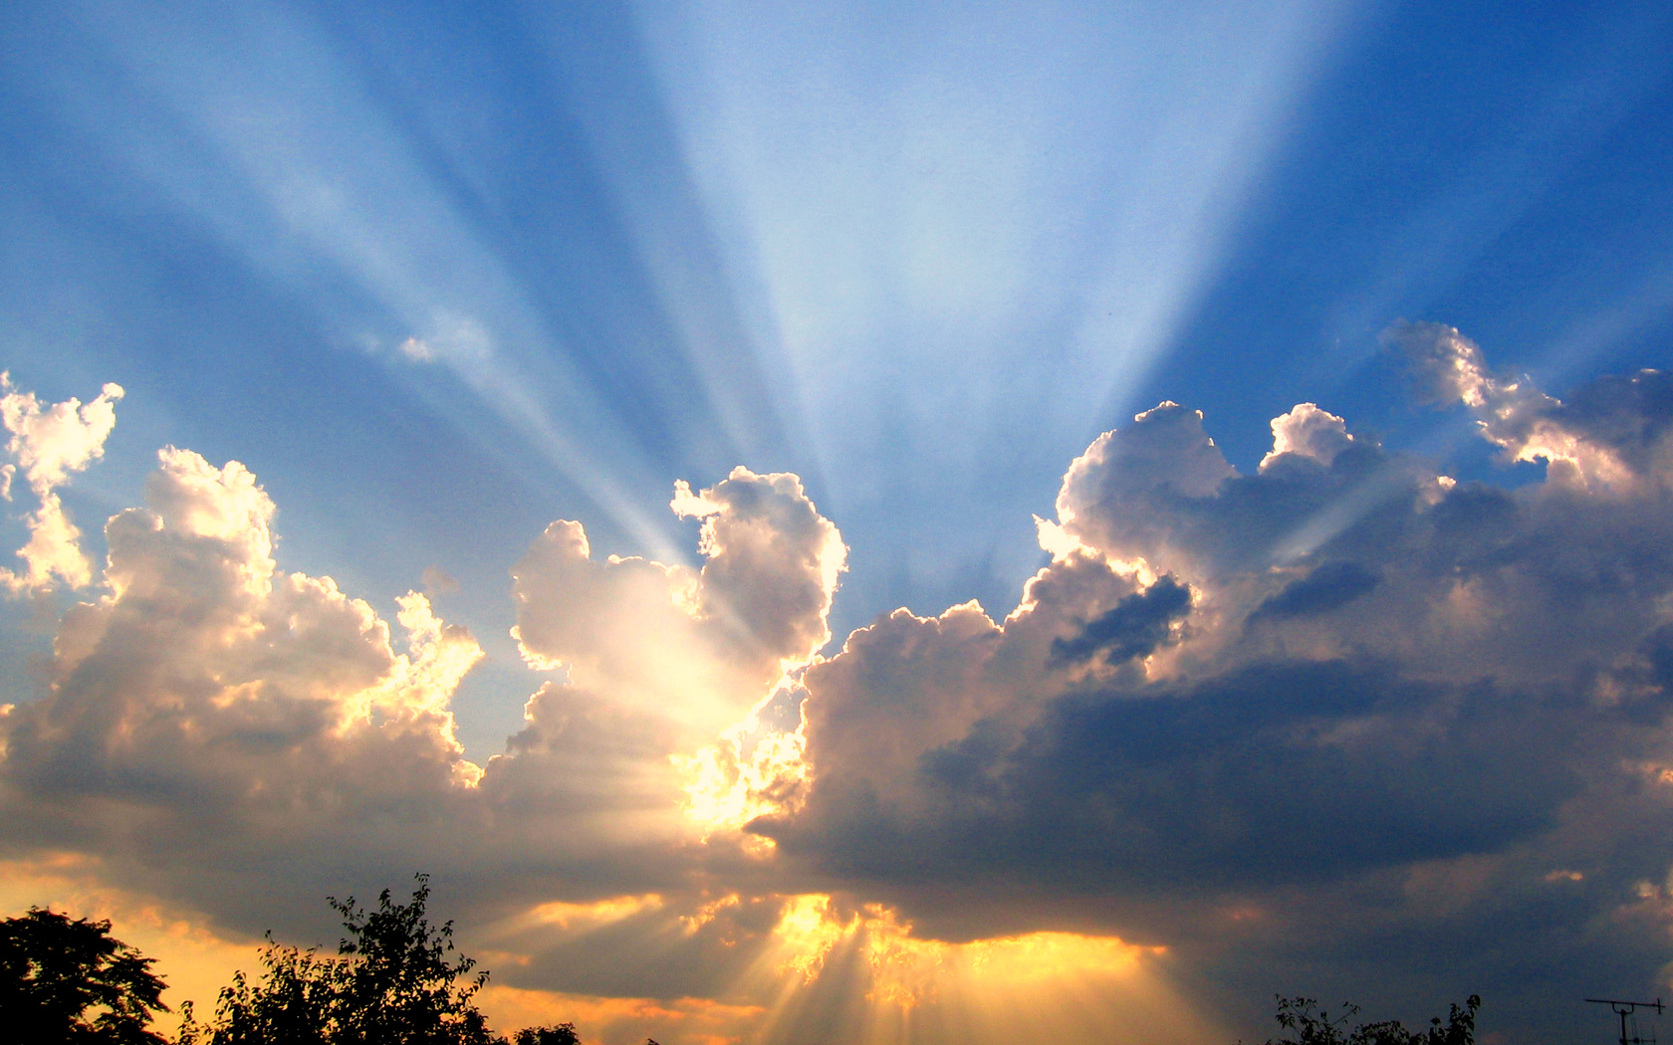
Lord Jesus Christ, Only Begotten Son,
Lord God, Lamb of God, Son of the Father,
You take away the sins of the world, have mercy on us;
You take away the sins of the world, receive our prayer;
You are seated at the right hand of the Father, have mercy on us

Slide 5
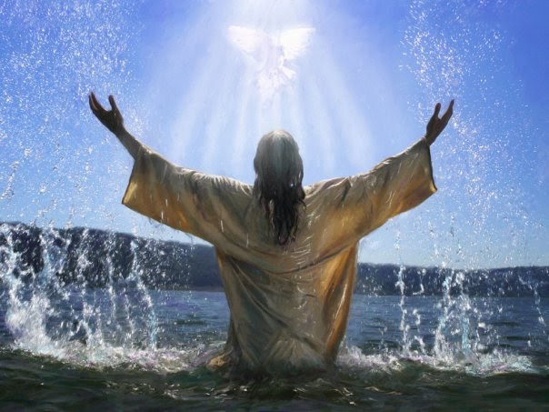
For you alone are the Holy One,
You alone are the Lord,
You alone are the Most High, Jesus Christ,
With the Holy Spirit, in the glory of God the Father.
Amen.

