Slide 2
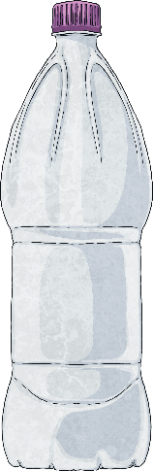
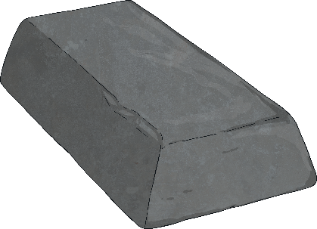
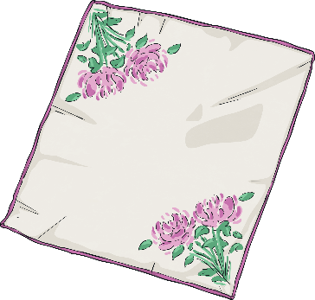

Materials
We use wood, metal, plastic, glass and fabric to make most
everyday objects.
Different materials have different properties.
Materials can be natural or man-made.
Here are a few facts about some materials…

Slide 3

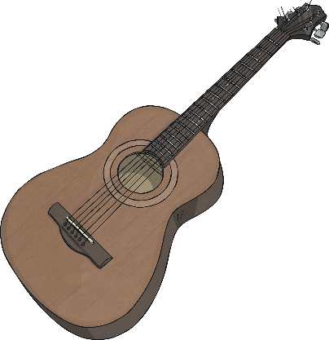
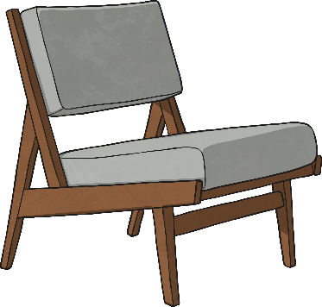
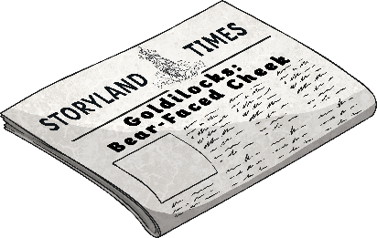
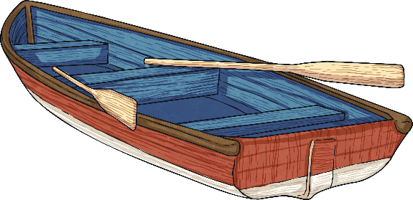
Wood
Wood is a natural material. It comes from trees.
A few things made from wood are:
furniture
boats
instruments
paper
Wood is used as it can be carved in to any shape, is strong and has a very nice appearance.

Slide 4

wood

Slide 5
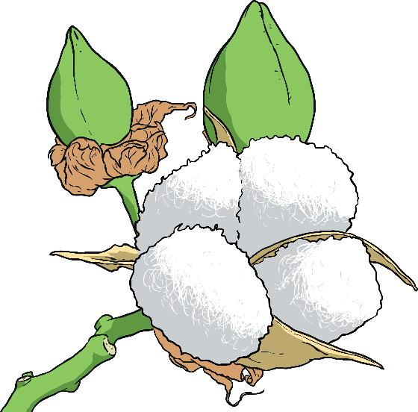
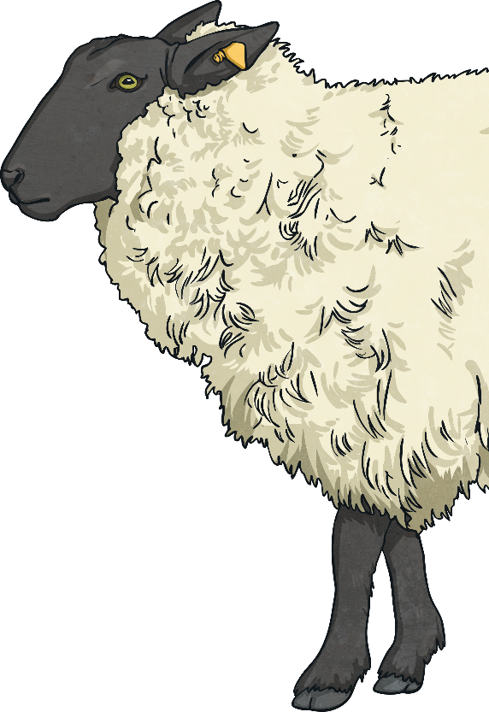
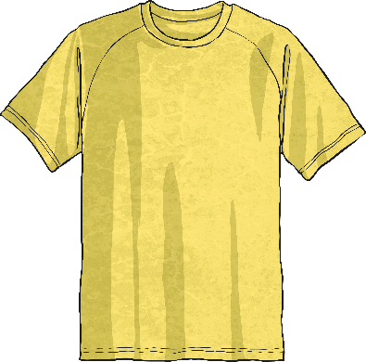
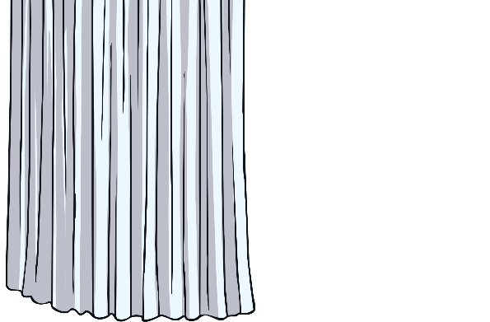
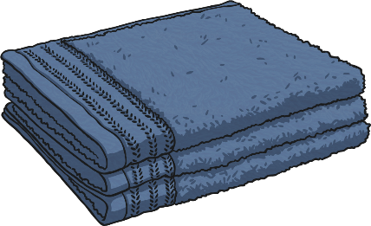
Fabric
Fabric comes from plants and animals.
A few things made from fabric are:
curtains
clothes
towels
Fabric is used as it is very light, warm, soft and
quite easy to produce and sew.

Slide 6
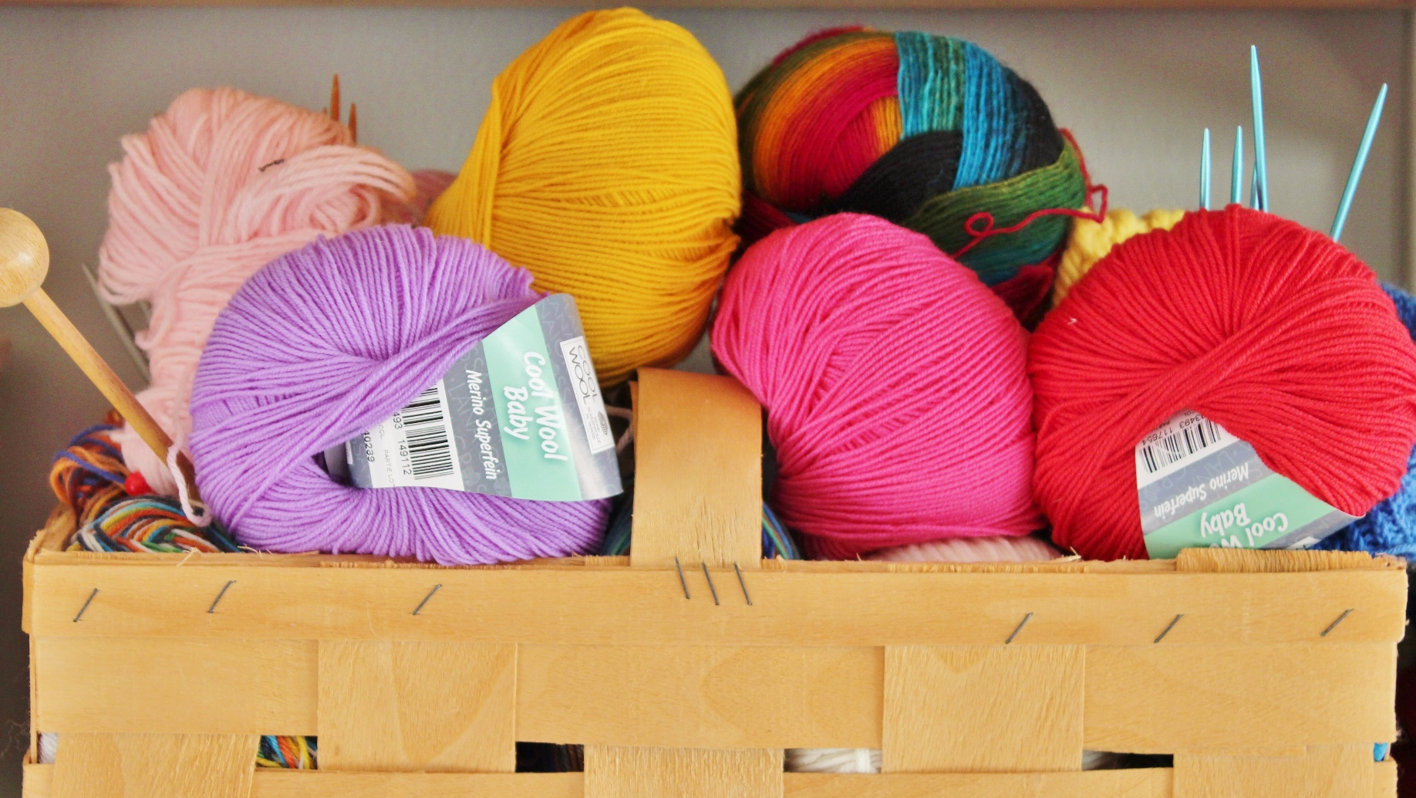
wool

Slide 7
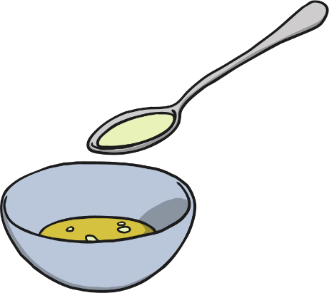


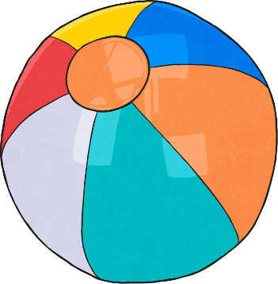
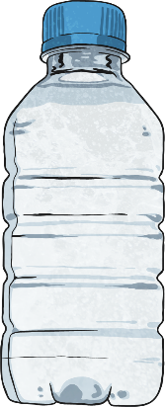
Plastic
Plastics are man-made, mostly from oil.
A few things made from plastic are:
balls
bottles
carrier bags
Plastic is used as it can be made to be flexible, hard, rough or smooth. It is also very cheap to produce and easily washable.

Slide 8
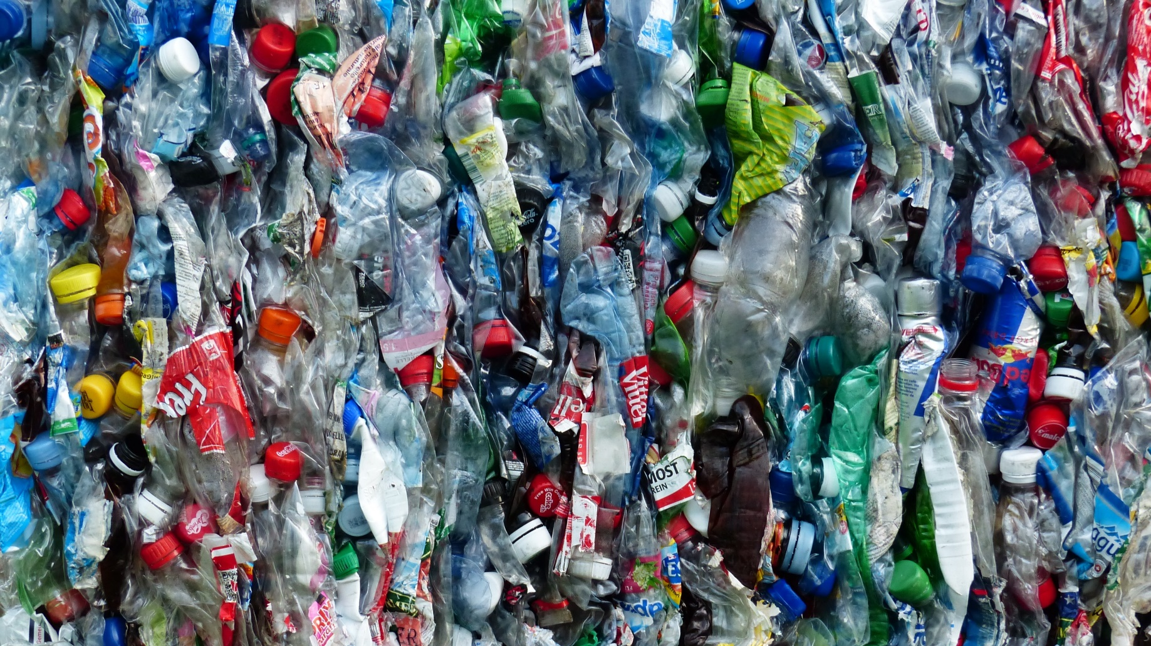
plastic

Slide 9
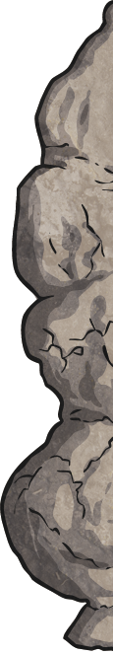
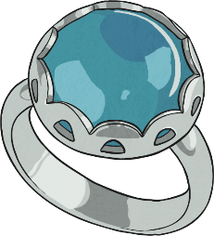
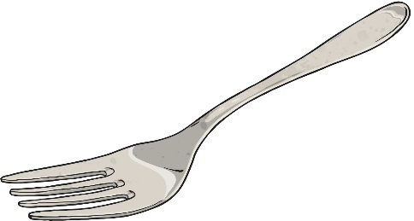
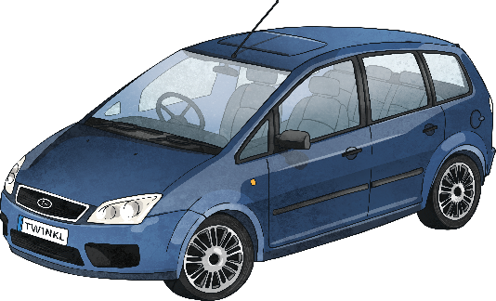
Metal
Metals are made from rocks. The rocks are dug up and taken to a factory where they are heated and processed into metal.
A few things made from metal are:
jewellery
cutlery
cars
Metal is used as it is strong, hard, smooth and easily washable.

Slide 10

metal

Slide 11
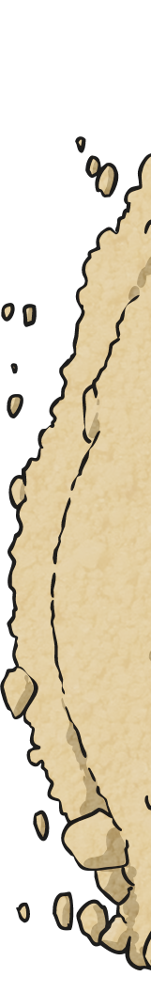
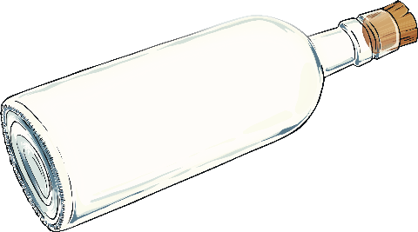

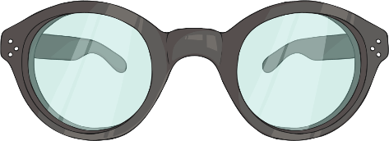
Glass
Glass is made from very fine sand. It is heated until it melts.
A few things made from glass are:
bottles
light bulbs
glasses
Glass is used as it is strong, hard, smooth, easily washable
and transparent.

Slide 12
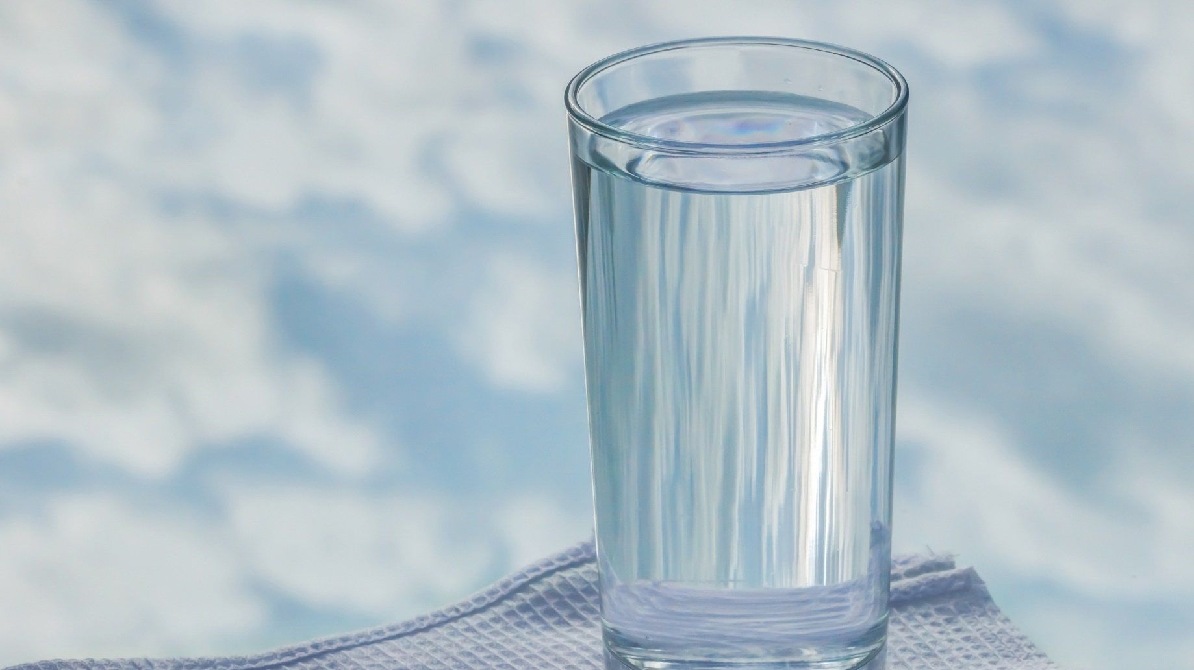
glass

