Slide 1
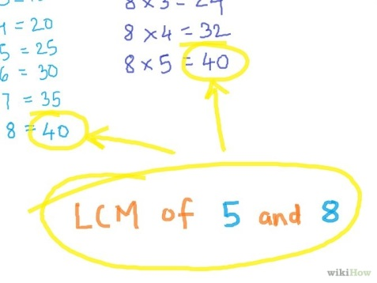
Number
Factors- Highest Common Factor

Slide 2
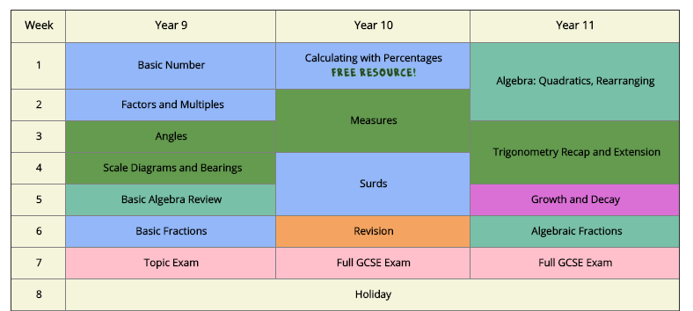
Schemes of work updated with the new content introduced into the GCSE specification
Teaching resources designed for the rigours of the new GCSE Specification
Topic assessments to monitor the progress of your students through the course

Slide 3
Factors
Factors are numbers that divide into a number exactly
6
4
1
Factors of 24
24
8
2
3
12

Slide 4
Factors
Usually we write factors in pairs
Factors of 24
1
24
2
12
3
8
4
6

Slide 5
Rainbow method
1, 2, 3, 4, 6, 8, 12, 24

Slide 6
Factors
Write down all the factors of…
12
1
12
2
6
3
4

Slide 7
Factors
Write down all the factors of…
20
1
20
2
10
4
5

Slide 8
Factors
Write down all the factors of…
28
1
28
2
14
4
7

Slide 9
Factors
Write down all the factors of…
48
1
48
2
24
3
16
4
12

Slide 10
Factor Spiders Solutions
1
1
9
5
54
30
6
54
6
30
2
2
18
10
27
15
3
3

Slide 11
Factor Spiders Solutions
10
1
1
9
90
9
15
63
90
63
2
6
7
3
30
45
3
21

Slide 12
Highest Common Factor (HCF)
What is the Highest Common Factor (HCF) of 12 and 18?
1
1
4
6
12
18
12
18
3
3
2
2
6
9
The Highest Common Factor (HCF) of 12 and 18 is 6

Slide 13
Highest Common Factor (HCF)
What is the Highest Common Factor (HCF) of 21 and 28?
1
1
7
28
21
28
7
21
4
3
2
14
The Highest Common Factor (HCF) of 21 and 28 is 7

Slide 14
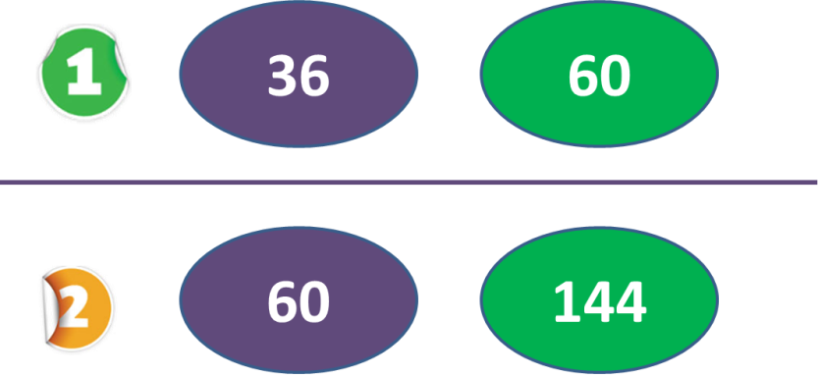
Student Task
Highest Common Factor

Slide 15
Independent Task - HCF
Find the HCF of the following pairs
36
60
60
144

Slide 16
HCF - Solutions
6
10
6
1
12
1
9
36
5
60
60
36
4
15
2
2
4
12
30
3
18
20
3
The Highest Common Factor (HCF) of 36 and 60 is 12

Slide 17
HCF - Solutions
16
12
9
6
1
10
12
1
18
144
5
8
144
60
60
2
15
2
24
72
4
30
6
3
20
3
36
48
4
The Highest Common Factor (HCF) of 144 and 60 is 12

