Slide 1
Multiples
Multiples are all the numbers in the numbers times table
Multiples of 3
3,
6,
9,
12,
15
…

Slide 2
Multiples
Multiples are all the numbers in the numbers times table
Multiples of 7
7,
14,
21,
28,
35
…

Slide 3
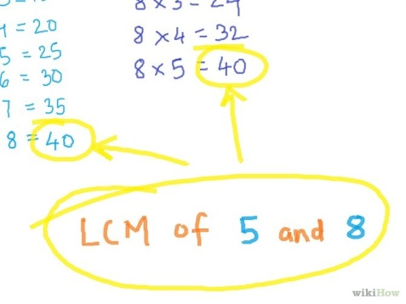

Mini-Whiteboards
Multiples

Slide 4

Multiples
Write down the first 5 multiples of…
6
6, 12, 18, 24, 30

Slide 5
Multiples
Write down the first 5 multiples of…
8
8, 16, 24, 32, 40

Slide 6
Multiples
Write down the first 5 multiples of…
12
12, 24, 36, 48, 60

Slide 7
Multiples
Write down the first 5 multiples of…
9
9, 18, 27, 36, 45

Slide 8
Multiple Venn Diagrams
Multiples of 5
Multiples of 10
10
5
20
25
30
15
40
35
Multiples of 5 and 10

Slide 9
Multiple Venn Diagrams – Your Turn
Multiples of 2
Multiples of 4
Multiples of 2 and 4

Slide 10
Multiple Venn Diagrams – Your Turn
Multiples of 2
Multiples of 4
18
4
2
20
8
10
24
22
12
6
16
14
Multiples of 2 and 4

Slide 11
Lowest Common Multiple (LCM)
Work out the lowest common multiple (LCM) of 12 and 18
12
18
12, 24, 36, 48, 60
18, 36, 54, 72, 90
The lowest common multiple of 12 and 18 is 36

Slide 12
Lowest Common Multiple (LCM)
Work out the lowest common multiple (LCM) of 36 and 60
36
60
36, 72, 108, 144, 180
60, 120, 180, 240
The lowest common multiple of 36 and 60 is 180

Slide 13


Independent Task - LCM
Find the LCM of the following pairs
5
7
12
9

Slide 14
LCM Solutions
5
7
5, 10, 15, 20, 25, 30, 35
7, 14, 21, 28, 35
The lowest common multiple of 5 and 7 is 35

Slide 15
LCM Solutions
12
9
12, 24, 36, 48, 60
9, 18, 27, 36, 45
The lowest common multiple of 12 and 9 is 36

Slide 16
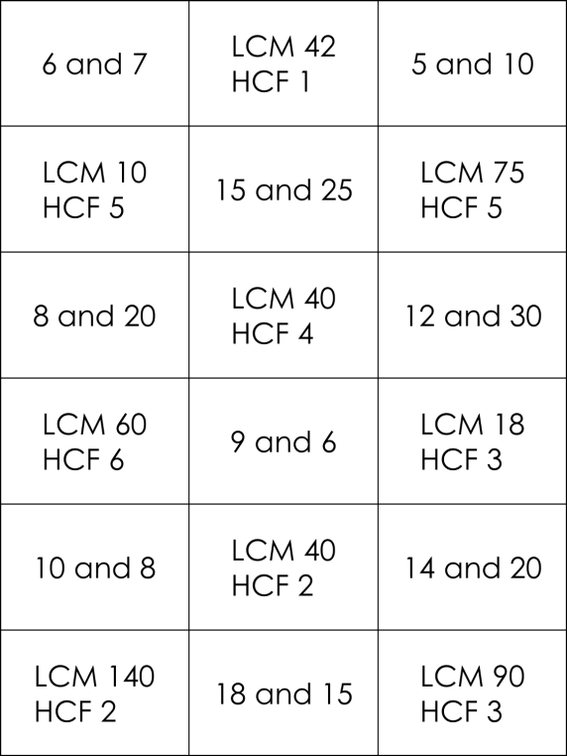
End of Topic Review
Factors and Multiples Matching Cards

Slide 17
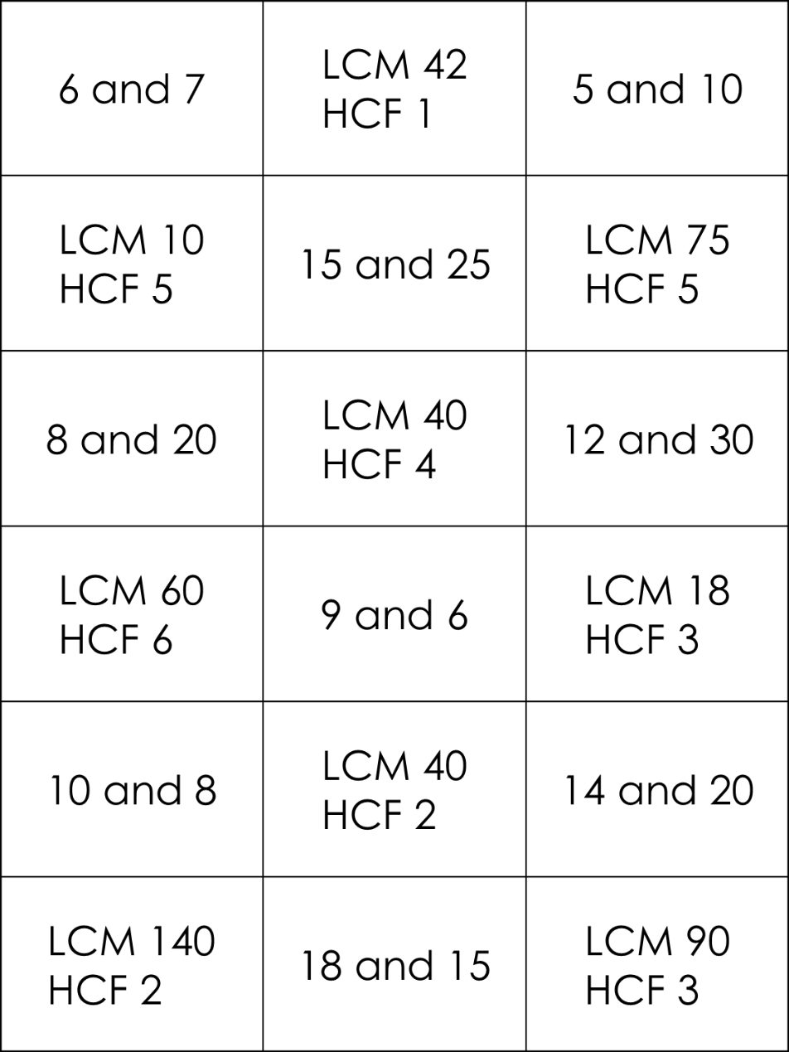
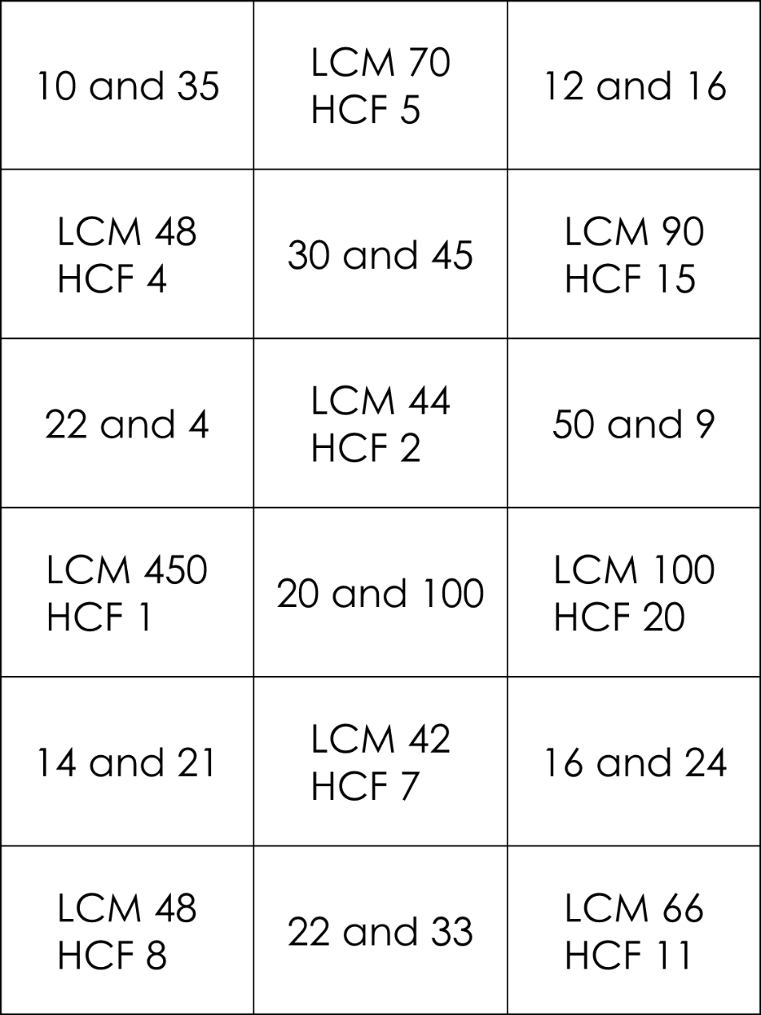
Matching Cards – HCF and LCM

