Slide 2
Aim
I can solve multiplication problems using short multiplication.
Success Criteria
I can set my calculation out correctly in columns.
I can start at the right hand side when calculating.
I check my answers using another method.

Slide 3
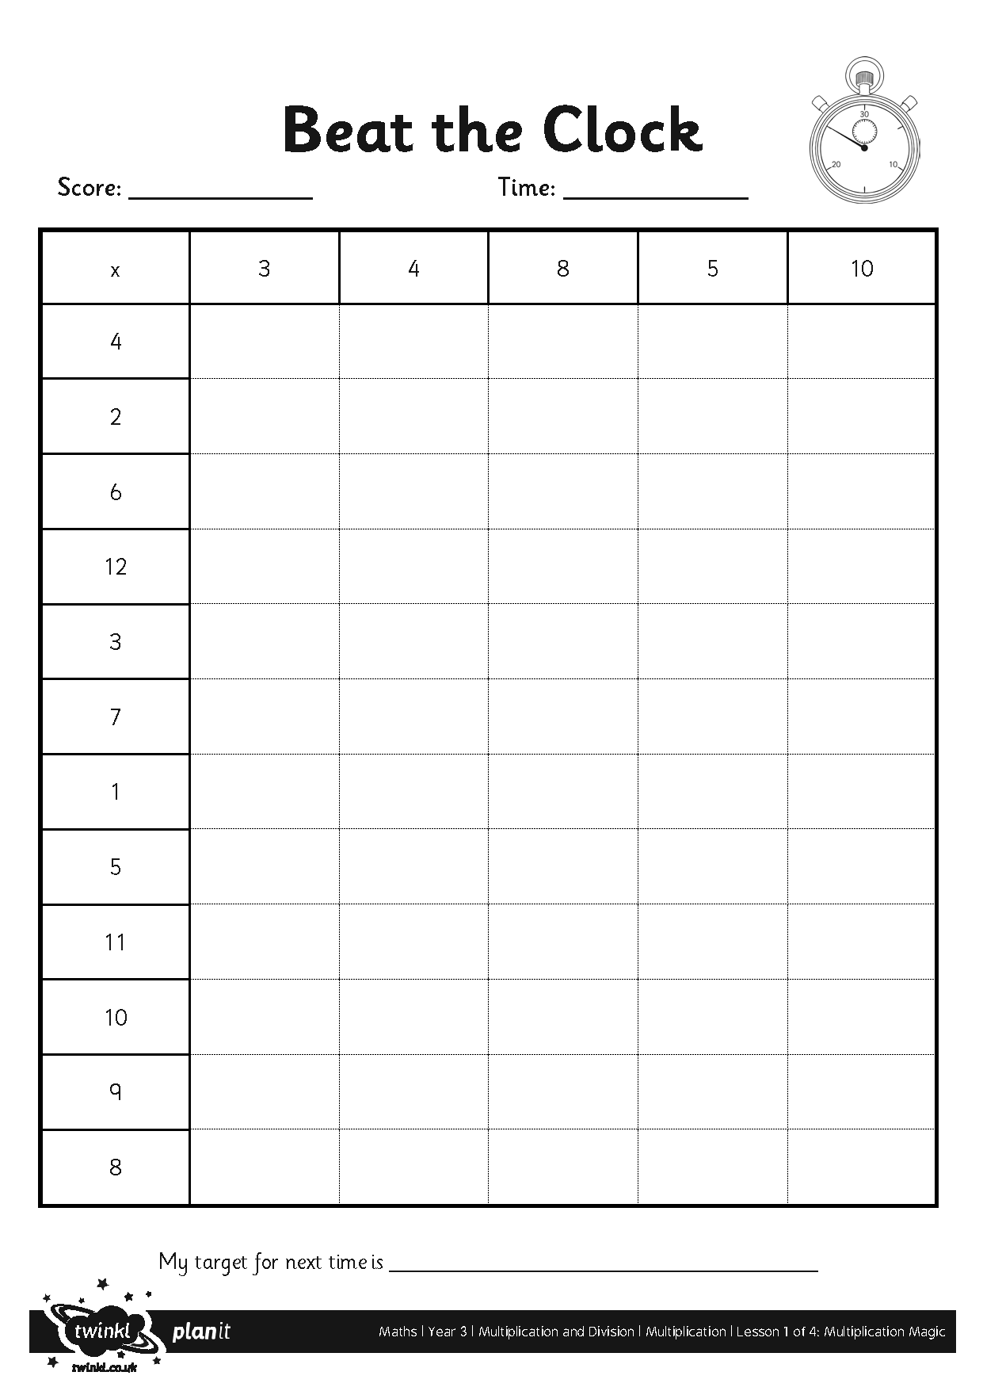
Beat the Clock

Slide 4
Short Multiplication
Use place value counters or base ten blocks to calculate the answer.
T
O
 | 5 | 6
× |  | 4
2
2
4
2

Slide 5
Multiply 2 Digits by 1 Digit
Diving
Complete this calculation to match the representation shown.
Tens | Ones
 | 2 | 4
× |  | 4
10
10
1
1
1
1
10
10
1
1
1
1
9
6
10
10
1
1
1
1
10
10
1
1
1
1
1
10

Slide 6
Multiply 2 Digits by 1 Digit
Diving
Complete this calculation to match the representation:
Hundreds | Tens | Ones
 | 3 | 7
× |  | 5
1
8
5
1
3

Slide 7
Multiply 2 Digits by 1 Digit
Diving
Use place value counters or base ten blocks to calculate the answer.
Hundreds | Tens | Ones
 | 4 | 9
× |  | 3
10
10
10
10
1
1
1
1
1
1
1
1
1
10
10
10
10
1
1
1
1
1
1
4
7
1
1
1
1
10
10
10
10
1
1
1
1
1
1
1
1
1
1
2
100
10
10
Or

Slide 8
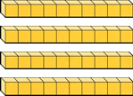
Multiply 2 Digits by 1 Digit
Diving
Use place value counters or base ten blocks to calculate the answer.
Hundreds | Tens | Ones
 | 4 | 9
× |  | 3
1
4
7
1
2
Or

Slide 9
Your Turn Now
45 × 3 =
89 × 4 =
8 × 72 =
How will you set the third problem out?
Remember that 8 × 72 is the same as 72 × 8.

Slide 10
Answers
T
O
T
O
T
O
 | 4 | 5
× |  | 3
1 | 3 | 5
 | 1
 | 8 | 9
× |  | 4
3 | 5 | 6
 | 3
 | 7 | 2
× |  | 8
5 | 7 | 6
 | 1
45 × 3 = 135
89 × 4 = 356
8 × 72 = 576

Slide 11
Multiply 2 Digits by 1 Digit
Deeper
Brent has used place value counters to represent a calculation.
Which calculation has he represented?
Tens | Ones
10
10
10
1
1
1
1
1
1
1
1
10
10
10
1
1
1
1
1
1
1
1
10
10
10
1
1
1
1
1
1
1
1
10
10
10
1
1
1
1
1
1
1
1
38 × 3
48 × 4
38 × 4
Brent has represented 38 × 4, as each of the four rows represents 38.

Slide 12
Multiply 2 Digits by 1 Digit
Deeper
Brent has used his representation to work out the answer to 38 × 4 and has given an answer of 143. Can you spot his mistake?
Tens | Ones
 | 3 | 8
× |  | 4
10
10
10
1
1
1
1
1
1
1
1
10
10
10
1
1
1
1
1
1
1
1
10
10
10
1
1
1
1
1
1
1
1
1
4
3
10
10
10
1
1
1
1
1
1
1
1
1
2
Brent has incorrectly exchanged from the ones to the tens column. 8 × 4 = 32 so he should have exchanged 30 ones for 3 tens and he should have written 2 in the ones column.

