Slide 1
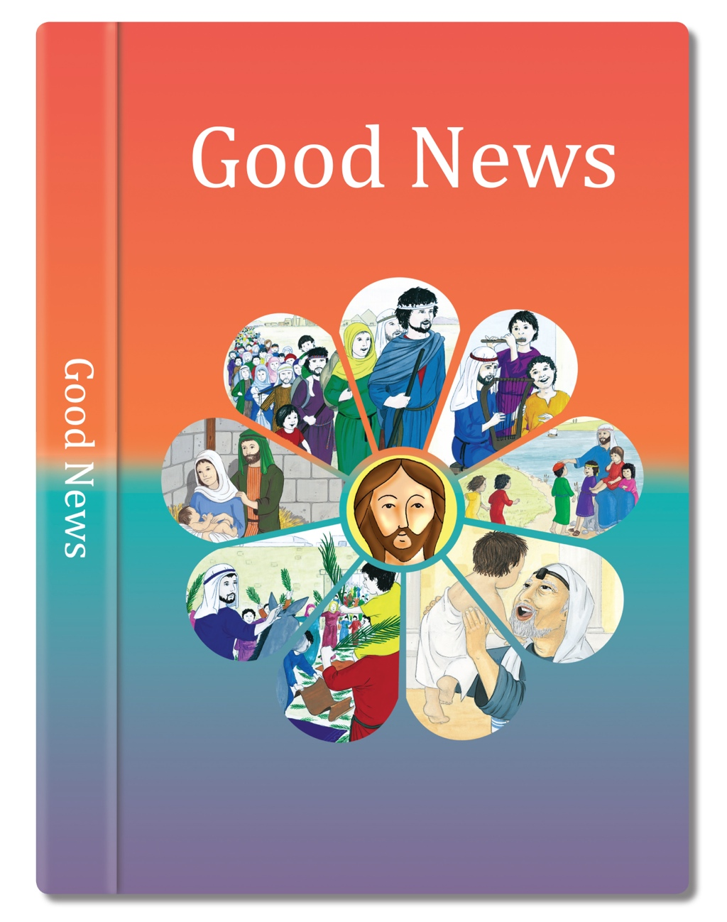

Slide 2
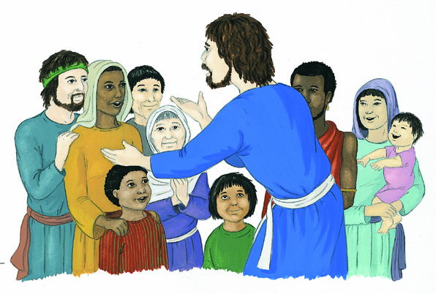
Jesus, filled with the Holy Spirit, returned to Galilee.
News about him spread all through that place. He taught in the synagogues and everyone praised him.
He came to Nazareth where he had been brought up and went into the synagogue as he usually did. He stood up to read.
He was given the scroll of the prophet Isaiah. He unrolled the scroll and found the place and read:
“The Spirit of the Lord is upon me for he has chosen and anointed me to bring good news to the poor, to heal the broken hearted.
He has sent me to set free all those who are imprisoned or oppressed in any way.”

Slide 3
All the people in the synagogue were looking at him as he said to them, “This passage of Scripture came true today while you heard it being read.”
Everyone was impressed by him and marvelled at the wonderful and powerful words that he spoke.
He rolled up the scroll, gave it back to the synagogue attendant and sat down.
Based on Luke 4: 14-22
God’s Story 3

Slide 5
Answer these questions in your book. Read God’s Story 3 p.95, 96, 99.
What was Jesus inspired to do?
 What does this quote from Isaiah tell you about Jesus?
 What was his mission?
 What did he mean by saying, “This passage of scripture has come true today”?
 How did those listening to him, react to what he said?
Read God’s Story 3 page 99, Luke 8: 1-3 The Women, discuss how women helped Jesus in his mission.
 How did the women help Jesus in his mission?
 How does Jesus’ mission affect what people believe and how they live today?

Slide 6
Name of Group | What do they do? | What part of Jesus’ mission does this fulfil? | Where else can this be seen?
e.g. St Vincent de Paul | Help people in need | Jesus said, ‘Follow me.’ He helped the poor and oppressed. | Story of the ‘Good Samaritan’ (Luke 10, 25-37 p100 GS3)

