Slide 1


Slide 3


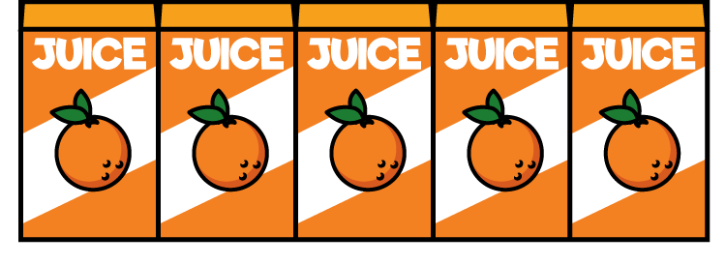
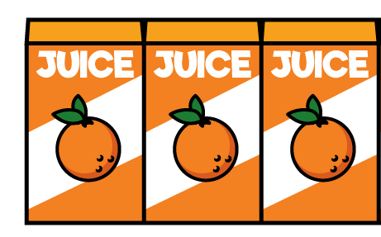
How many is represented here?
1)
2)
3)

Slide 4
How many is represented here?
1)
2)
3)
10
25
13

Slide 6



Teddy is drawing a tally chart while his mum unpacks the shopping.
How many bananas Mum?
5 altogether Teddy dear

Slide 7




Slide 8




Draw a tally for these amounts of fruit
Have a think

Slide 9
Draw a tally for these amounts of fruit

Slide 10
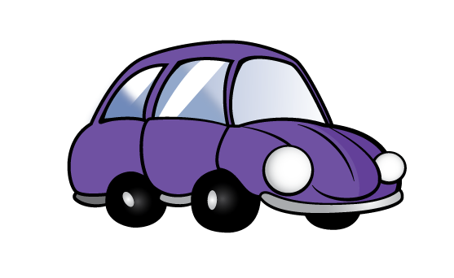



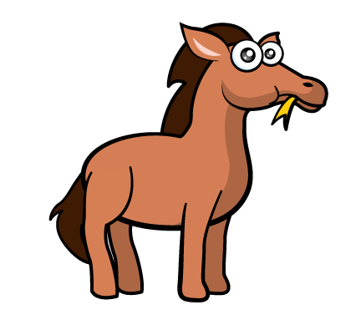
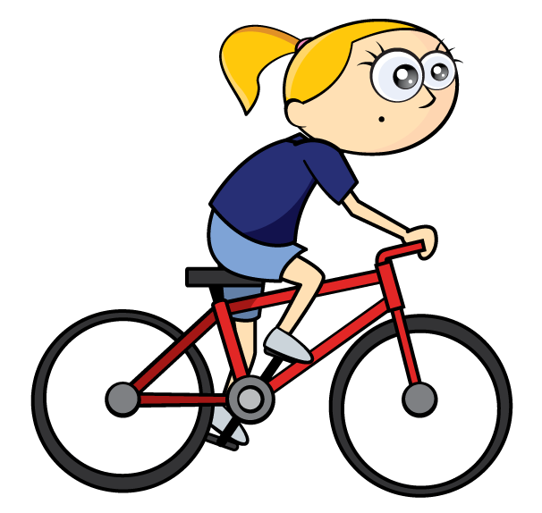

Tally
Cars
Bikes

Slide 11


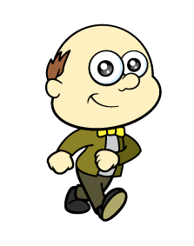

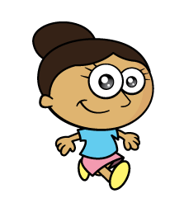







Tally
Adults
Children
Have a
think

Slide 12
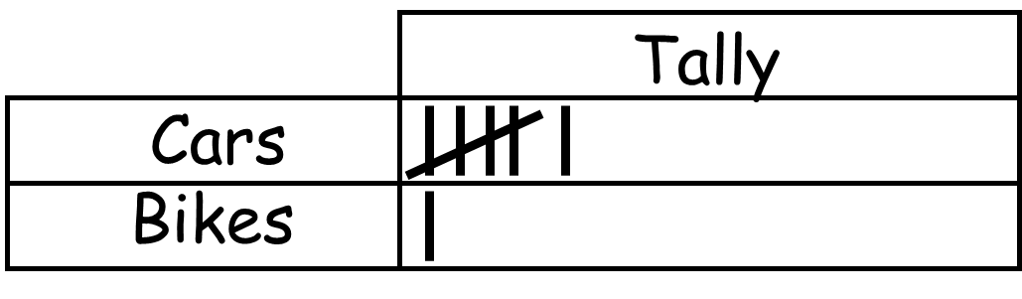
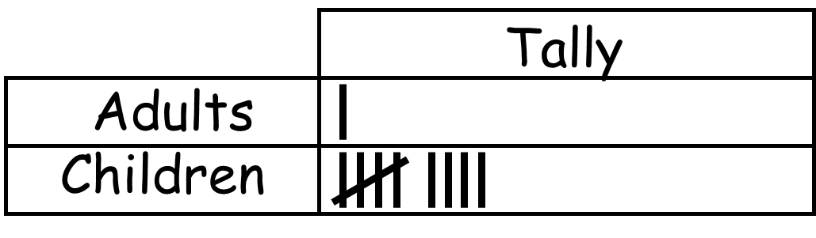
Make a tally and record what you see out of your window or the people you see at school

Slide 13


Sport Tally Total
Running 6
Football 3
Tennis 11

Slide 14






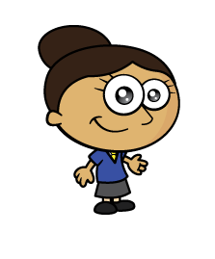


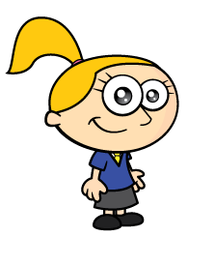

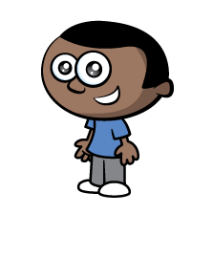
Make a tally of children’s favourite fruit
Fruit Tally Total

Slide 15
Make a tally of children’s favourite fruit
Fruit Tally Total
Oranges
Pears
Grapes
5
10
13

