Slide 1
History
The Maya Civilisation
Year One
History | UKS2 | The Maya Civilisation | Meeting the Maya | Lesson 1

Slide 3
Aim
OLI: To explore the lives of the Maya today, and use this as a way to begin to explore the Maya 1,000 years ago
Success Criteria
I can recall and organise relevant facts about the Maya civilisation.
I can label a map to show where the Maya lived and where some main cities were.

Slide 4
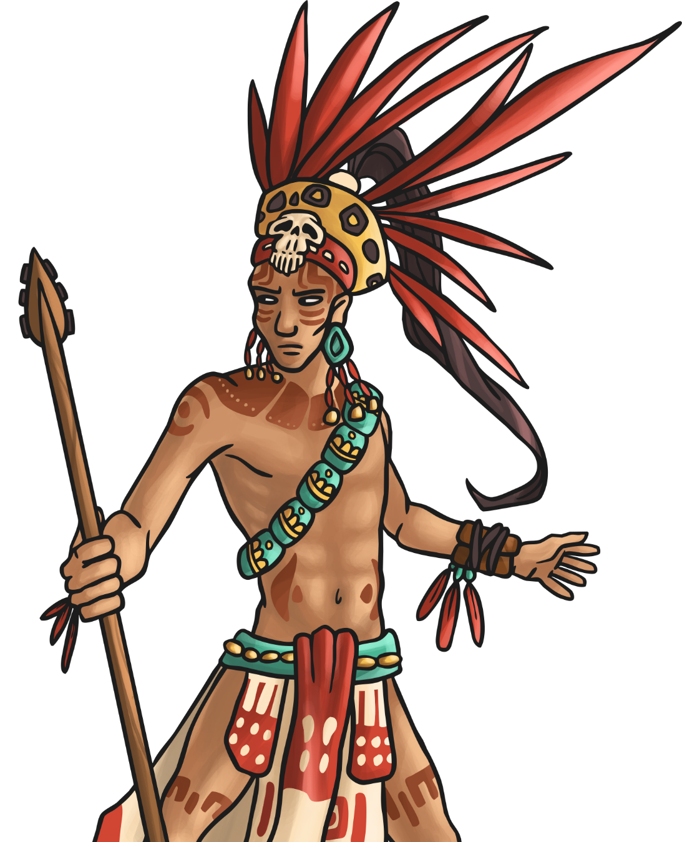
Maya People
The ancient Maya people were quite a sophisticated bunch! They developed a writing and number system; studied and charted the stars and planets; invented three complex calendars to keep track of time; built impressive temples, palaces, monuments and cities; skilfully farmed the land and established a complex political system.
The ancient Maya were a clever, deeply religious people who valued intelligence and learning. This helps to explain how and why they were able to develop a complex, thriving civilisation which began over 2000 years ago.

Slide 5
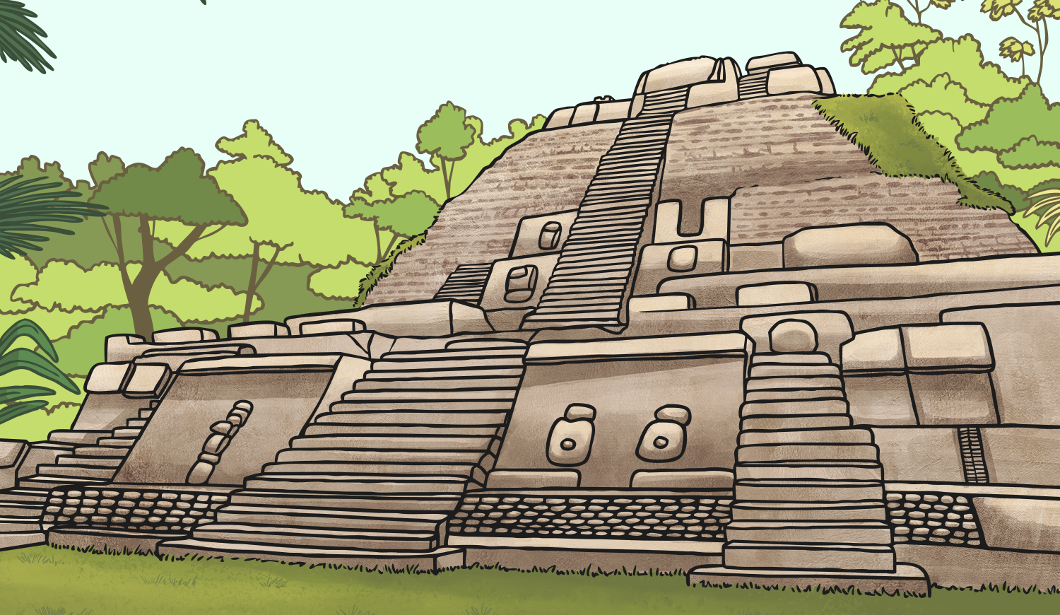
The Ancient Maya Place in Time
The Maya civilisation came into being around 2000 BC and cities such as El Mirador became large and powerful from 300 BC onwards.
By around AD 900, cities in the rainforest were abandoned and people moved up north to the highlands of Guatemala and the Yucatan. This was because there was an extensive drought in the area that lasted a long time and people needed to move out of the rainforest.
Cities like Chichen Itza were still thriving in AD 1000 and the Maya civilisation was still in existence in AD 1500.
It was due to the arrival of the Spanish in the 16th century that their ancient cities fell to ruin.

Slide 6
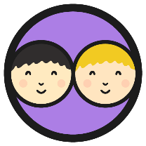
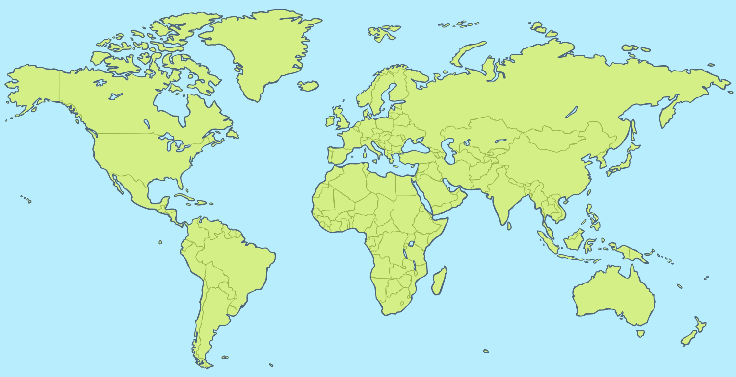
Maya Maps
With your partner, see if you can locate Central America on your map or atlas. What countries can you find in Central America?

Slide 7
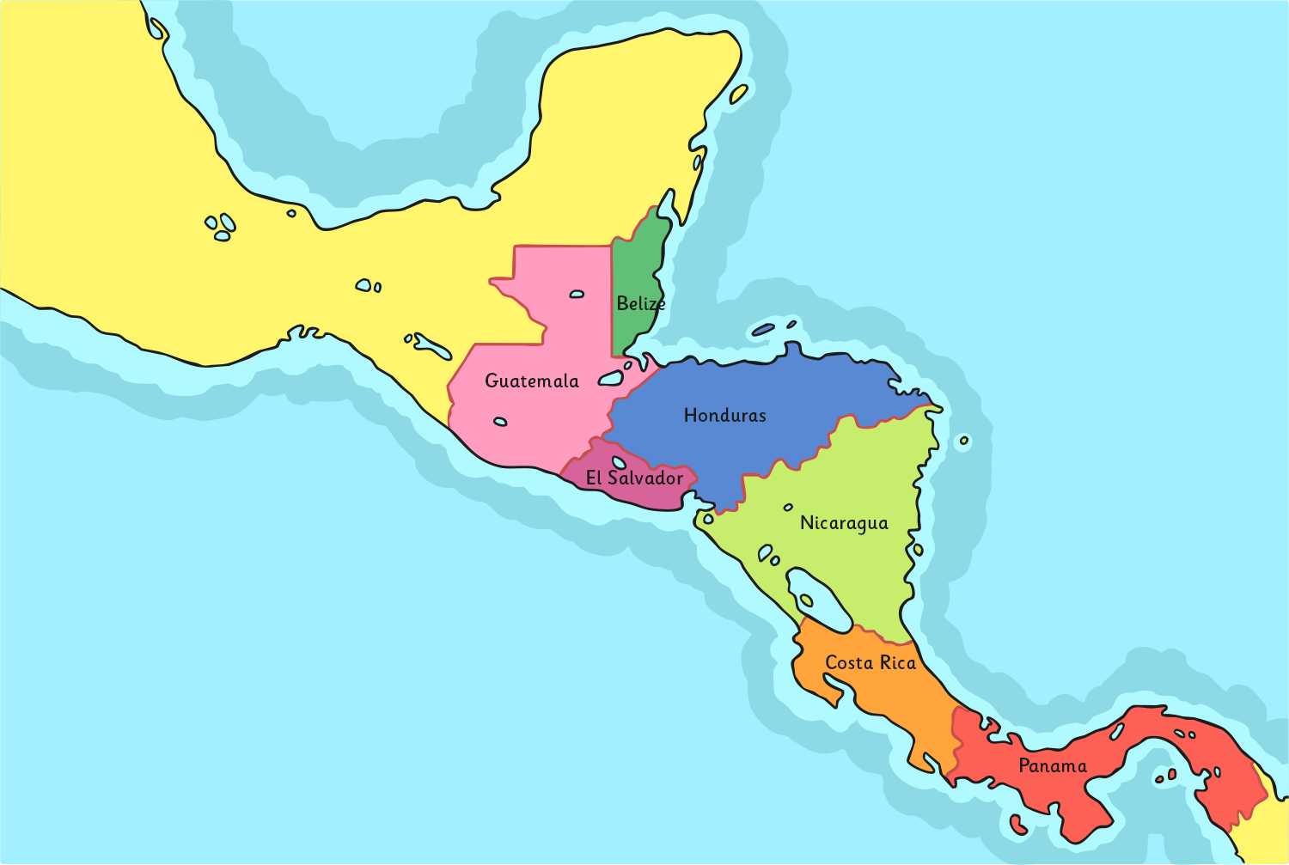
Central America
Central America consists of seven countries: Belize, Costa Rica, El Salvador, Guatemala, Honduras, Nicaragua and Panama.
Can you find and label these on your Maya Map Activity Sheet?

Slide 8
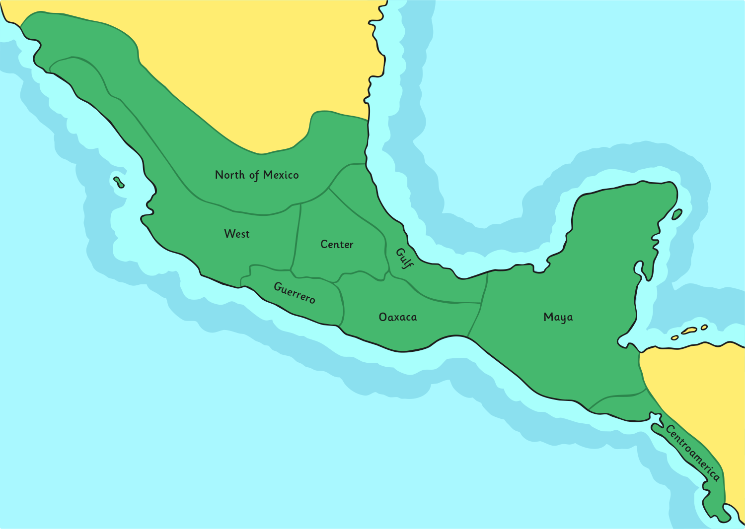
Mesoamerica
‘Mesoamerica refers to an area where a number of societies had been formed before the Spanish arrived in the 16th century. It covers Mexico and the northern parts of Central America. ‘Mesoamerica’ can also refer to the culture of the people who lived there. The Maya lived in the south east of this area.

Slide 9
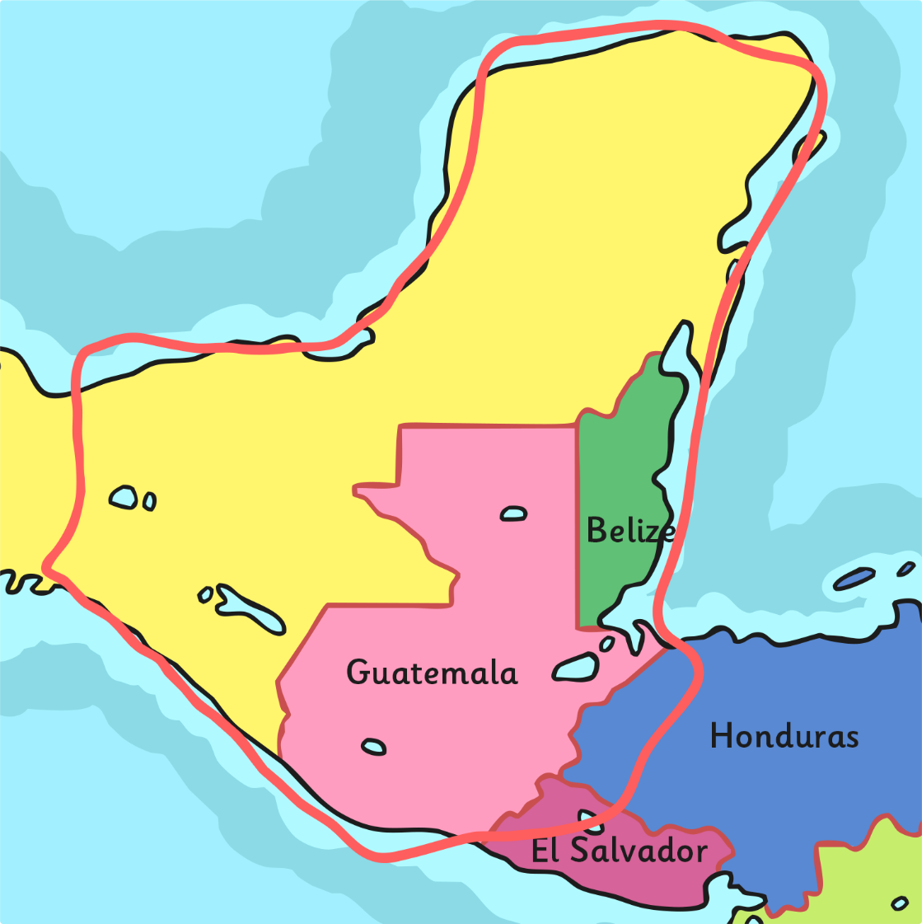
The Location of the Maya
Today, the area the Maya used to live in spreads over 5 countries: Mexico (southern Mexico and the Yucatan Peninsula), Belize, Guatemala, a small area of west Honduras and the very north of El Salvador.

Slide 10
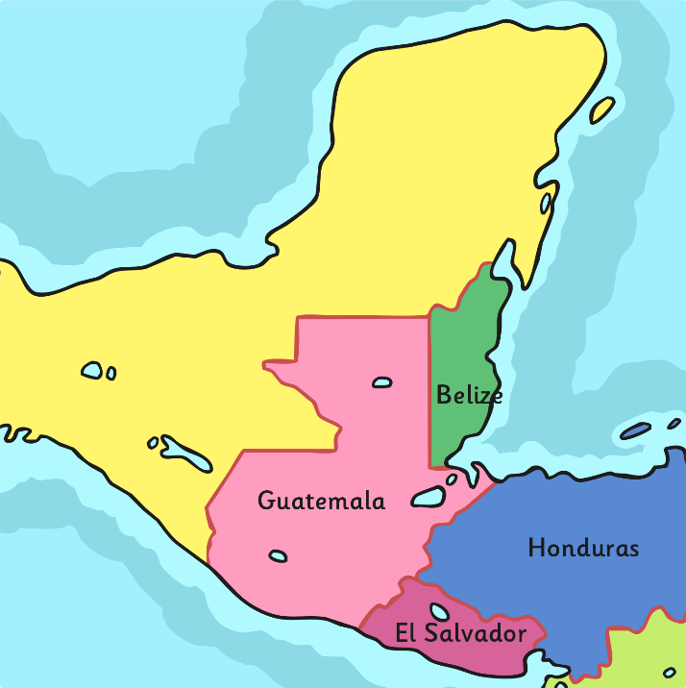
Maya Cities
Use your map or atlas to outline the area of land where the Maya used to live.
Can you use a map or atlas to find and label the countries listed on your activity sheet?
Then find the location of the following ancient Maya cities and mark them on your map too. You could use a key or draw arrows and label them.
Xunantunich
Chichen Itza
Uxmal
Palenque
Calakmul
Coba
Copán
Tikal
Tulum

Slide 11
Cities Revealed
Some of these ancient Maya cities were almost 1000km apart yet they shared the same culture and way of life.
Uxmal
Palenque
Calakmul
Tikal
Chichen Itza
Coba
Tulum
Xunantunich
Copán

Slide 12
Maya Today
There are about 6 million Maya alive today.
How can these Maya help us to learn about ancient Maya?
What are their houses like?
What food do they grow?
What do they wear?
Do they live in towns and cities or villages?
What products do they make and sell?
What is their music like?
Why do tourists go to the area the Maya live in?

Slide 13
Activity
You are each going to research different aspects of Maya life today- use the A3 sheet to guide your research.
Don’t worry if you cannot print off the sheet, as we will complete this in class next week. You can just make some notes and bring them into school! ☺

Slide 14
Aim
I can discover facts about the Maya civilisation and explain who the Maya people were and when and where in the world they lived.
Success Criteria
I can recall and organise relevant facts about the Maya civilisation.
I can label a map to show where the Maya lived and where some main cities were.

