Slide 3
Which tally chart is correct?
Why are the others incorrect?
Children | Amount of smiles
Bella | 6
Isla | 4
Theo | 10
Bella
Isla
Theo
Bella
Isla
Theo
Bella
Isla
Theo
Bella
Isla
Theo

Slide 4
Which tally chart is correct?
Why are the others incorrect?
Children | Amount of smiles
Bella | 6
Isla | 4
Theo | 10
Bella
Isla
Theo
Bella
Isla
Theo
Bella
Isla
Theo
Bella
Isla
Theo

Slide 6
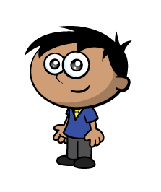
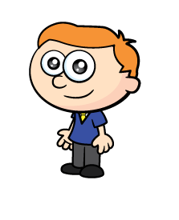
Ron and Amir have been tallying animals they saw on their walk.
Can you help to complete the tally chart?
Animals | Tally | Total
Birds
Alpacas
Dogs
Horses
10
2
6
4
Have a think

Slide 7
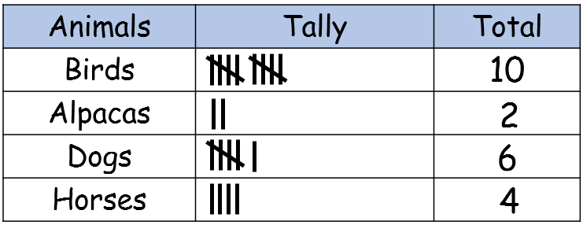
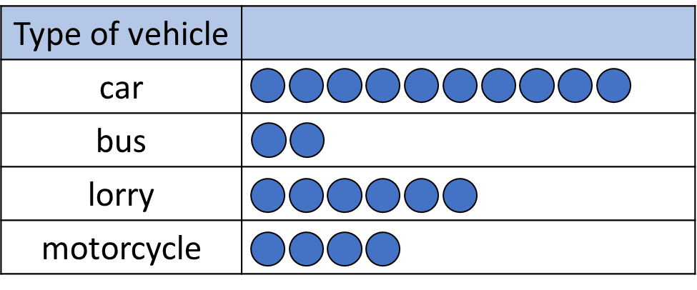
They use their tally to draw pictograms.
Key $=$1 animal
Animals
Birds
Alpacas
Dogs
Horses
Key $=$1 animal
Amir hasn’t drawn circles.
Animals
Birds
Alpacas
Dogs
Horses

Slide 8
Either go on a walk or use my virtual walk, or both!
Key $=$1 animal
Animals
Birds
Frogs
Octopuses

Slide 9
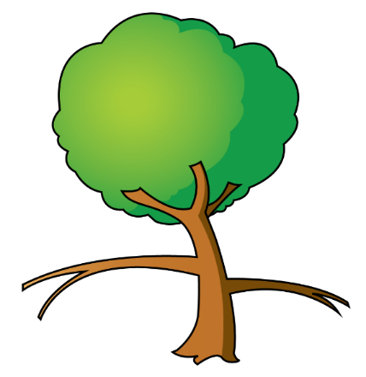
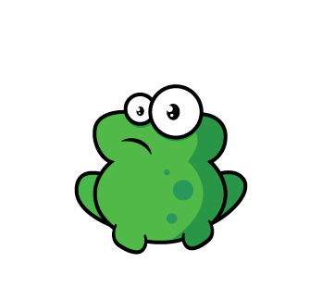
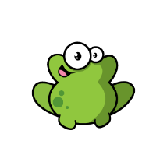
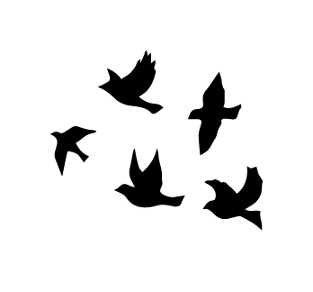
Animals
Birds
Frogs
Octopuses
Key $=$1 animal

Slide 11
How many bananas?
Key $=$1 banana
Children
Alex
Rosie
Mo
Amir

Slide 12
How many bananas?
Have a think
Key $=$1 banana
Children
Alex
Rosie
Mo
Amir

Slide 13
How many bananas?
Have a think
Key ? $=$1 banana
Children
Charlotte
Poppy
Noah
Oliver

