Slide 1

Express yourself!

Slide 3
The Big Questions

Slide 4


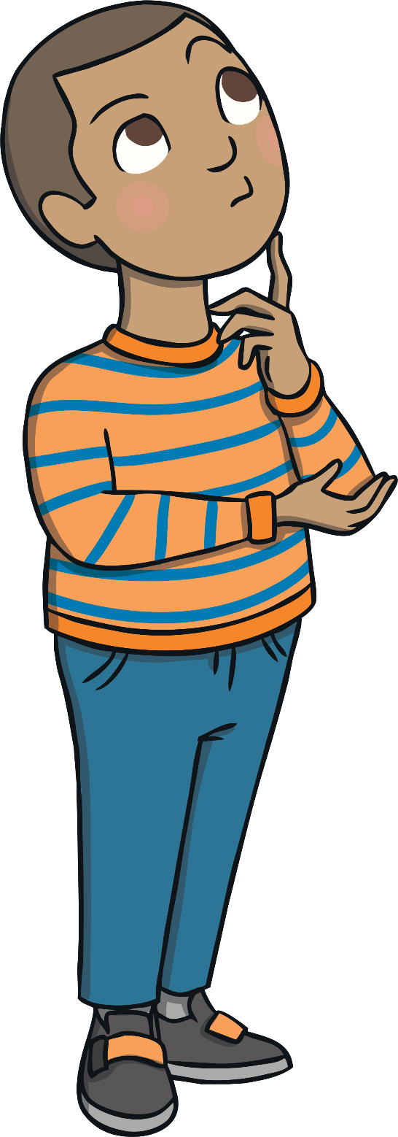
The Big Questions
How can we keep our minds healthy?
What is positive mental health?

Slide 5

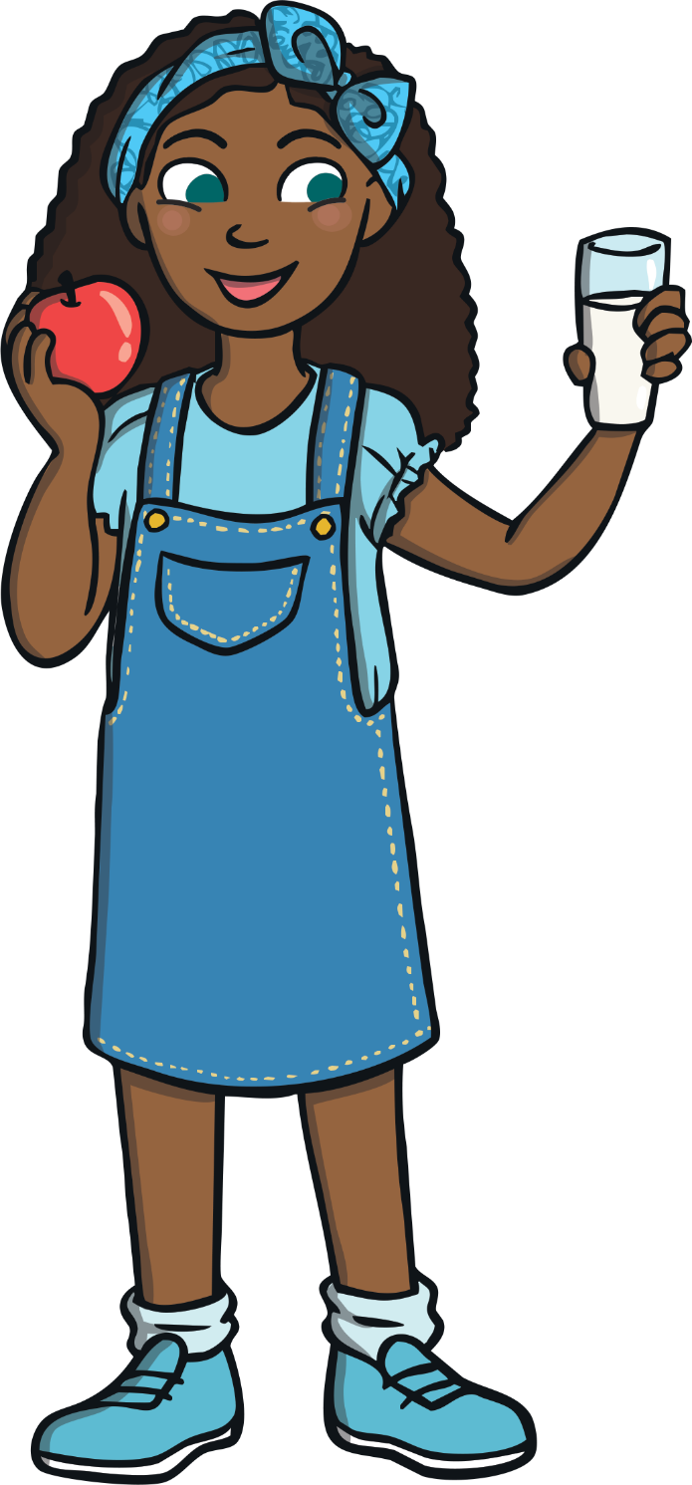
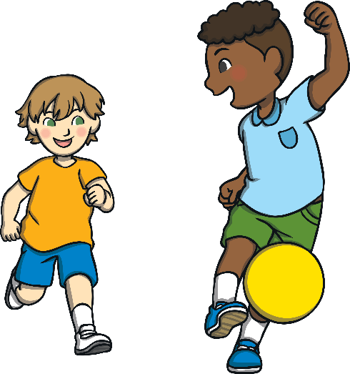
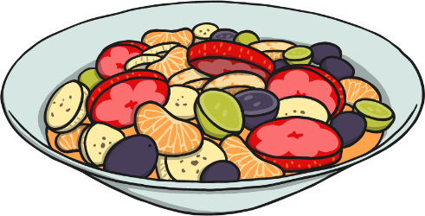

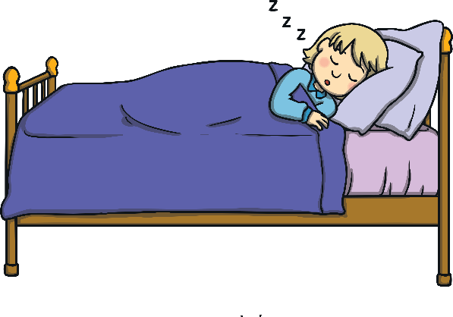
Healthy Bodies
Being healthy means that our body and our mind are in good condition and that we feel well.
What can we do to help our body to
be healthy, be in good condition and
feel well?
Think of three different things that you can do to keep healthy.

Slide 6


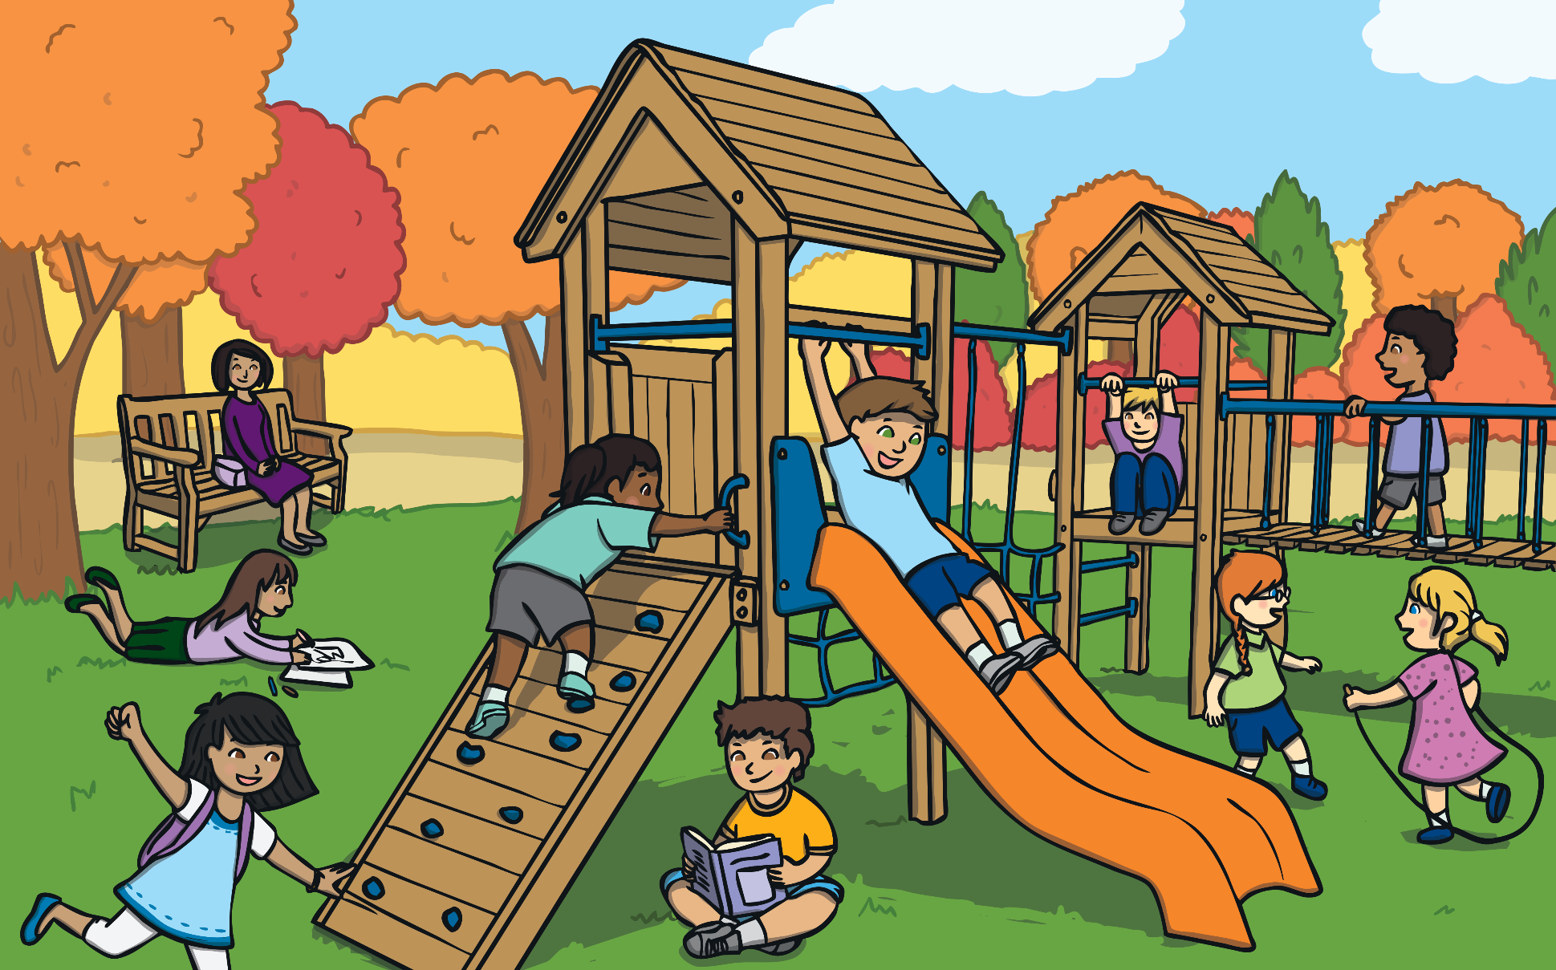
Healthy Bodies
Why do you think it is important to make choices and take actions to keep our bodies healthy?
It is important to make healthy choices so our body works as well as it can.
Doing all we can to keep our body healthy can help us to feel happy too.

Slide 7
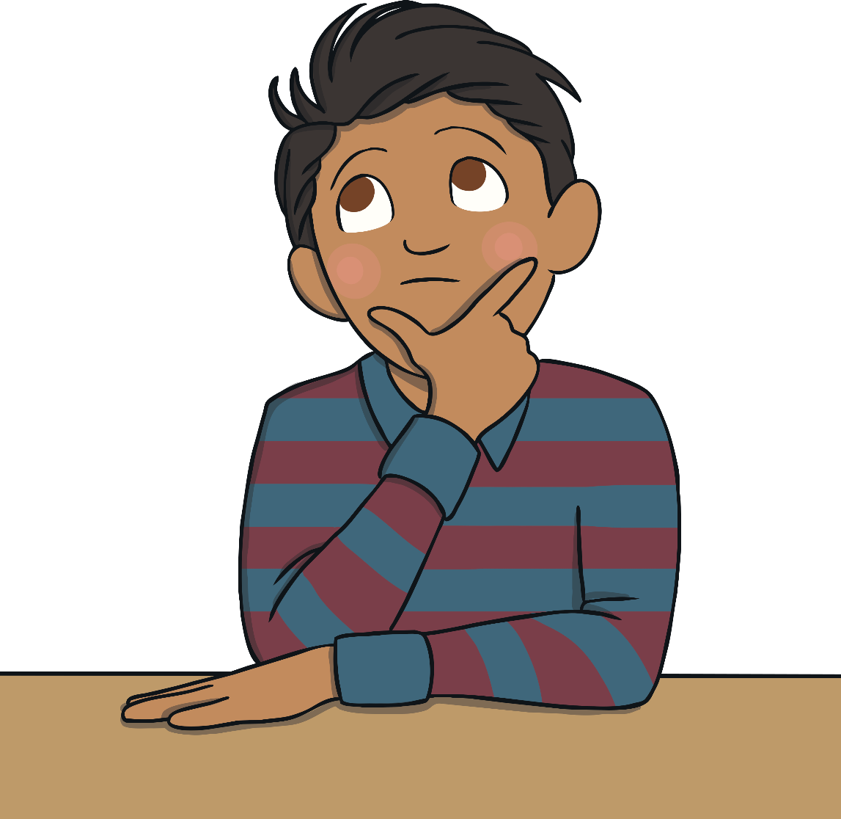
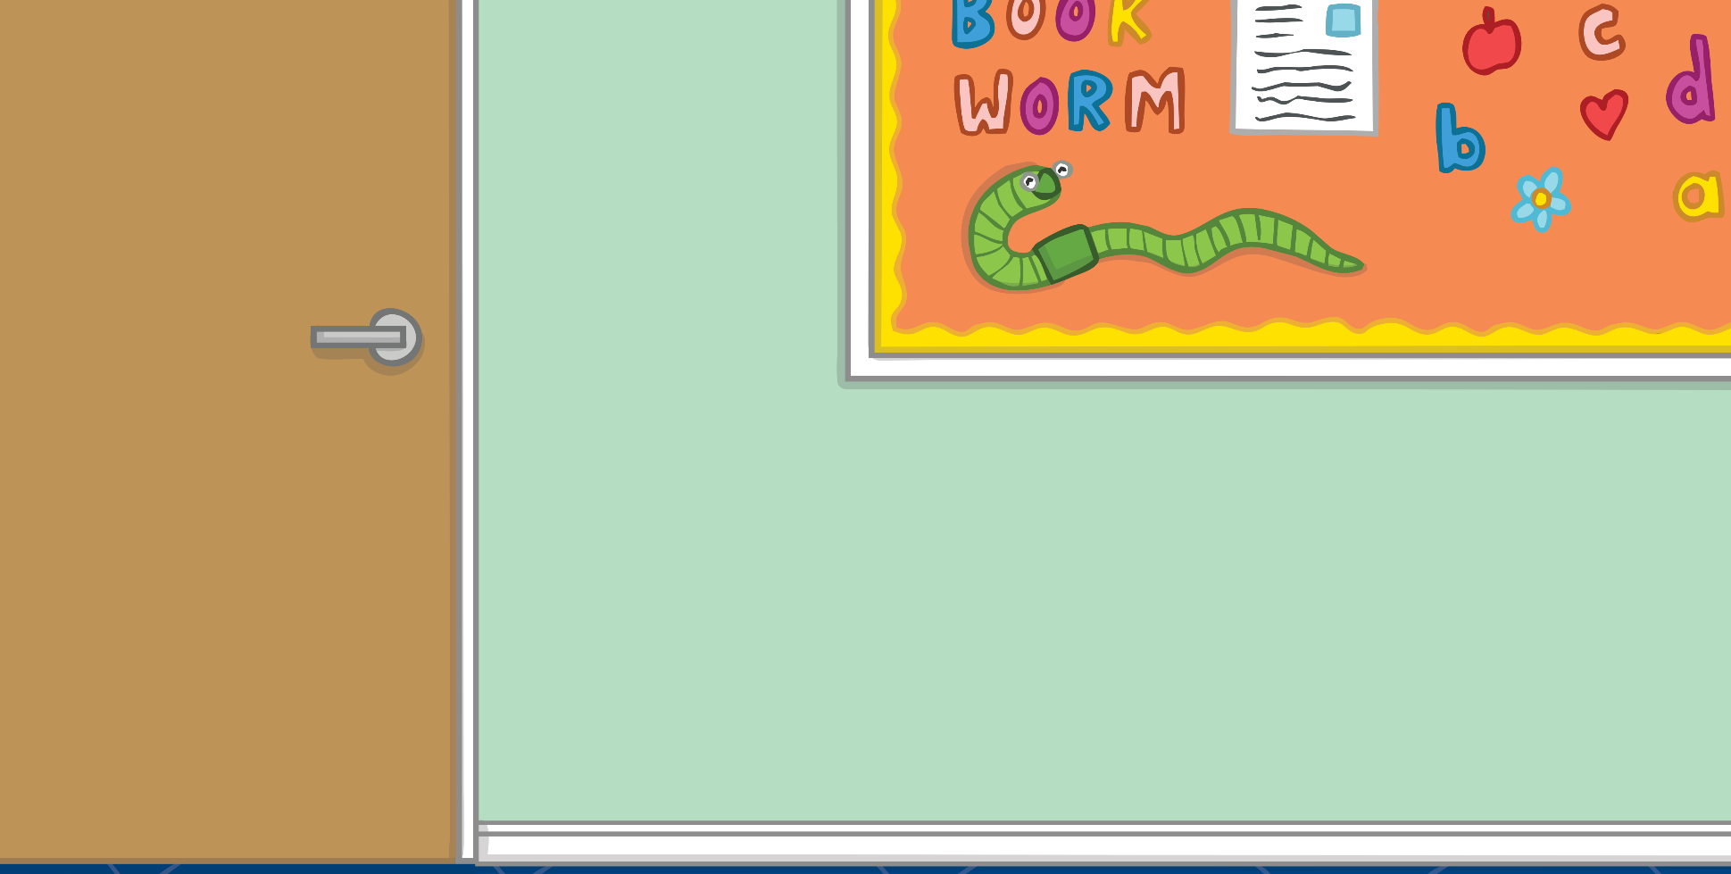
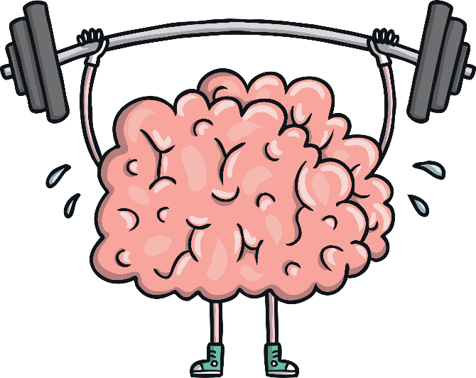
Healthy Minds
Mental health is all about how we are feeling and the thoughts we are having. It can affect how we behave and the choices we make.
Just like with our body, it is important we do things to help our minds to be healthy, be in good condition and feel well.

Slide 8
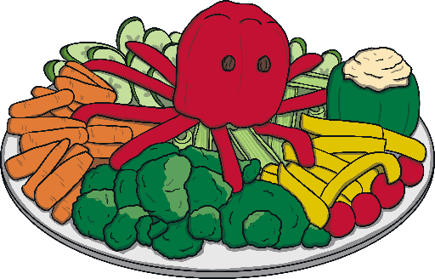
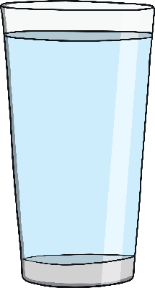

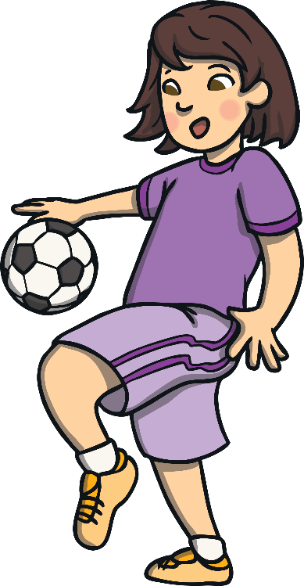
Healthy Minds
What can we do to help our minds be healthy?
We can keep active.
We can eat healthily.
We can drink enough water.
We can ask for help if something is troubling us.
We can make sure we have time each day when we can be calm and quiet.

Slide 9
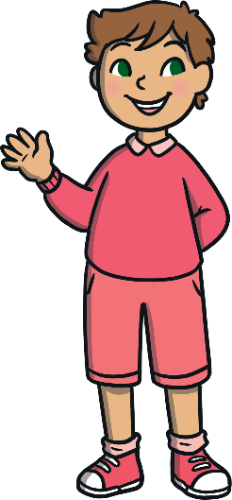

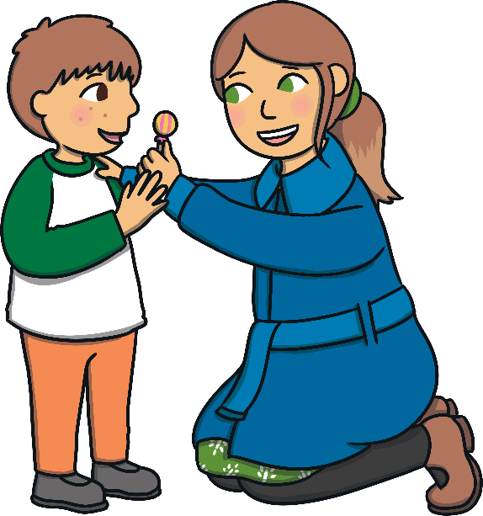
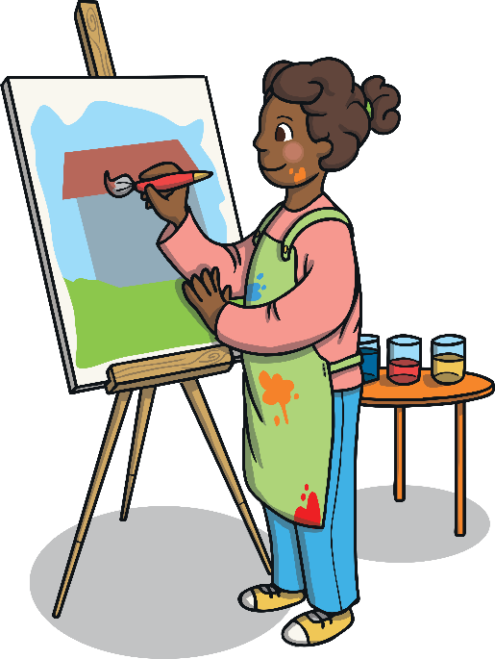
Healthy Minds
We can spend time each day doing something we love.
We can spend time outside.
We can be creative.
We can help others.
We can make sure we get enough sleep.
We can spend time with people who make us smile.
We can remember we are special just the way we are.

Slide 10

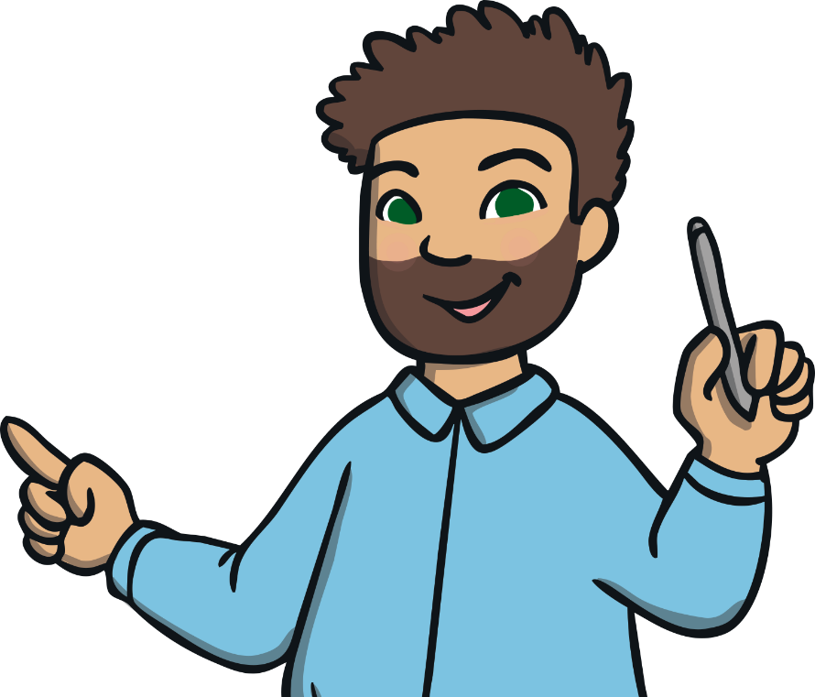
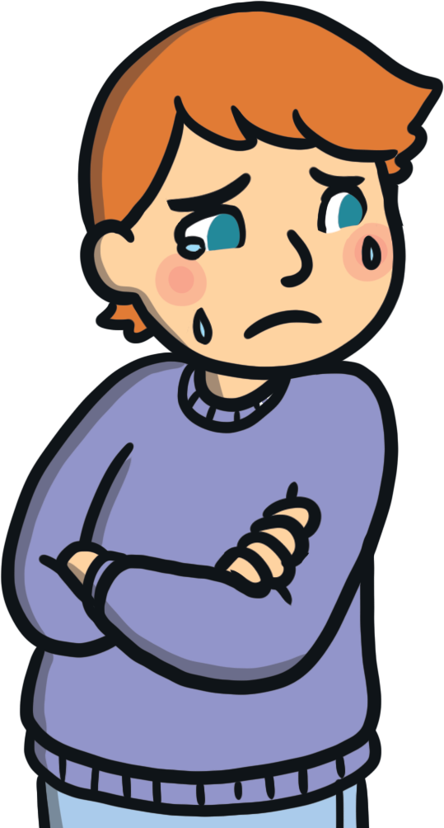
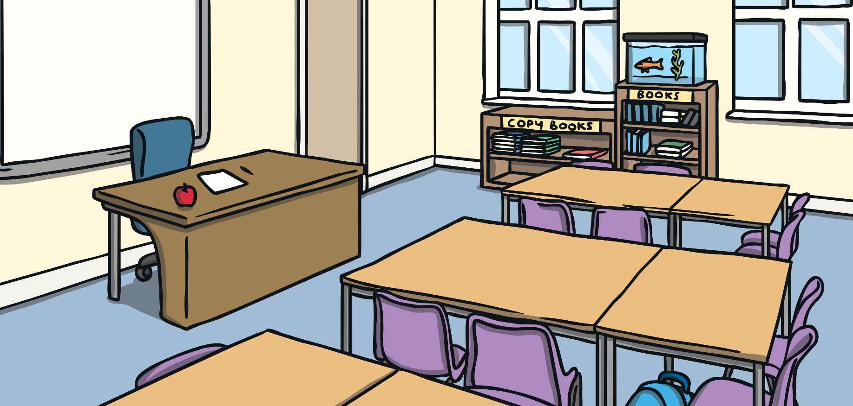
Healthy Minds
Sometimes, just like our body, our mind doesn’t feel well. We might feel very worried, frightened or extremely sad. We might have thoughts which feel uncomfortable and that make us behave in a way that hurts ourselves or others.
If you are feeling worried or sad, talking to someone you trust is a good place to start.
Positive mental health is not about being happy all of the time. It is about feeling well, being able to enjoy life and knowing what to do if we have troubling thoughts and feelings.

Slide 11
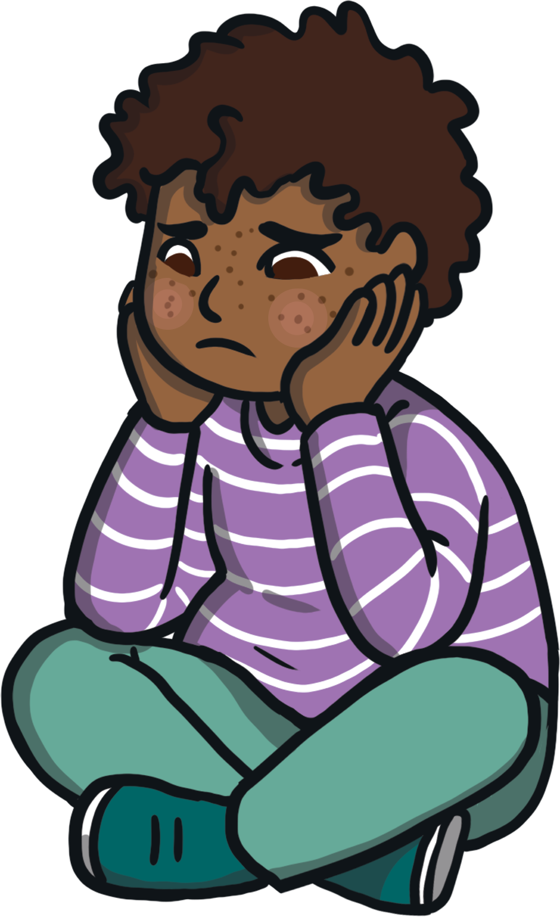
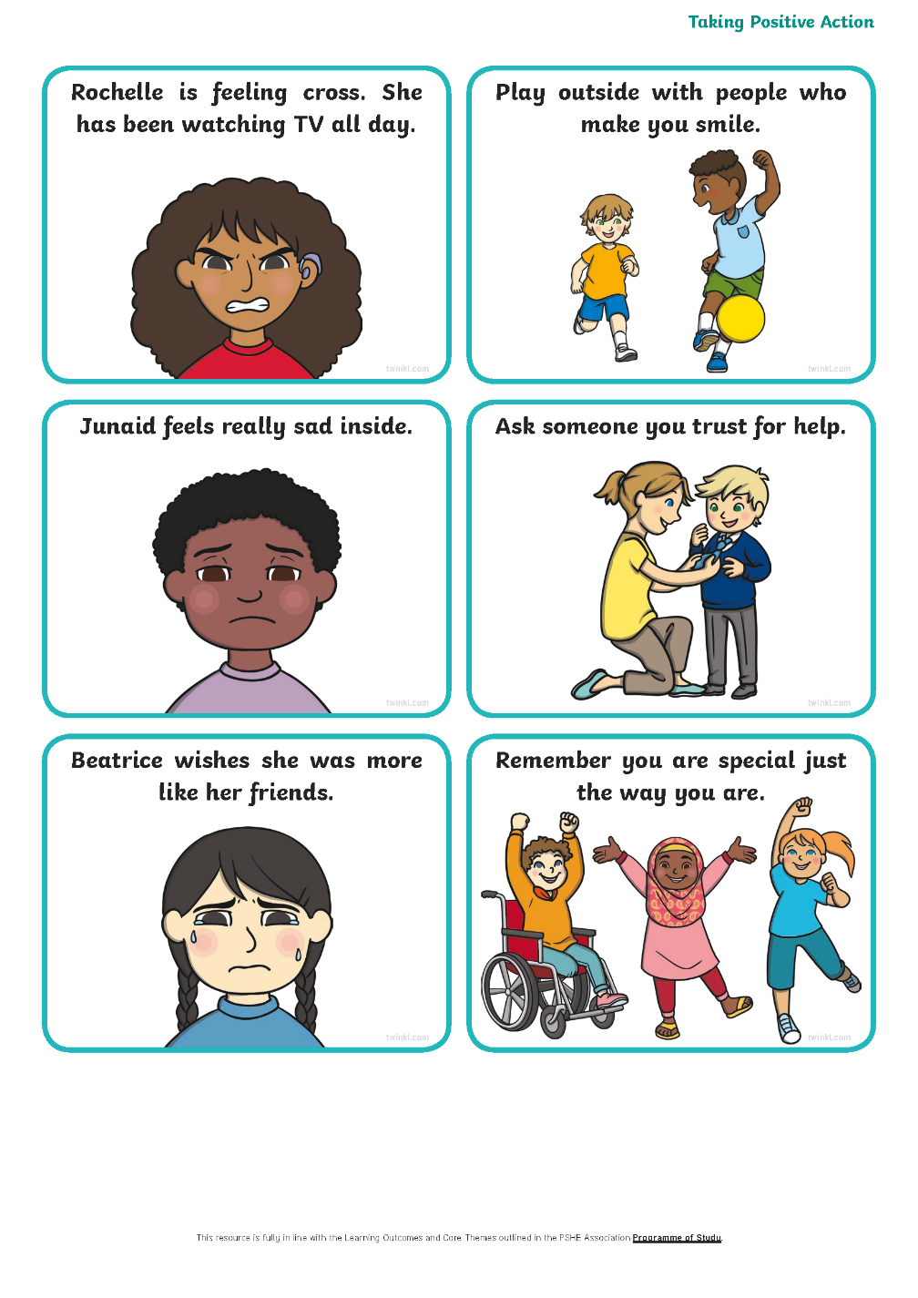

Task 1:
There are lots of things we can do to keep our minds healthy and to help us cope and feel better when we have uncomfortable thoughts and feelings.
Using the sorting cards, match the feeling or situation with an action that could help.

Slide 12

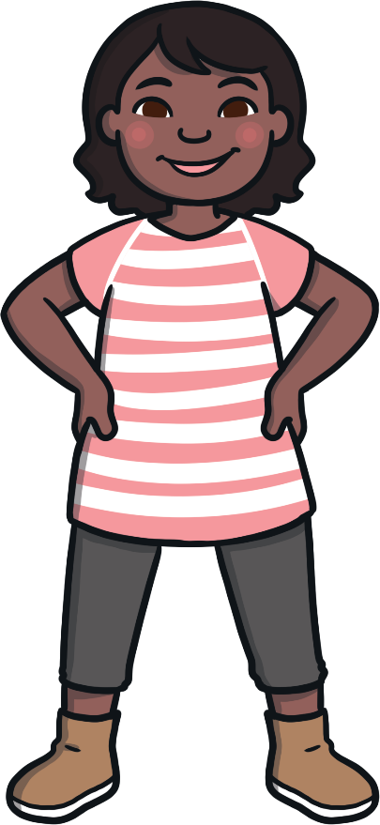

Taking Positive Action
It is important that we do all we can to look after our mental health.
Having a healthy mind can help us feel good on the inside and can help us do well in lots of different situations.
Consolidating

Slide 13
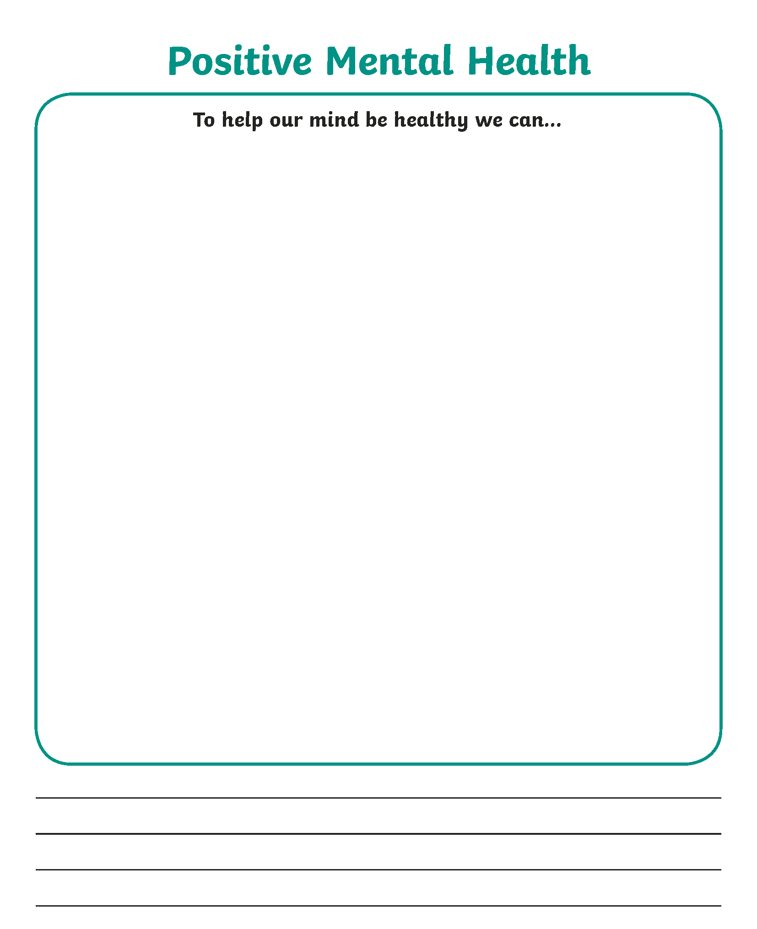
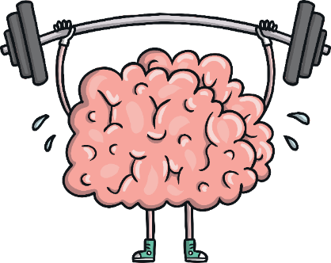

Task 2:Positive Mental
Health Posters
Let others know what they can do to help their minds be healthy!
On your Positive Mental Health Poster Activity Sheet, draw a picture and write a sentence to show one thing that people can do to look after their mental health.

Slide 14
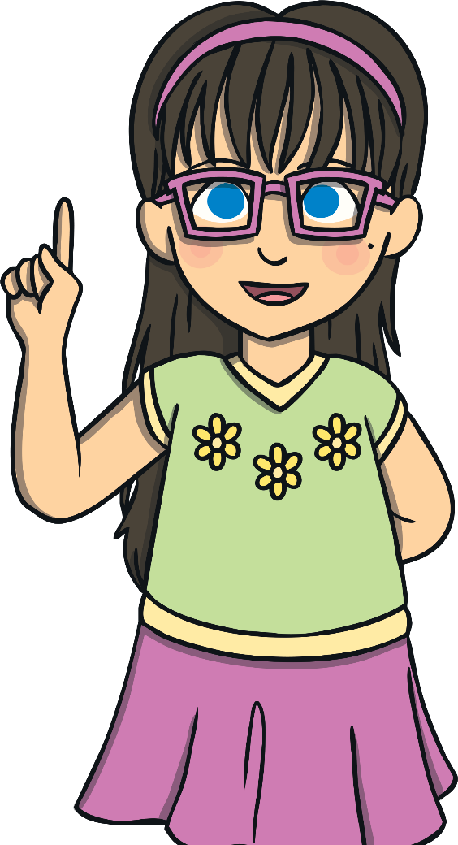
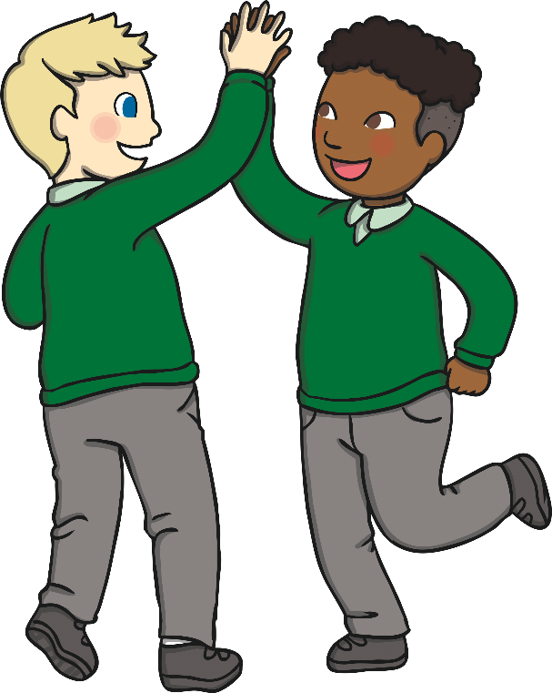

Helping Others
There is a lot we can do to help keep our minds healthy and help us cope when have uncomfortable feelings.
It is important we think, act and behave in a way that helps others feel good on the inside too.
What could you do to help others feel happy and have a healthy mind?

Slide 15
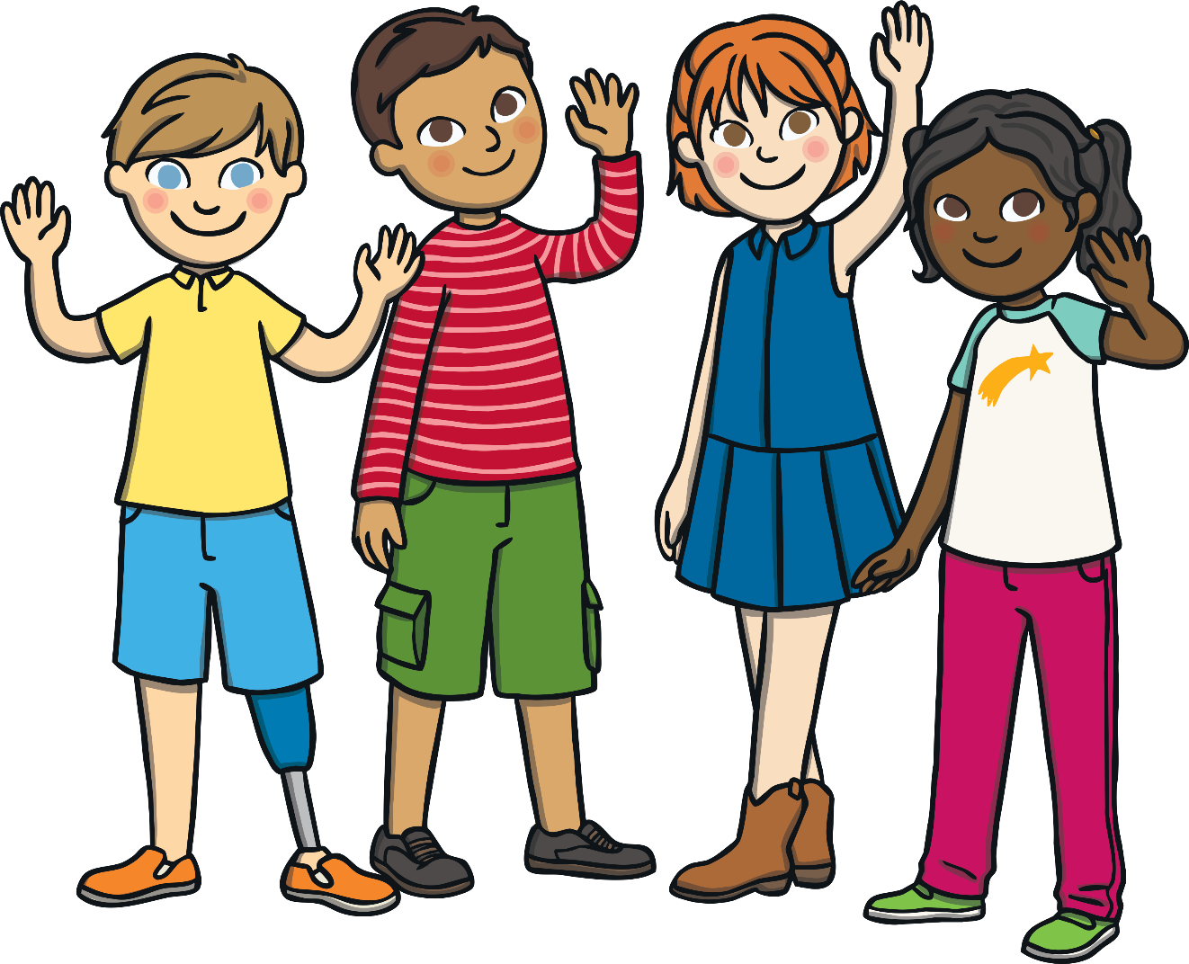
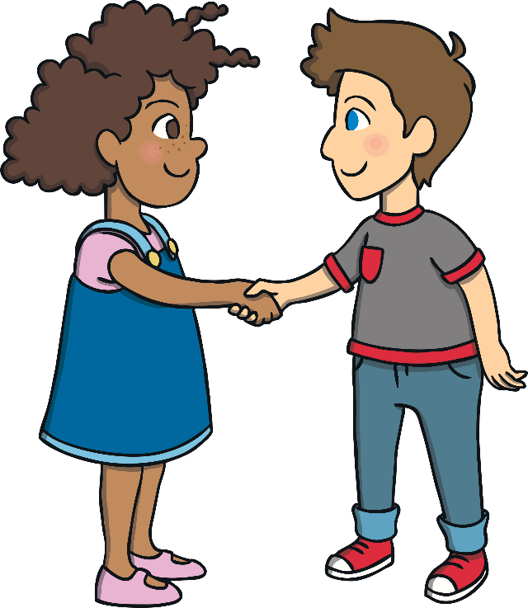

Helping Others
Take a moment of quiet to think about this and then share your thoughts with someone at home or at school.
By doing a little, we can make a big difference to how others
feel on the inside.

Slide 16
The Big Questions

Slide 17
The Big Questions
How can we keep our minds healthy?
What is positive mental health?
What have you learnt today?
How can we keep our minds healthy?

Slide 18
Wellbeing Journal
On Google Classroom you will also find a wellbeing journal. There is a page for each day for you to fill out. It is good to pause for a few moments each day and think about our wellbeing; how we are feeling that day, what we want to achieve and positive things that have happened.
Have a go at completing the wellbeing journal throughout the week. It might be a nice activity to share with your family at home or some of your friends at school.

