Slide 1
Are we damaging our world?

Slide 2
Lesson 2
OLI: To understand what minerals are and question if they can be used sustainably.

Slide 3
What is a mineral?
Examples of common minerals include: coal, oil, sea shells, diamonds, rubies, table salt, gold, copper, aluminium, iron, steels, gravel, brick, sand and stone.

Slide 4
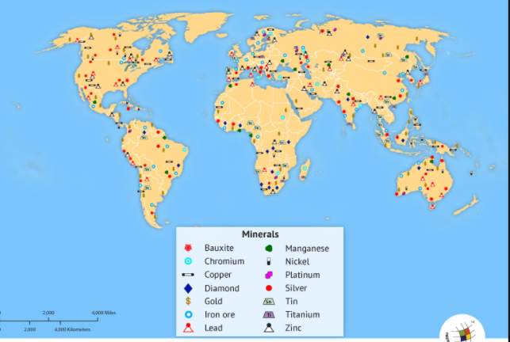
Where are minerals found?

Slide 5
Look closely at the map on the previous page:
What do you notice?
Which areas of the world have more minerals?

Slide 6
Rocks, oil, coal and metals
These minerals are extracted, mined or quarried from the earth for human use.
Most metals occur in rocks which have to be crushed and processed to obtain the metal.
Watch the video that shows how steel is made from ore-rich rock:
https://www.youtube.com/watch?v=9l7JqonyoKA&feature=youtu.be

Slide 7
Your task- Monday
I want you to look into and research how and why we use minerals in our daily lives. You can draw pictures or use images from Google to go along side your writing.
You can use the other PowerPoint called Rocks and Minerals every day to help you as well.
Extension: Do you think there are an endless supply of these minerals?
Add a paragraph that explains some of the issues concerning the sustainable development of minerals.

Slide 8
Your task- Thursday
Task One
Look at the PowerPoint titled ‘Reuse, reduce and recycle.’
Create a poster to show these important things we need to do for our environment.
Task Two (you can add this to your poster or do on a separate sheet) :
Choose one mineral that you learnt more about on Monday, for example gold. Think of your ideas about how this mineral can be used sustainably (think about reuse, reduce recycle- can you recycle gold?) You can add photos!

