Slide 2


sea

Slide 3
steam

Slide 4



bead

Slide 5

read

Slide 6


treat

Slide 7


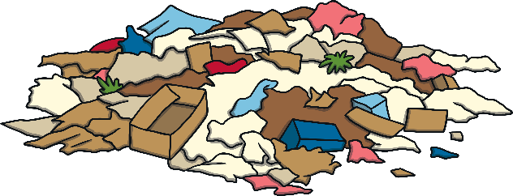
heap

Slide 8
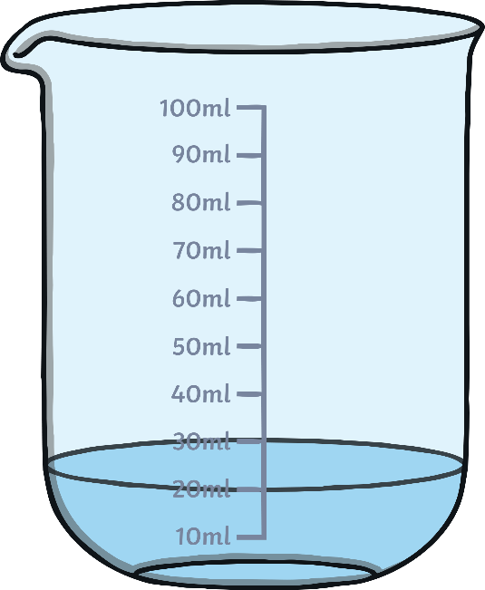
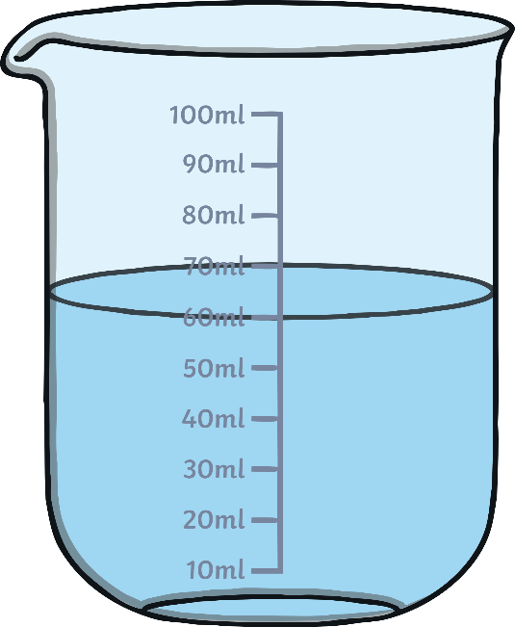
least

Slide 9
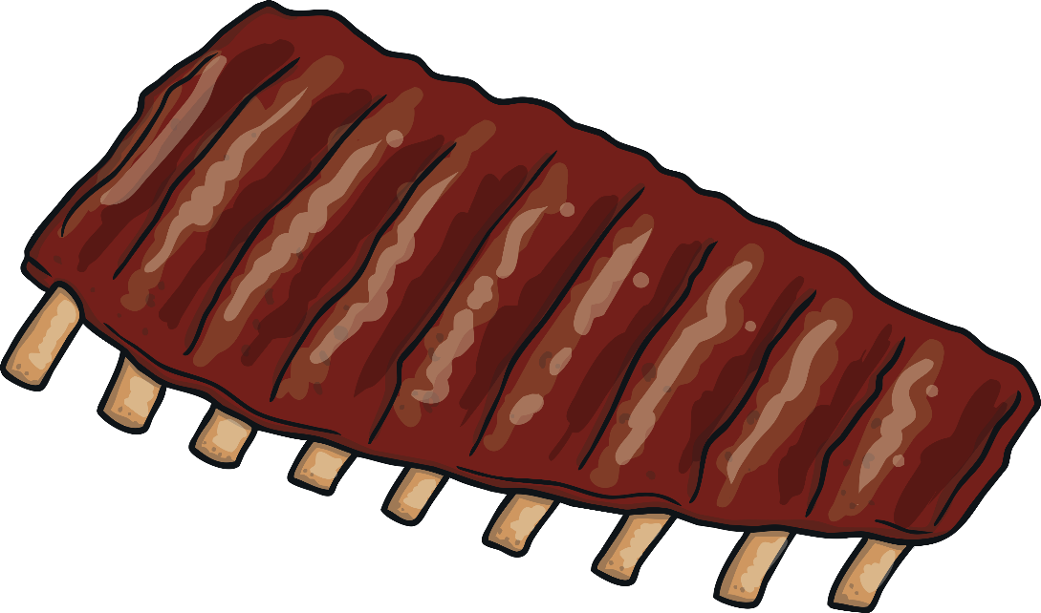
meat

Slide 10



repeat

Slide 11

seat

