Slide 2
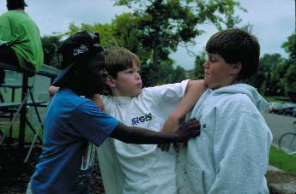
You have Learned …
No, I tell you, your love must be like God’s love.
God loves everyone no matter who they are or what they do.
You must not put any limits on your love, for the love of your Father in heaven is never-ending, never- changing.
You have learned ‘You must love your neighbour and hate your enemy’. But I say this to you:
Love your enemies and pray for those who persecute you; in this way you will be sons and daughters of God.
God’s love is like the sun, which rises each day and gives warmth and light to everyone, not just good people.
God sends rain to water the earth and the rain falls on the honest and the dishonest people alike.
Don’t just love people who love you!
Don’t just talk to the people who are your friends!
Based on Matthew 5: 45-58
God’s Story 3

