Slide 3

Use $<, >$ or $=$ to complete the comparisons
1)
2) 15
12 $×$ 0 12 $+$ 0
50 12 $×$4

Slide 4
Use $<, >$ or $=$ to complete the comparisons
1)
2) 15
12 $×$ 0 12 $+$ 0
50 12 $×$4
$$>$$
$$>$$
$$<$$
$$>$$

Slide 6
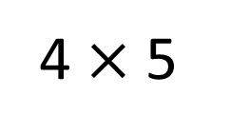
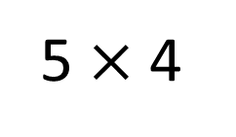
Use $<, >$ or $=$ to compare the total
number of spots.
$$=$$
5 $×$ 4
4 $×$ 5
I think this side has more.
Have a think

Slide 7
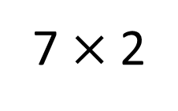
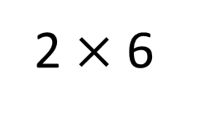
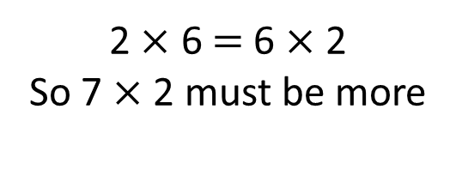
Use $<, >$ or $=$ to complete the comparison
$$<$$
2 $×$ 6
7 $×$2
I think this side has more again.
2 $×$ 6 $=$ 6 $×$ 2
So 7 $×$ 2 must be more

Slide 8
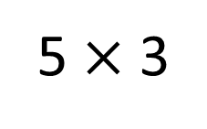
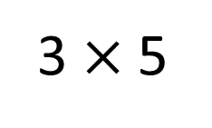
Use $<, >$ or $=$ to complete the comparison
$$=$$
5 $×$ 3
3 $×$5
Have a think

Slide 9
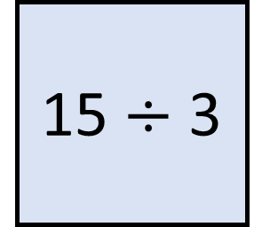
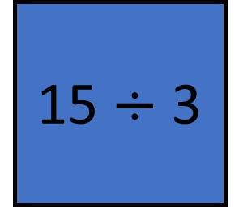
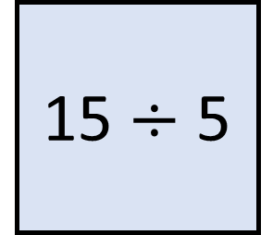
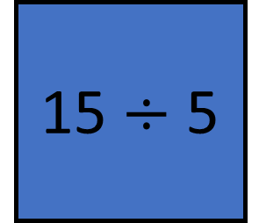
Which card has the greater value?
15 $÷$ 3
15 $÷$ 3
15 $÷$ 5
15 $÷$ 5
$$>$$
15
5 | 5 | 5
15
3
3
3
3
3

Slide 10
Have a go at questions 1 – 3 on the worksheet

Slide 11
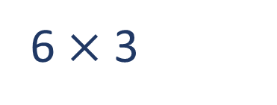
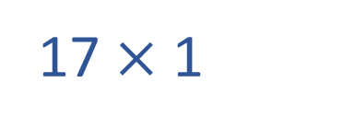



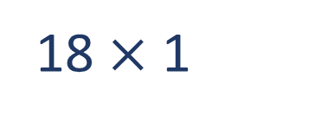

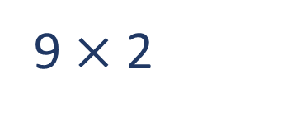
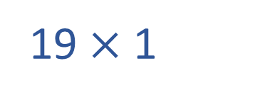
Tommy has a multiplication fact which is greater than Dexter’s but less than Jacks.
What multiplication fact could Tommy have?
Which card has the greater value?
5 $×$ 4
4 $×$ 4
5 $×$ 4
4 $×$ 4
$$<$$
?
$$<$$
$$<$$
16
17
18
19
20
6 $×$ 3
17 $×$ 1
19 $×$ 1
9 $×$ 2
Have a think
18 $×$ 1

Slide 12
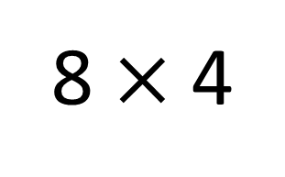
Use $<, >$ or $=$ to complete the comparison
Have a think
8 $×$ 4
$$=$$
8 × 2 × 2
8
8
8
8
8
8
8
8

Slide 13
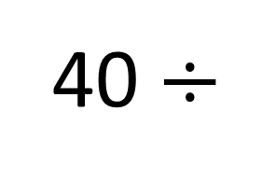
Complete the comparison
40 $÷$
2
4
8
$$=$$
× 5
4
2
1
Have a think

Slide 14
Complete the comparison
Have a think
0
$$>$$
1
3 $×$ 8 8 $×$
2
$$=$$
$$>$$

Slide 15
Have a go at the rest of the questions on the worksheet

