Slide 1
The Eucharist

Slide 2
Friday 12th February
LEARNING FOCUS 2: In Communion with Jesus.

Slide 3
Communion
What does the word communion mean? (Not as in Holy Communion)
What is another word for this? e.g. relationship, empathy, unity, union, one with etc. What do you think being ‘in communion with Jesus’ means?
Paul was one of the friends of Jesus who went from city to city telling people about the Good News of Jesus. He often wrote to the people he had left to remind them of the message of Jesus, to say ‘well done’ or to give them advice. In his letter to the Christians in Rome, Paul explains how although we are all different, we may all be one with Jesus Christ through the gifts we have been given.

Slide 4
Romans 12:3-10
And because of God’s gracious gift to me I say to every one of you: Do not think of yourself more highly than you should. Instead, be modest in your thinking, and judge yourself according to the amount of faith that God has given you.
We have many parts in the one body, and all these parts have different functions. In the same way, though we are many, we are one body in union with Christ, and we are all joined to each other as different parts of one body.
So, we are to use our different gifts in accordance with the grace that God has given us. If our gift is to speak God’s message, we should do it according to the faith that we have; if it is to serve, we should serve; if it is to teach, we should teach; if it is to encourage others, we should do so.
Whoever shares with others, should do it generously; whoever has authority should work hard; whoever shows kindness to others should do it cheerfully. Love must be completely sincere. Hate what is evil, hold on to what is good. Love one another warmly as Christians and be eager to show respect for one another.

Slide 5
Questions to consider:
Which of the different gifts that Paul mentions do you think you have?
Which one would you most like to have and why?
What is Paul telling the Christians in Rome about communion (friendship)?
How do you think the use of these gifts can bring union with Christ?

Slide 6
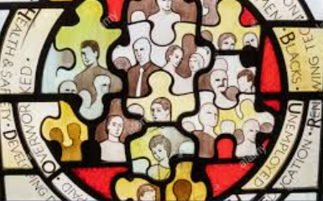
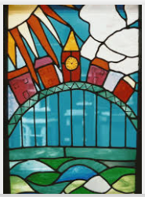
Activity
1) Design a stained-glass window which expresses in pictures that ‘though we are many, we are one body’.
2) Write a commentary on your design giving reasons for your choices.
Think about how to draw what ‘community’ looks like and how we are all part of ‘one body’ and one world.

