Slide 1
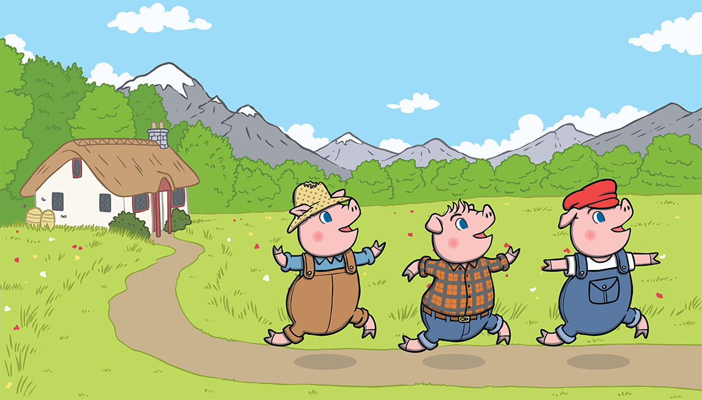
English The Three Little Pigs
Week 8
Week commencing Monday 1st March 2021

Slide 2
Monday and Tuesday OLI: To retell the story of ‘The Three Little Pigs’. This week we will continue to focus on the traditional tale ‘The Three Little Pigs’, and then introduce the spin off story ‘The True Story of the Three Little Pigs’. Today and tomorrow your task is to retell the story in an extended piece of writing, remembering as much detail as you can, in the correct order. Use your story map from last week and the uploaded word mat with key words to help you. Steps to success: - I can retell important parts of the story. - I can retell the story in the correct order. - I can use my story map and the word mat to help me. - I can use time words (first, next, then, after that, finally) - I can use capital letters and full stops.

Slide 3
Re read the story again before you write it out.

Slide 5
Once upon a time, there lived three little pigs.

Slide 6
One day, they decided to leave home and build houses of their own.

Slide 7
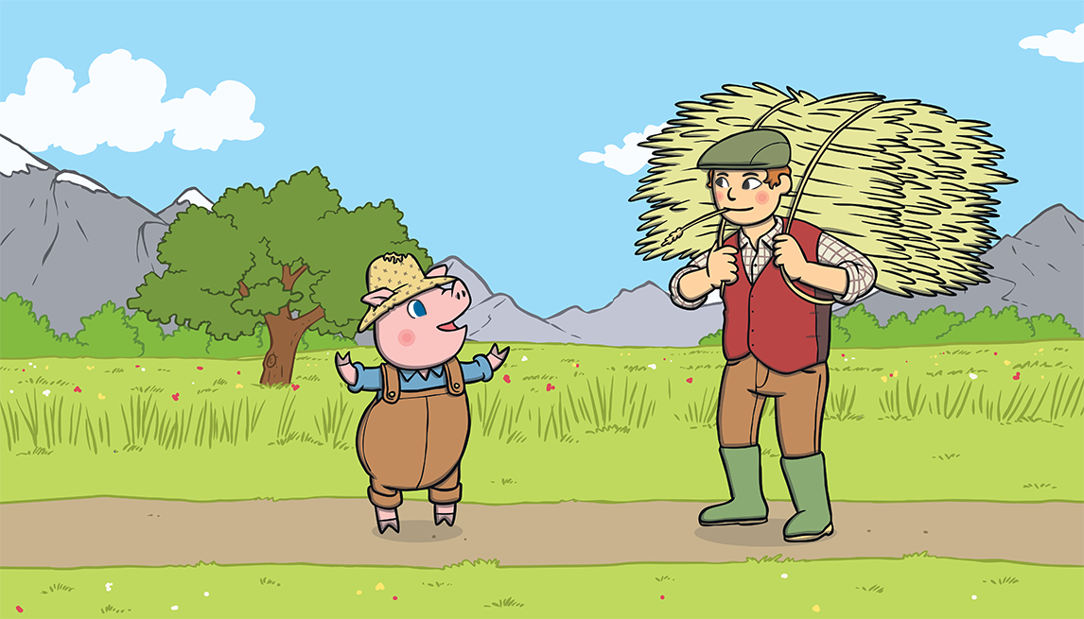
The first little pig thought that straw would make a good house.

Slide 8
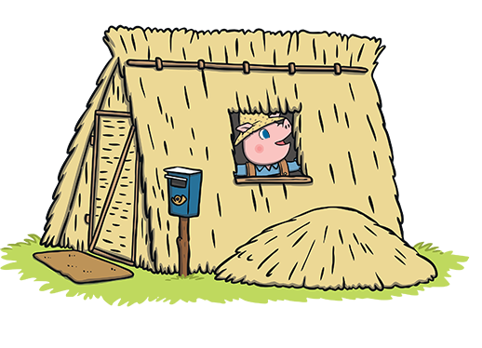
He built the house very quickly and he was very pleased with it.

Slide 9
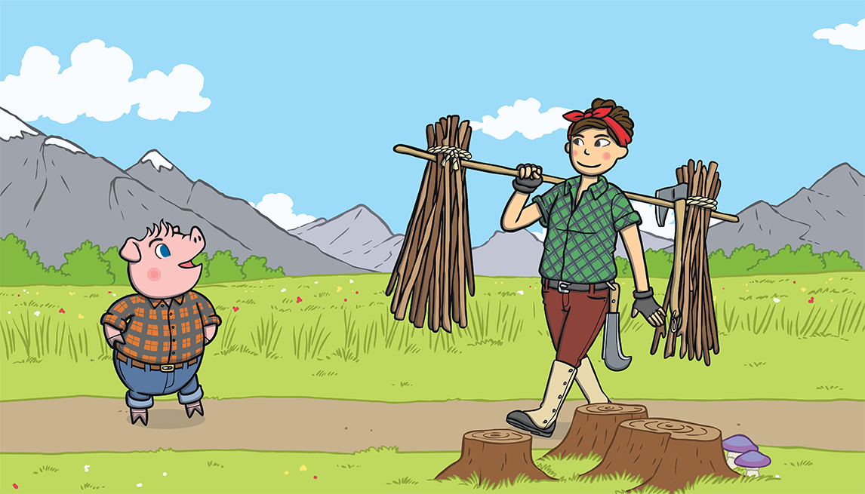
The second little pig thought that sticks would make a fine house.

Slide 10
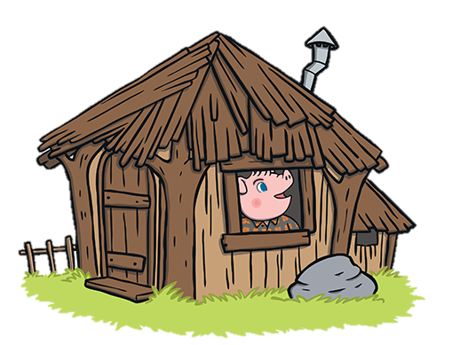
He built the house very quickly and he was very pleased with it.

Slide 11
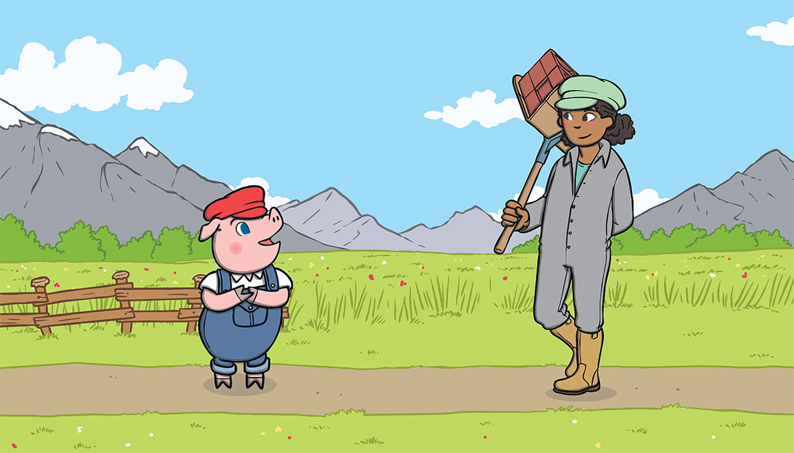
The third little pig thought that bricks would make a strong house.

Slide 12
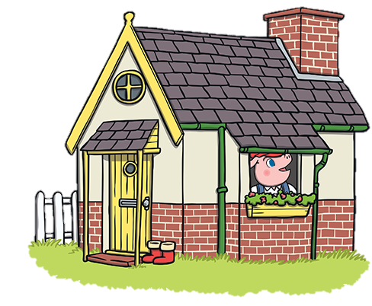
It took him a long time to build the house but he was very pleased with it.

Slide 13
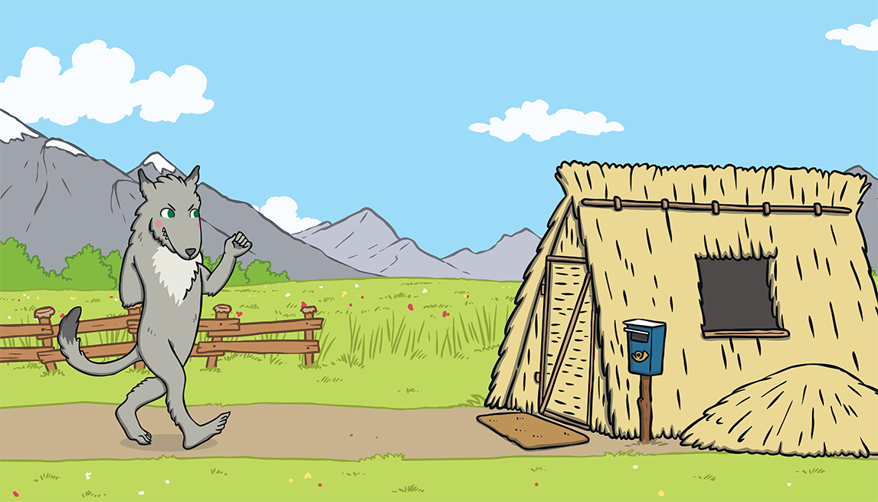
One day, a big bad wolf came along.

Slide 14
He saw the first little pig in his house of straw.

Slide 15
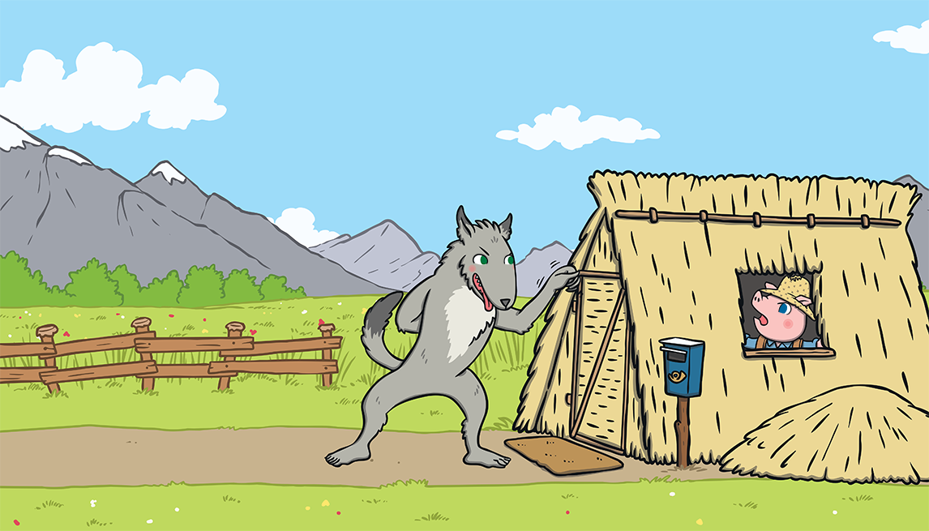
“Little pig, little pig, let me come in,” he snarled. “Not by the hair on my chinny, chin, chin!” cried the first little pig.

Slide 16
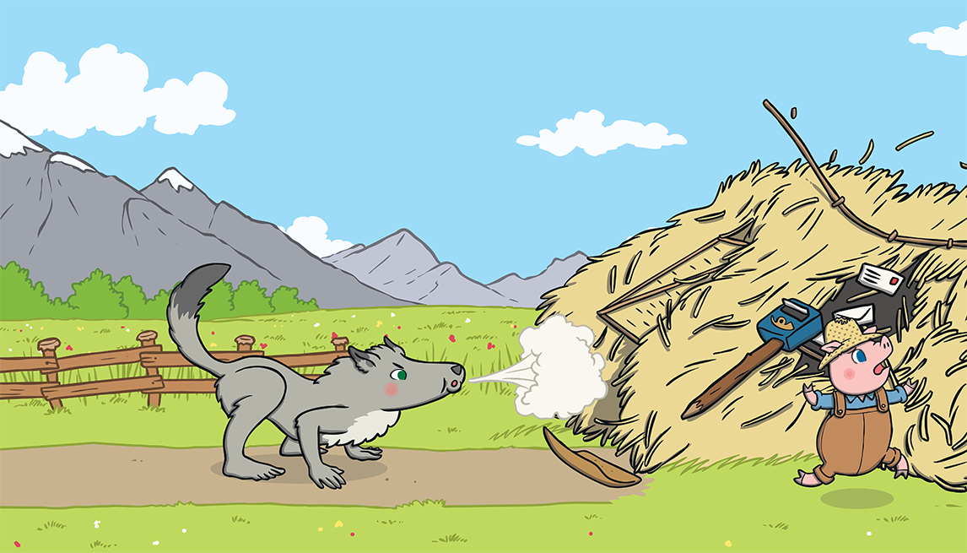
“Then I’ll huff and I’ll puff and I’ll blow your house down!” growled the big bad wolf.

Slide 17
So he huffed and he puffed and he blew the house down!

Slide 18
The first little pig escaped and ran to join his brother in the house made of sticks.

Slide 19
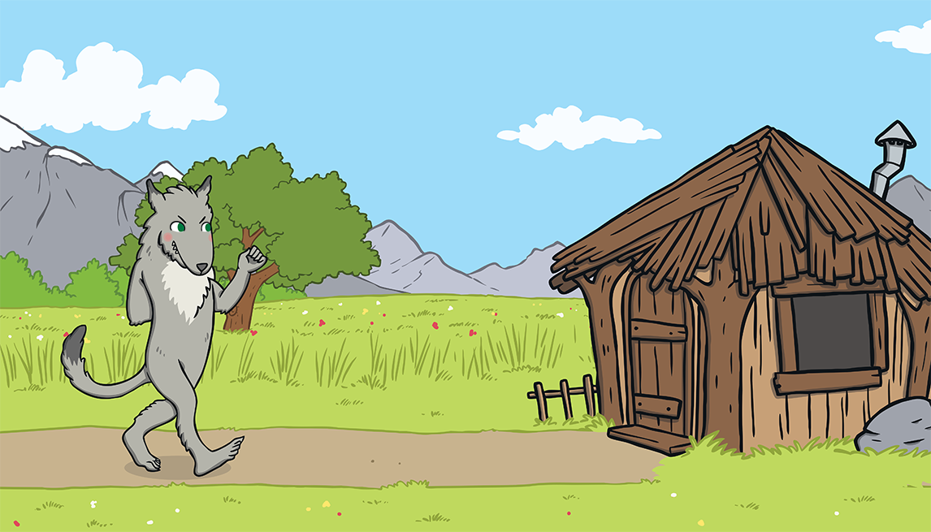
The big bad wolf followed the little pig to the house made of sticks.

Slide 20
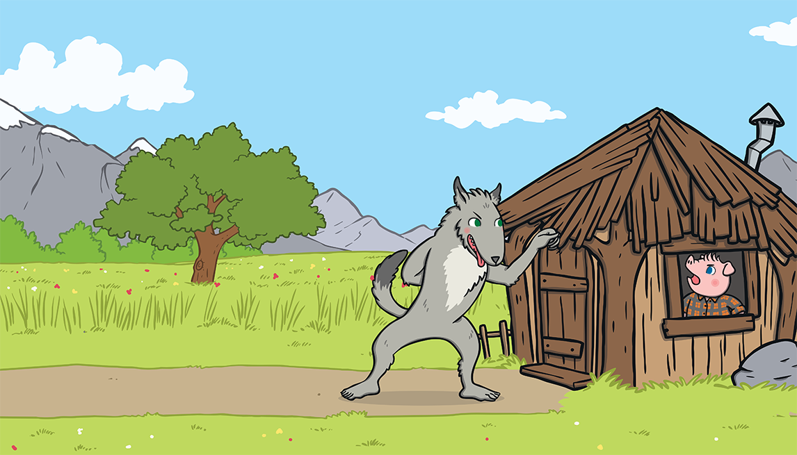
“Little pig, little pig, let me come in,” he snarled. “Not by the hair on my chinny, chin, chin!” cried the second little pig.

Slide 21
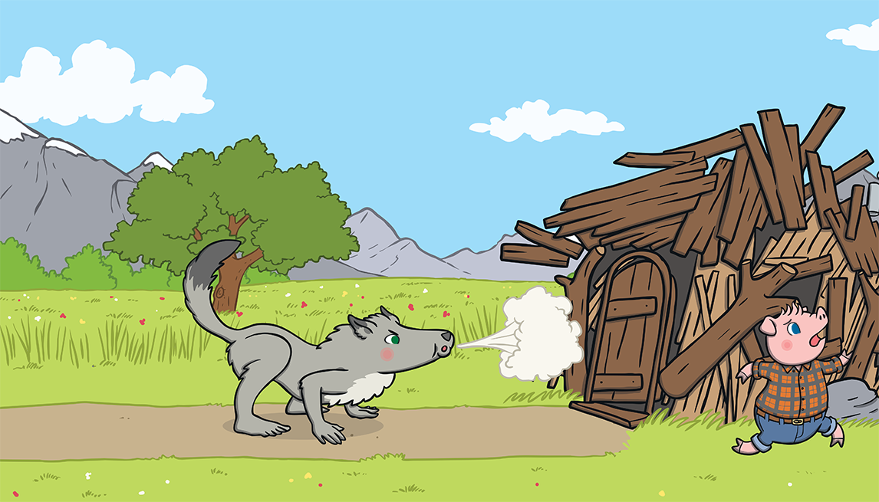
“Then I’ll huff and I’ll puff and I’ll blow your house down!” growled the big bad wolf.

Slide 22
So he huffed and he puffed and he blew the house down!

Slide 23
The two little pigs escaped and ran to join their brother in the house made of bricks.

Slide 24
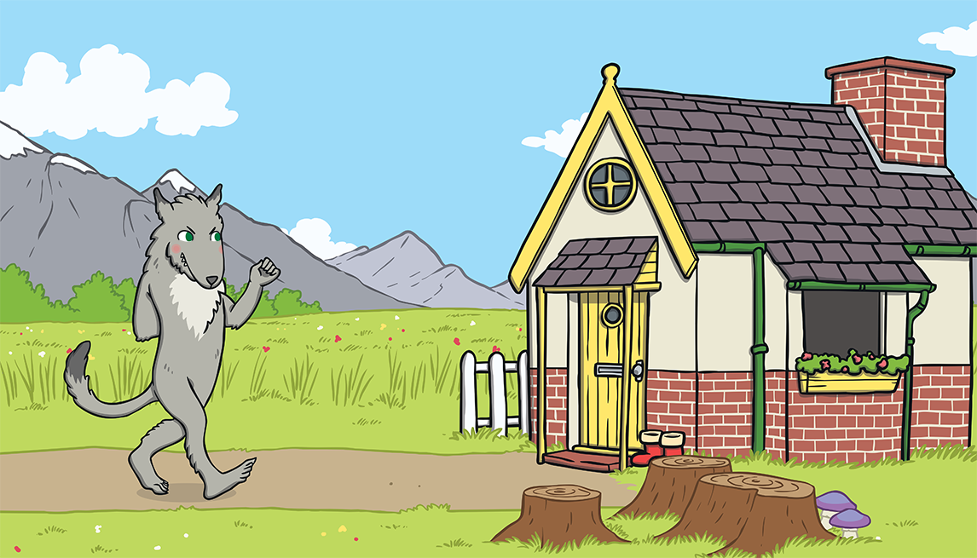
The big bad wolf followed the pigs to the house made of bricks.

Slide 25
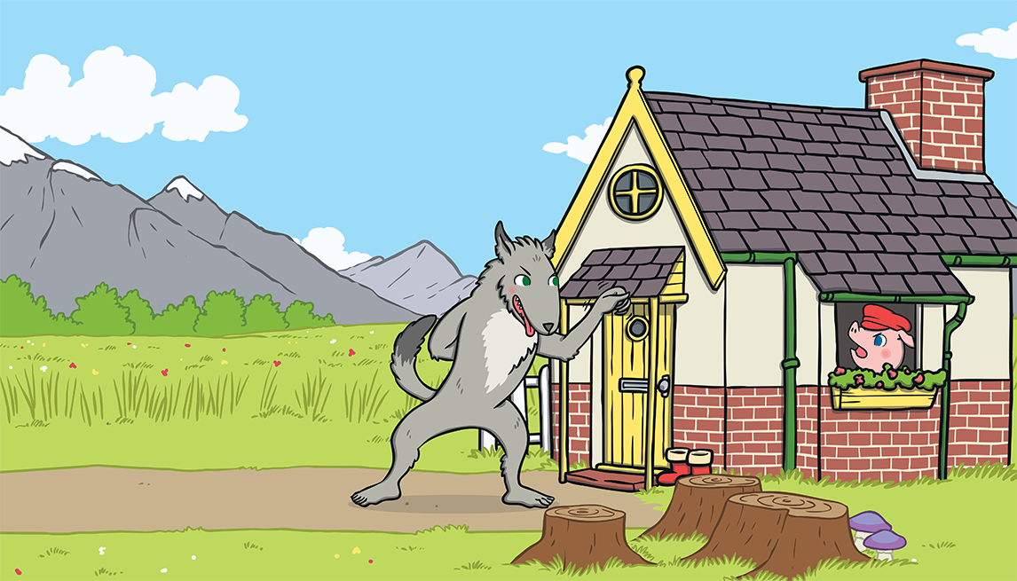
“Little pig, little pig, let me come in,” he snarled.
“Not by the hair on my chinny, chin, chin!” cried the third little pig.

Slide 26
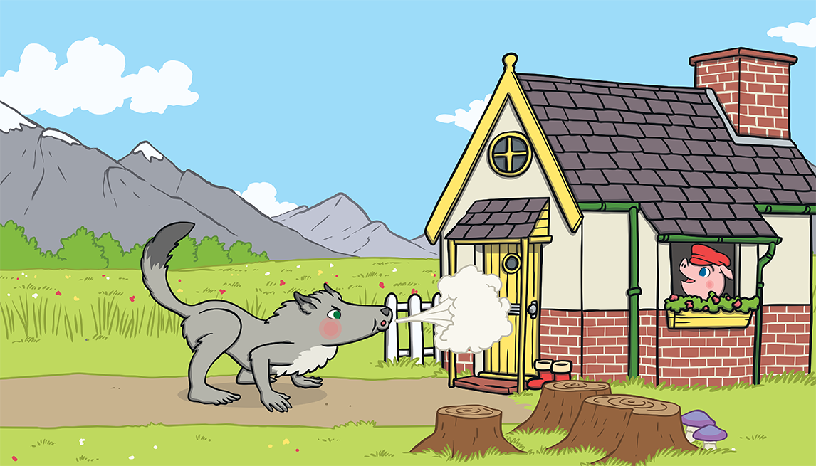
“Then I’ll huff and I’ll puff and I’ll blow your house down!” growled the big bad wolf.

Slide 27
He huffed and he puffed, but the house was too strong. He could not blow it down!

Slide 28
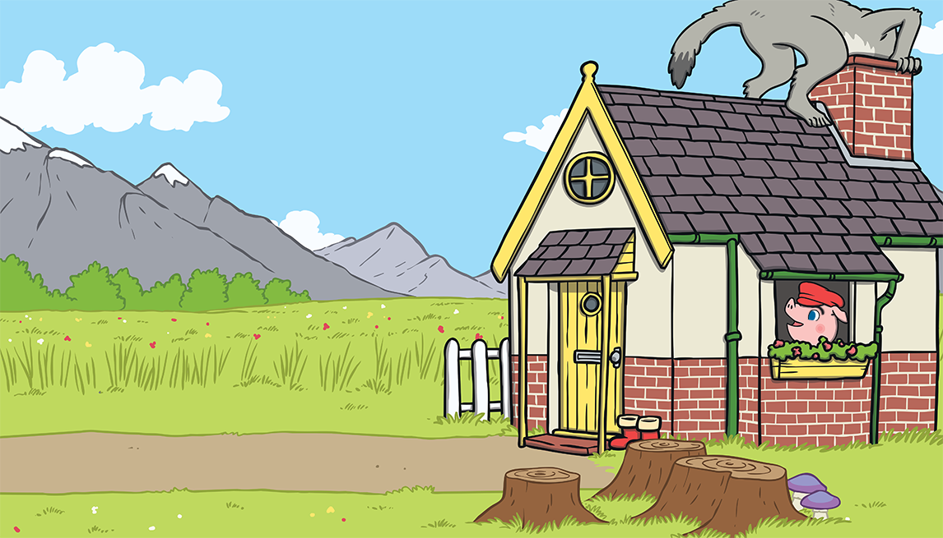
This made the big bad wolf very angry.
He climbed onto the roof of the house so he could crawl down the chimney.

Slide 29
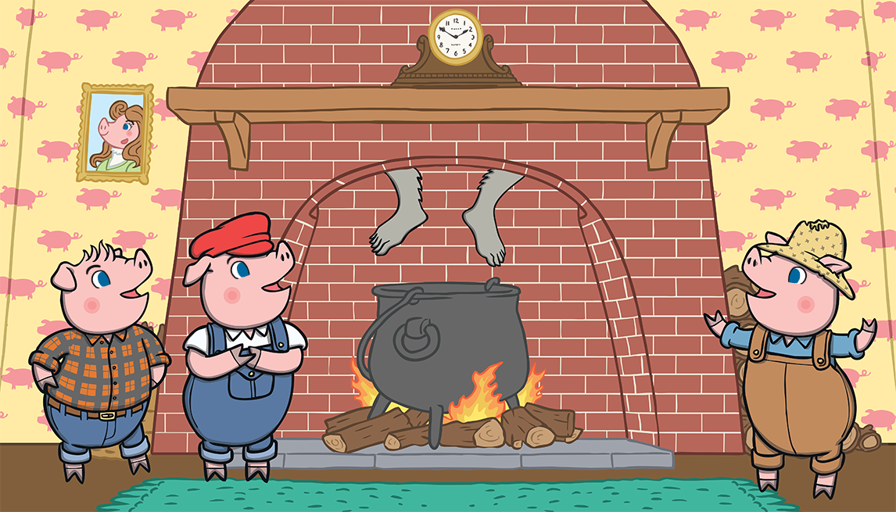
The big bad wolf was in for a big surprise!

Slide 30
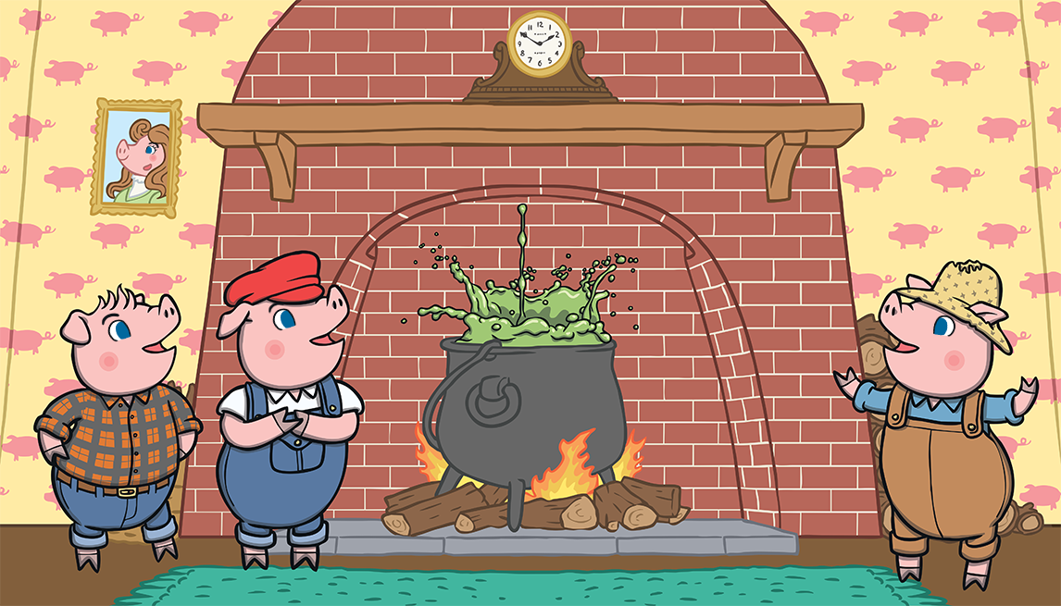
The third little pig had been cooking a big pot of stew and SPLASH! The wolf fell right into the pot!

Slide 31
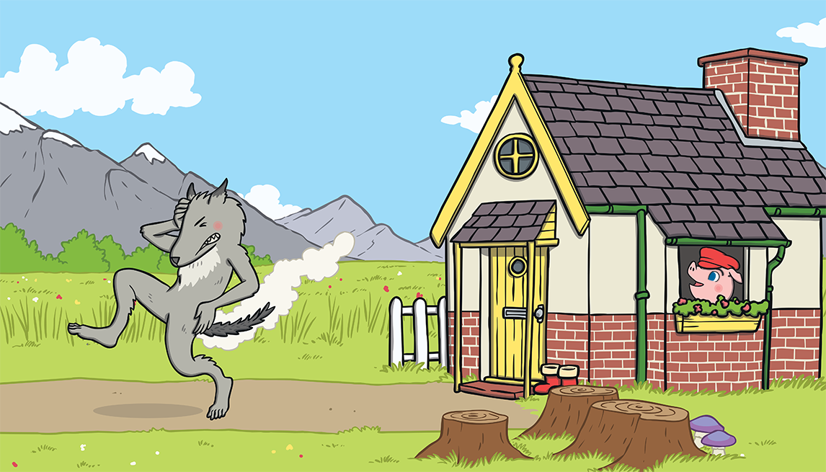
The wolf was very shocked. He jumped out of the pot and ran straight out of the house. He never came back again.

Slide 32
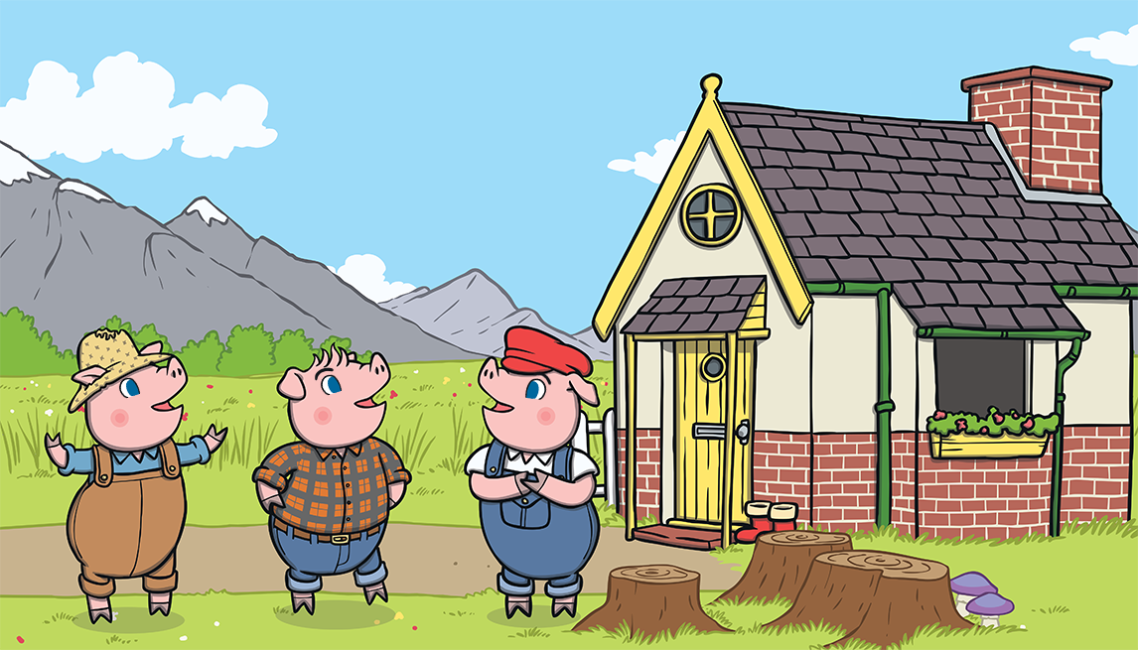
The little pigs lived happily ever after in the house made of bricks.

Slide 33
The end!

Slide 34
Wednesday OLI: to write a letter to the wolf. Introduce the spin off story ‘The True Story of the Three Little Pigs’. The story is on YouTube, Google Classroom, the website or click https://www.youtube.com/watch?v=1Q01X8JU3GU&feature=emb_logo. Once you have watched the story, think about your opinion of the wolf now. Has it changed? Do you feel sorry for him in anyway? Did he still do some things he shouldn’t have done? Write a letter to him in jail.

Slide 35
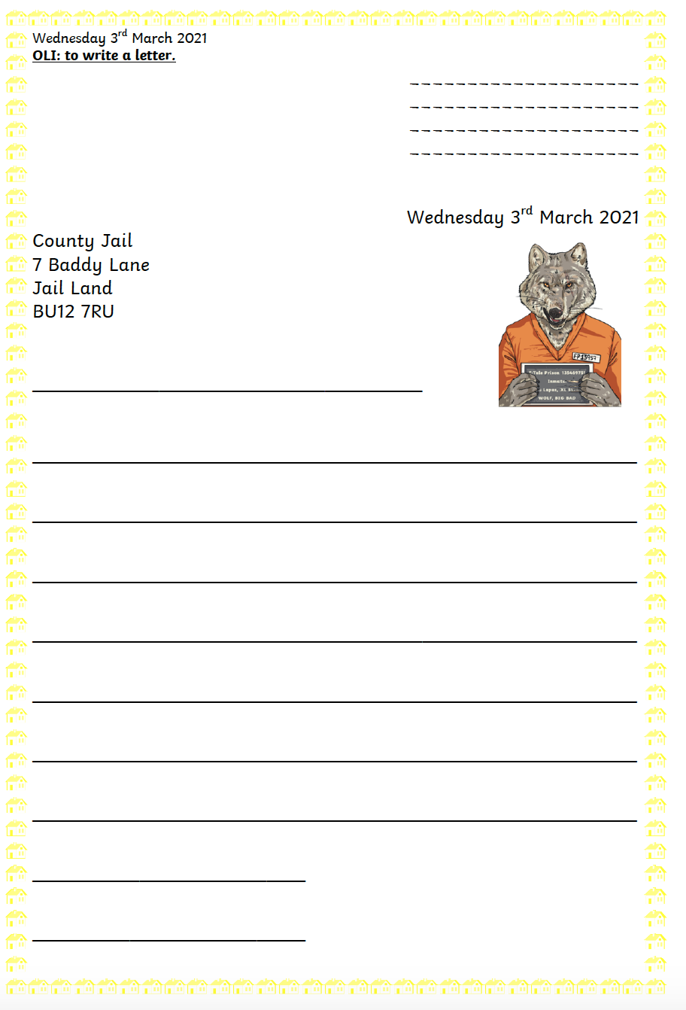
Wednesday OLI: to write a letter to the wolf.

Slide 36
Thursday OLI: design and label a cake. In the adapted story we read yesterday, the wolf wanted to make his Granny a cake. Imagine the best cake you possibly can. Draw it then label it and write a few sentences at the bottom describing it.

Slide 37
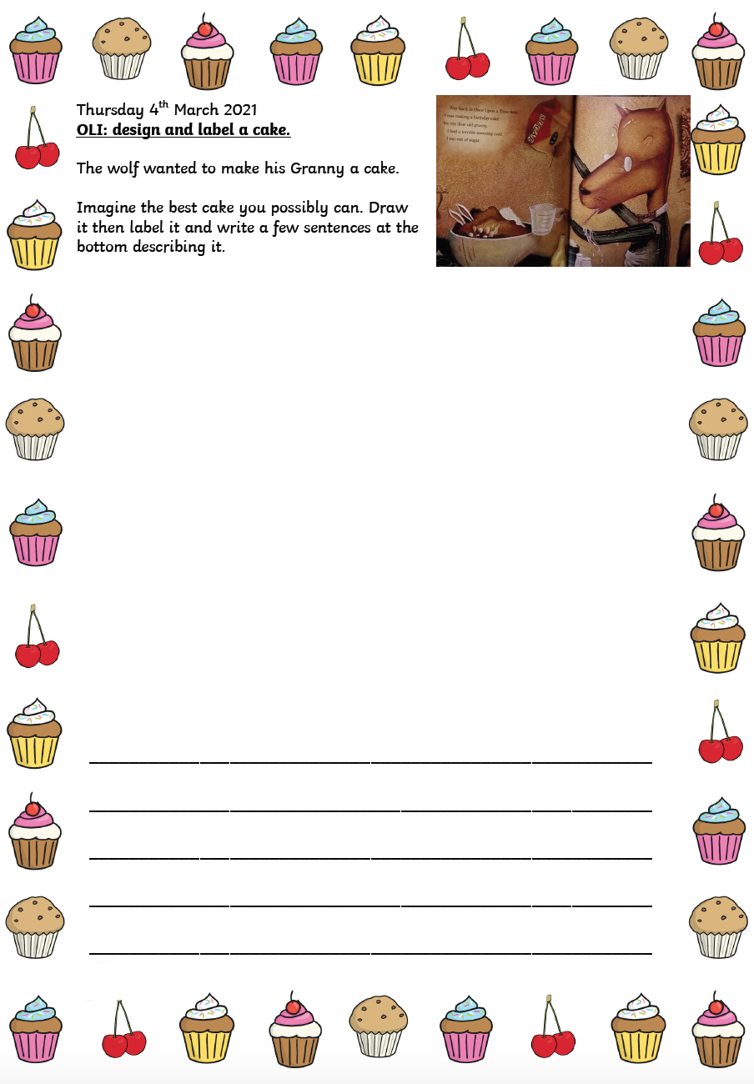
Thursday OLI: design and label a cake.

Slide 38
Friday OLI: Spelling Test!

