Slide 2
Aim
To recognise the features of haiku poems.
Success Criteria
I know that a haiku contains only 3 lines;
I can count the syllables in each line to check the pattern matches the format 5-7-5;
I understand that haiku poems are often about nature or the seasons and how we feel about them.

Slide 3
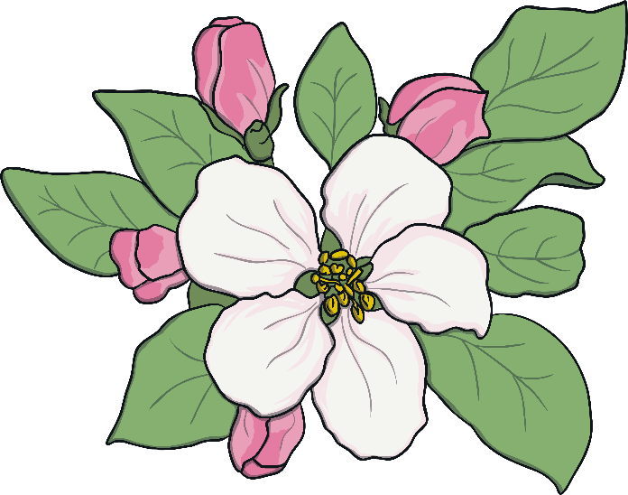
What is a Haiku?
Haiku poems are a traditional Japanese art form. Here’s one...
My two plum trees are
So gracious. See, they flower.
One now, one later.

Slide 4
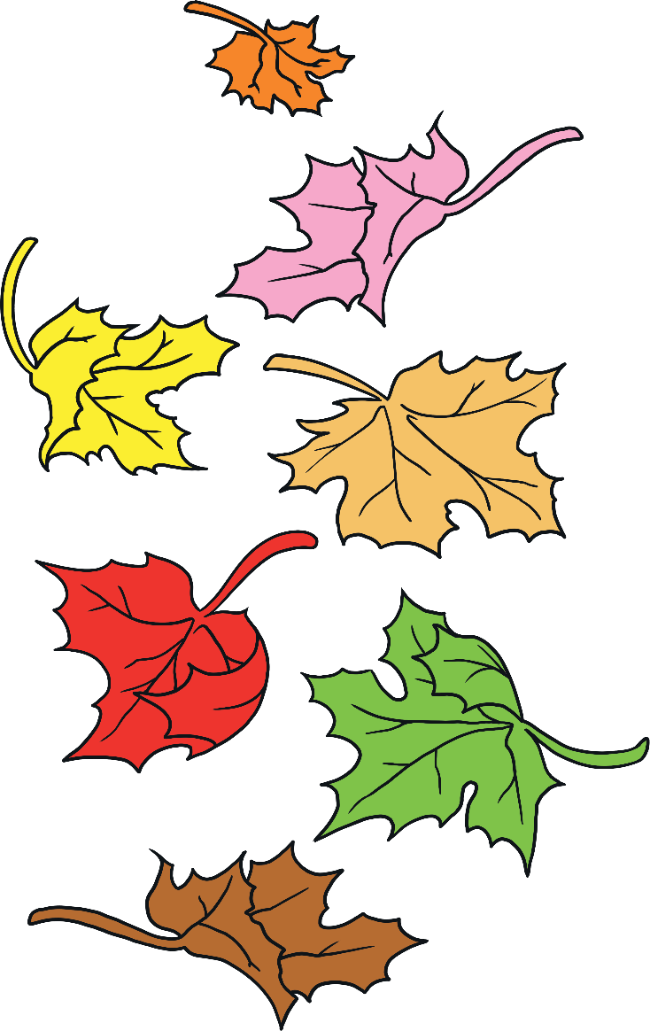
What is a Haiku?
Here’s another…
Winter is coming.
Snow will be arriving soon.
We should rake the leaves.

Slide 5
What is a Haiku?
What did you notice about the poems?
Think about:
the poem’s theme;
how many lines are in each poem;
how many syllables in each line.
Three lines in each poem.
My two plum trees are
So gracious. See, they flower.
One now, one later.
Winter is coming.
Snow will be arriving soon.
We should rake the leaves.
5 syllables in first line
7 syllables in middle line
5 syllables in final line
Final line is a comment or observation on the theme.
natural
theme

Slide 6
Let’s have a go!
How can we write a haiku?
First, we need to choose a theme. It doesn’t have to be about seasons or nature, but let’s be traditional.
Summer
hot
sunshine
flowers
holiday
beach
ice-cream
games
sea
swimming
fun
warm
sand

Slide 7
Let’s have a go!
How can we write a haiku?
Next, we choose two or three ideas which will flow together.
Summer
hot
sunshine
flowers
holiday
beach
ice-cream
games
sea
swimming
fun
warm
sand

Slide 8
Now we have our ideas, let’s try to fit them into the 5-7-5 syllable format.
You might have to alter words or phrases slightly fit the pattern.
Summer
Holidays are coming
We can go to the beach
Hot sand is next to and the cool sea
here
sea side
and

Slide 9
Now we have our ideas, let’s try to fit them into the 5-7-5 syllable format.
You might have to alter words or phrases slightly fit the pattern.
Summer
Holidays are here.
We can go to the sea side.
Hot sand and the cool sea.

Slide 10
Let’s have a go!
You could write a haiku about the seasons, or about an animal or plant.
The choice is yours!

Slide 11
What have we learned about Haiku?
Each poem has only 3 lines.
The syllable pattern of the poem should be 5-7-5.
Haiku are often written about seasons and nature.
So now you know – a haiku is a poem, not something a pigeon says on the top of Nelson’s Column!

Slide 12
Aim
To recognise the features of haiku poems.
Success Criteria
I know that a haiku contains only 3 lines;
I can count the syllables in each line to check the pattern matches the format 5-7-5;
I understand that haiku poems are often about nature or the seasons and how we feel about them.

