Slide 1




Year 1 - Spring - Block 2
Place Value

Slide 2



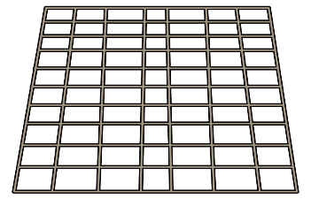




Annie counts how many muffins she has.
Do you agree with Annie?
Explain your answer.
I have 35 muffins.
30 | 31 | 32 | 33 | 34 | 35 | 36 | 37 | 38 | 39 | 40

Slide 3

Eva is counting from 38 to 24
Will she say the number 39?
Will she say the number 29?
Will she say the number 19?
Explain how you know.

Slide 4


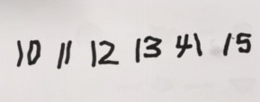
Ron and Whitney are counting.
Ron says:
Whitney writes:
Can you spot their mistakes?
43, 42, 41, 40, 41, 42

Slide 5

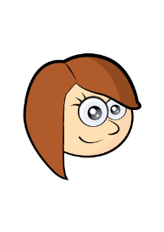

The children are completing the part whole models.
Tommy
Rosie
Jack
Are they correct?
Explain why.
32
3
2
27
29
10
10
7
9
20

Slide 6



Dora and Amir both try to build the same number.
Dora Amir
Who is correct?
Can you explain the mistake that has been made?
42
42

Slide 7

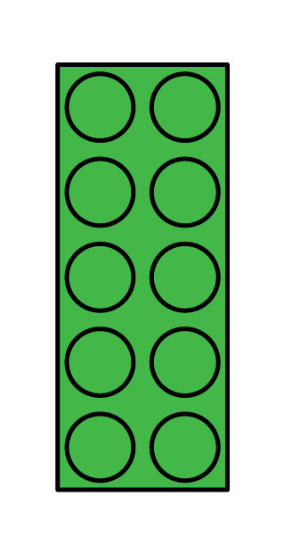
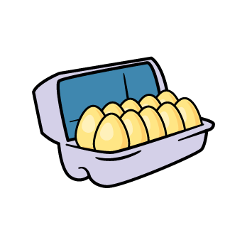
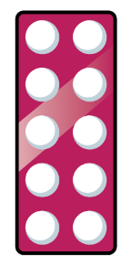

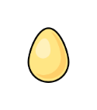
Sort the representations in to two groups.
Explain how you have sorted them.
Can you add your own representations?
23
Three tens and 2 ones
Twenty and three

Slide 8

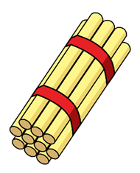

Whitney says,
How many straws does Whitney have?
  I have 2 tens and 14 ones.

Slide 9
Always, Sometimes, Never…
Convince me using some examples.
When you find one more than a number, only the ones digit will change.

Slide 10
Use the clues to work out the number.
I have a number with 3 tens.
One less than my number makes the tens digit change.
One more than my number has 1 one.
What is my number?
Can you make some clues to describe your secret number?

Slide 11
Choose the correct numbers to make the sentences correct.
28 26 33 45
36 43 35 49
is one less than 27
34 is one less than
is one more than 44
50 is one more than

Slide 12



Jack and Eva are playing a game.
They each collect a handful of cubes.
They arrange their cubes to see who has more.
Jack
Eva
Who is right?
Practise comparing objects with your friend.
I have more.
I have more.
Jack
Eva

Slide 13


Dexter compares two numbers.
Do you agree with Dexter?
Explain your answer.
30 is less than 33
Tens | Ones
Tens | Ones
$$>$$

Slide 14



Pick a card.
Draw pictures in the boxes to make the comparison true.
$$<$$
$$>$$
$$=$$

Slide 15


Teddy is comparing two numbers.
What could Teddy’s number be?
What can’t it be?
My number is larger than 19 but not one more than 19
23
$$>$$

Slide 16

Dora compares the two values.
Change one thing in the values so they are equal.
23
3 tens and 3 ones
$$<$$

Slide 17

Pick two dominoes to represent two two-digit numbers.
For example,
43 21
Then compare them using $<, >$or $=$
43 $>$ 21 21 $<$ 43
Explain how you know.

Slide 18
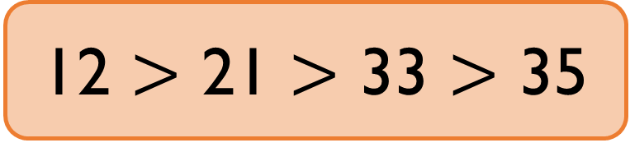
Spot the mistake
Can you correct it?
12 $>$ 21 $>$ 33 $>$ 35

Slide 19


Find at least 5 different numbers that could complete the statement.
$$>$$
$$>$$

Slide 20

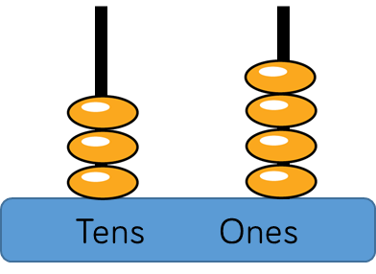
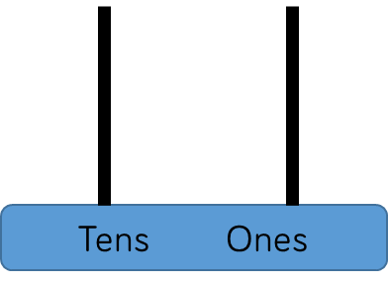



Alex has this abacus.
She uses 6 discs on each empty abacus.
Her numbers must have some tens and some ones.
Draw on the abacus what her numbers could be.
Can you find more than one answer?
$$>$$
$$>$$

Slide 21
Count in 2s backwards to complete the number track.
2 less 2 less 2 less 2 less 2 less 2 less
If you continue counting, will you say the number 25?
? | ? | ? | 40 | 42 | 44 | 46

Slide 22

Always, sometimes, never…
Prove it!
When you count in twos, your digits will be 0, 2, 4, 6, 8

Slide 23


Rosie counts back from 50 in 2s.
Amir counts up from 12 in 2s.
They say their numbers together.
Who will say 30 first.
50, 48, 46, 44…
12, 14, 16…

Slide 24
Amir is making this flower pattern with counters.
Annie says,
Do you agree with Annie?
Explain your answer.
If you make 9 flowers, you will use 43 counters.

Slide 25
Odd One Out
Which is the odd one out? Explain your answer.
25
30
27
45

Slide 26

Work in groups. Create a circle with your hands.
You can choose to put in one hand or both hands.
Count how many fingers and thumbs you can see altogether.
Can you predict how many? Count to check.

