Slide 1

Children’s Mental Health Week
1-7 February 2021

Slide 2
Watch the virtual assembly from Monday at 10am. Follow the link here for more info: https://www.childrensmentalhealthweek.org.uk/news/children-s-mental-health-week-assembly-with-bafta-kids-and-oak-national-academy/

Slide 3
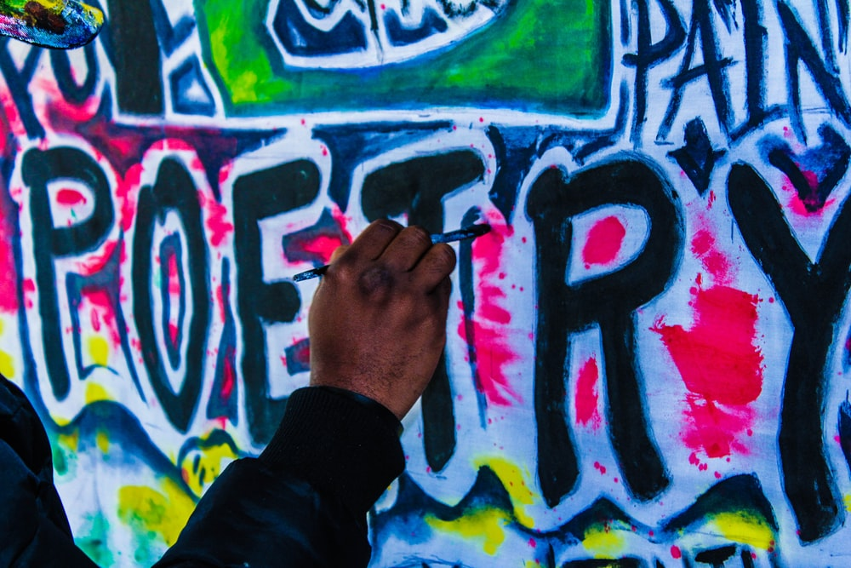
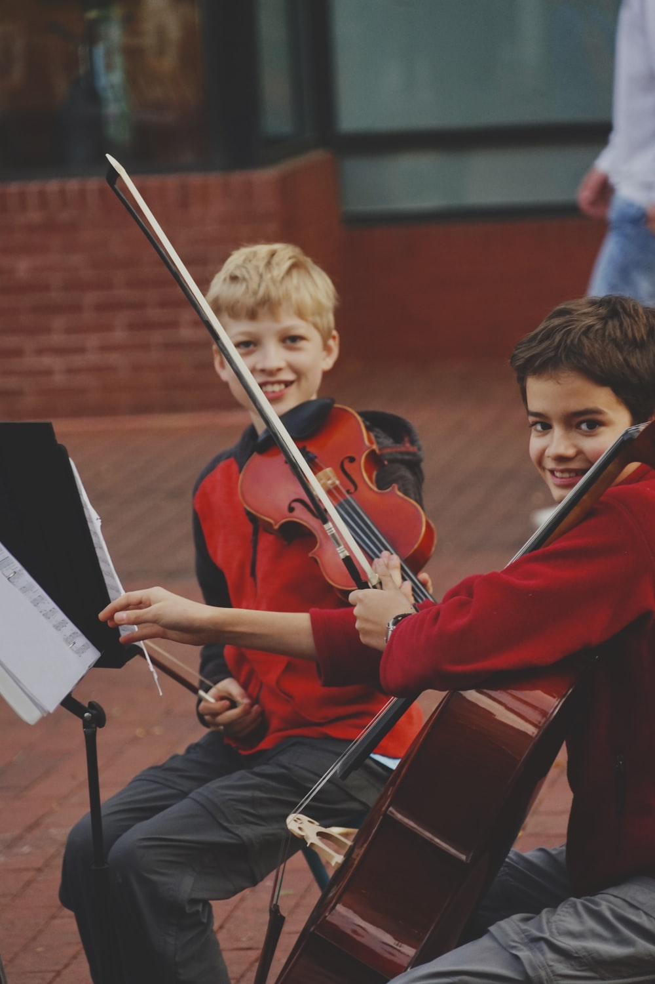
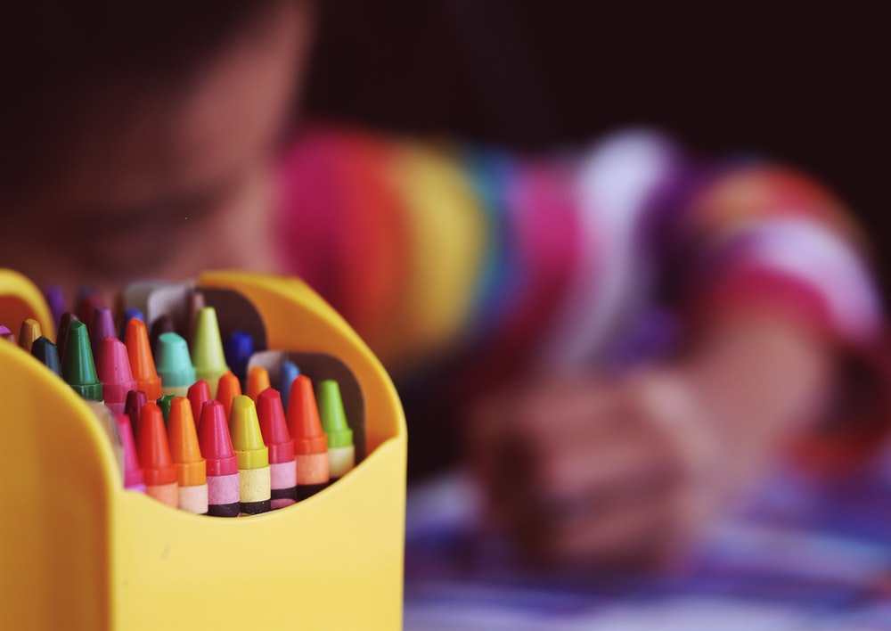
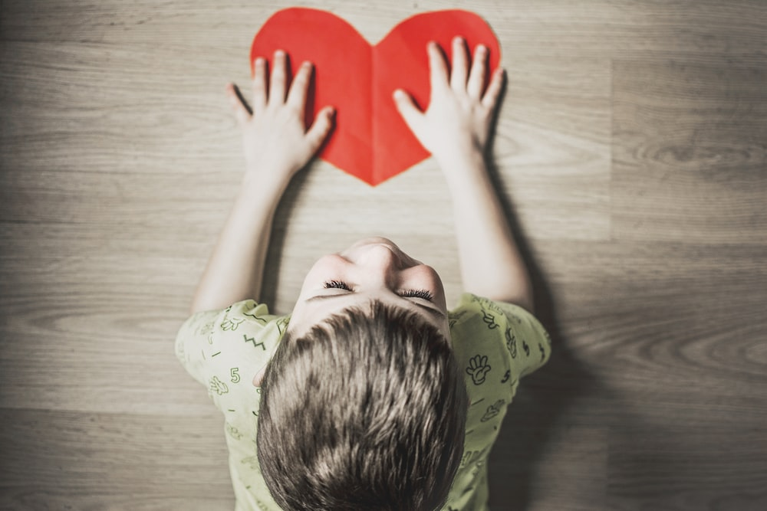
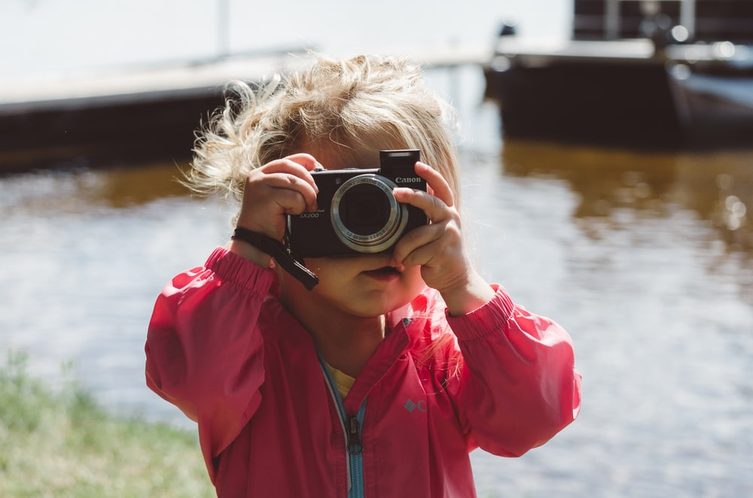
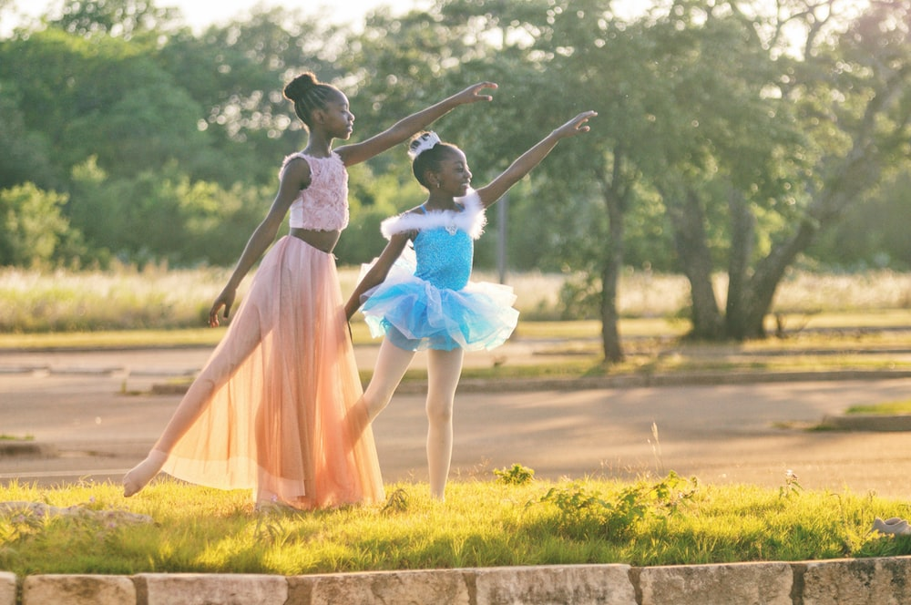

Slide 4


Slide 5
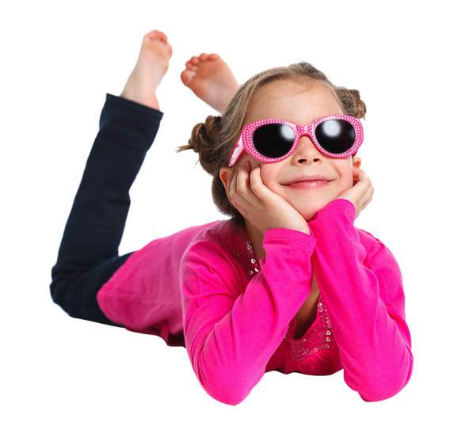

Slide 6

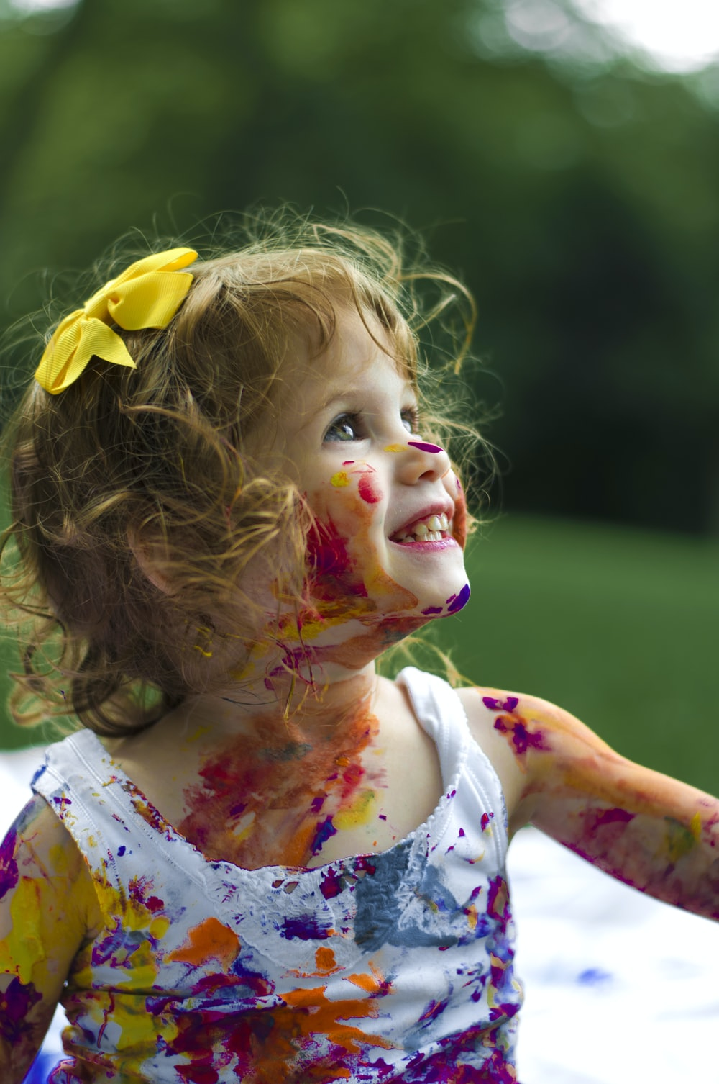
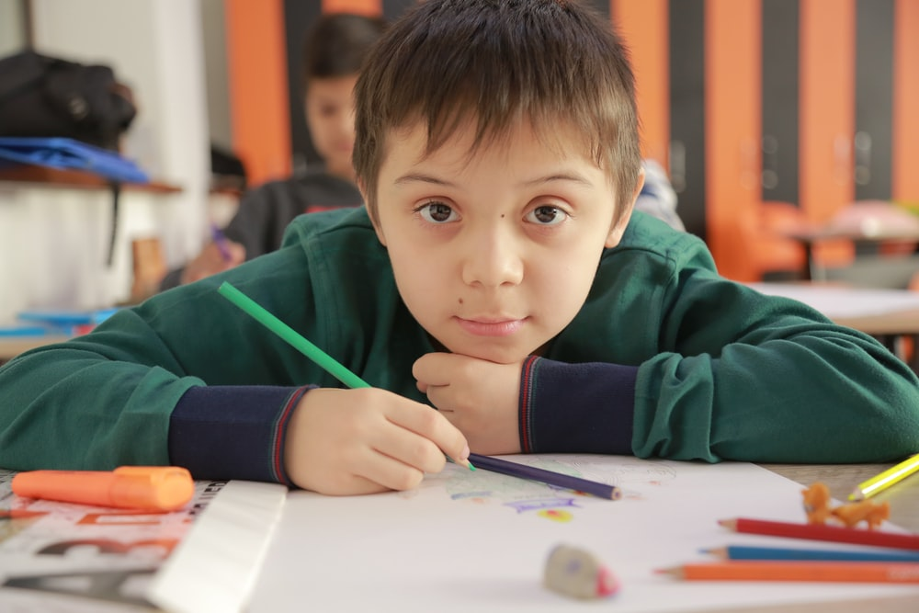
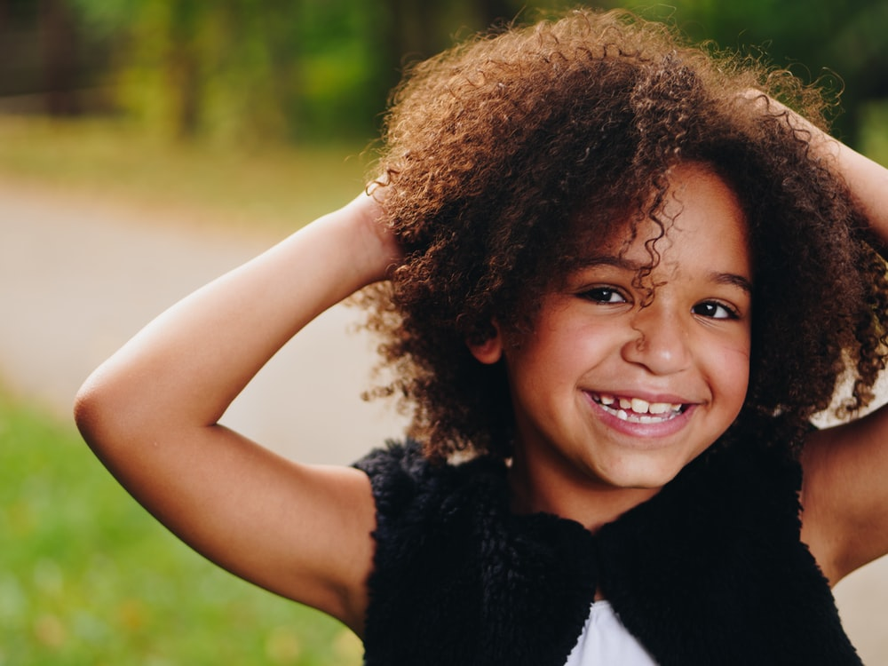
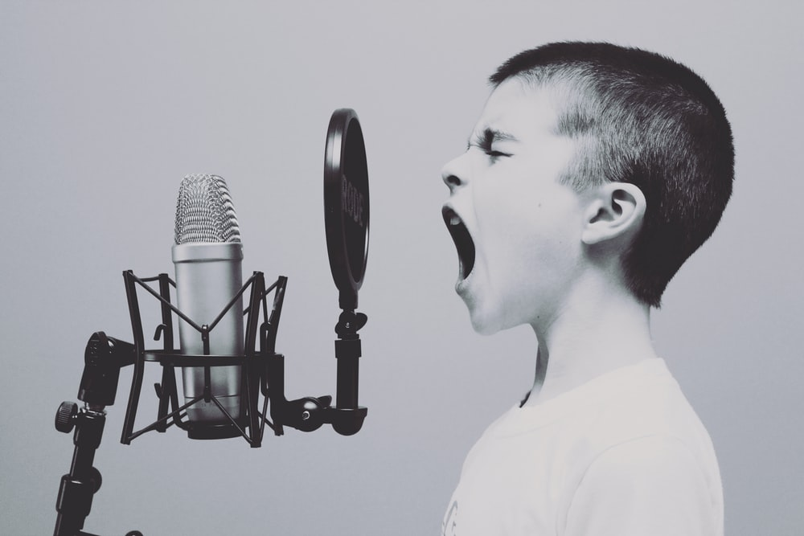
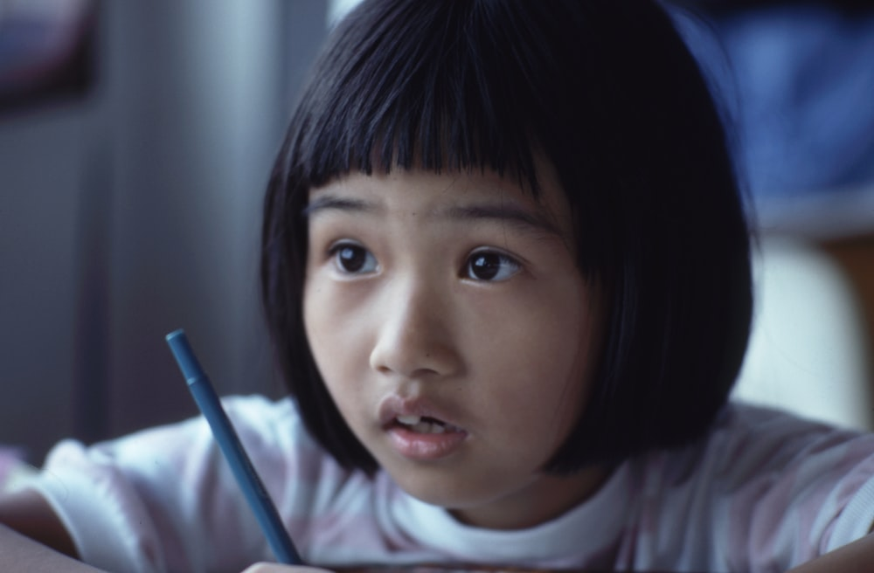

Slide 7

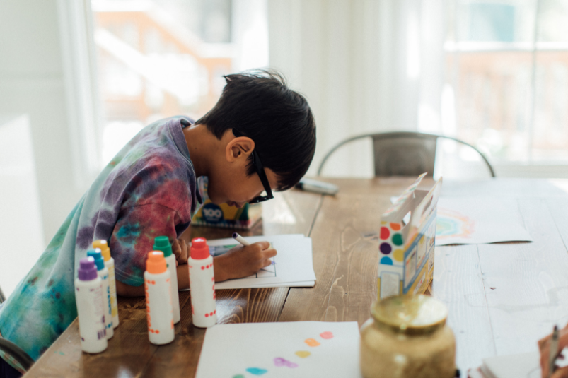
Listen to or read the story “Beautiful Oops” (or one of your own)
Remember, when we express ourselves we don’t have to be a great artist or a wonderful dancer.
It’s not about being the very best at something or putting on a performance.
Let’s encourage each other to find lots of different ways to get creative and express ourselves.

Slide 8

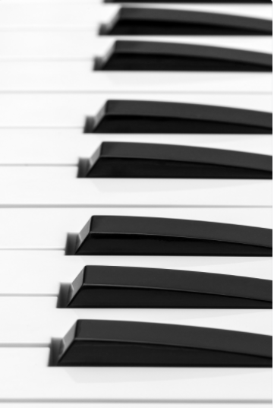
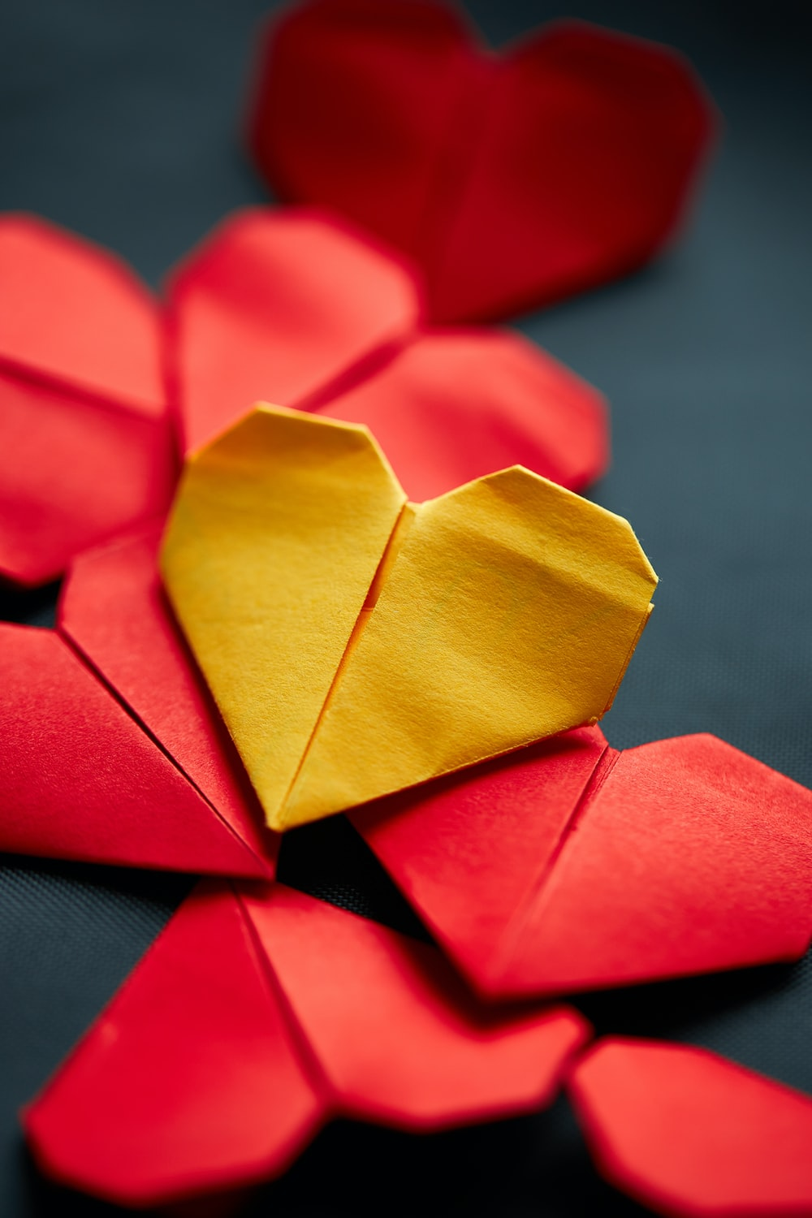
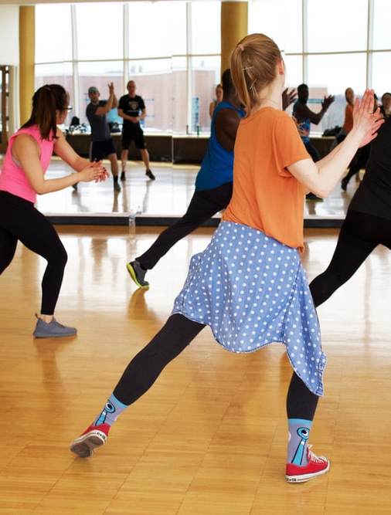

Slide 9
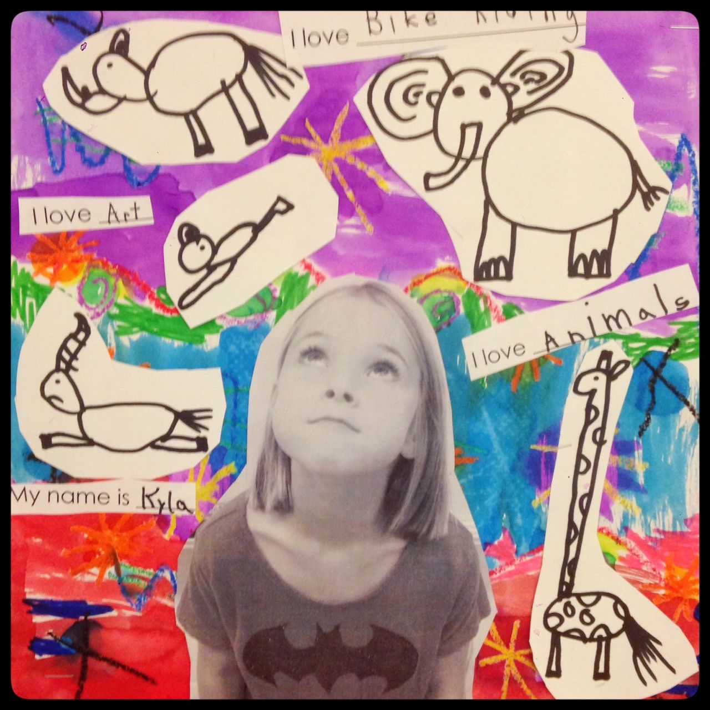
Your task!
Your first activity is to create your version of the art below.
Decorate a piece of paper however you want. This might be a collage of paper, paint with your favourite colours, splatter paint like Pollock Jackson or with colouring pencils and glitter! Whatever you like!
When it is dry, stick a photo (or draw yourself) and put it towards the bottom of the page in the centre.
Then draw and label all the things you enjoy, love and are good at! Tell me all the things that make you so wonderful! Cut them out and stick them on your masterpiece!

Slide 10
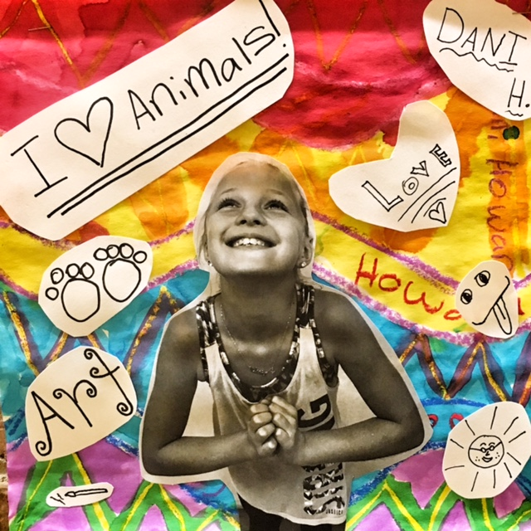
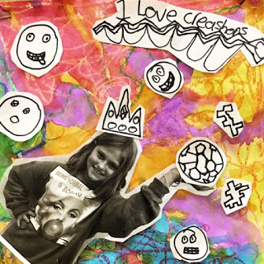
Your task!

Slide 11

If you finish this task, then…
Can you make up a dance?
Make up a song?
Create a story making characters from Lego or construction toys?
Paint?
Do a fashion show and ‘dress to express’
Show off your great football or juggling or skipping skills?
Ask your family members what makes them so wonderful? Tell your family why you love them and what makes them so special and unique!

